Slide 1
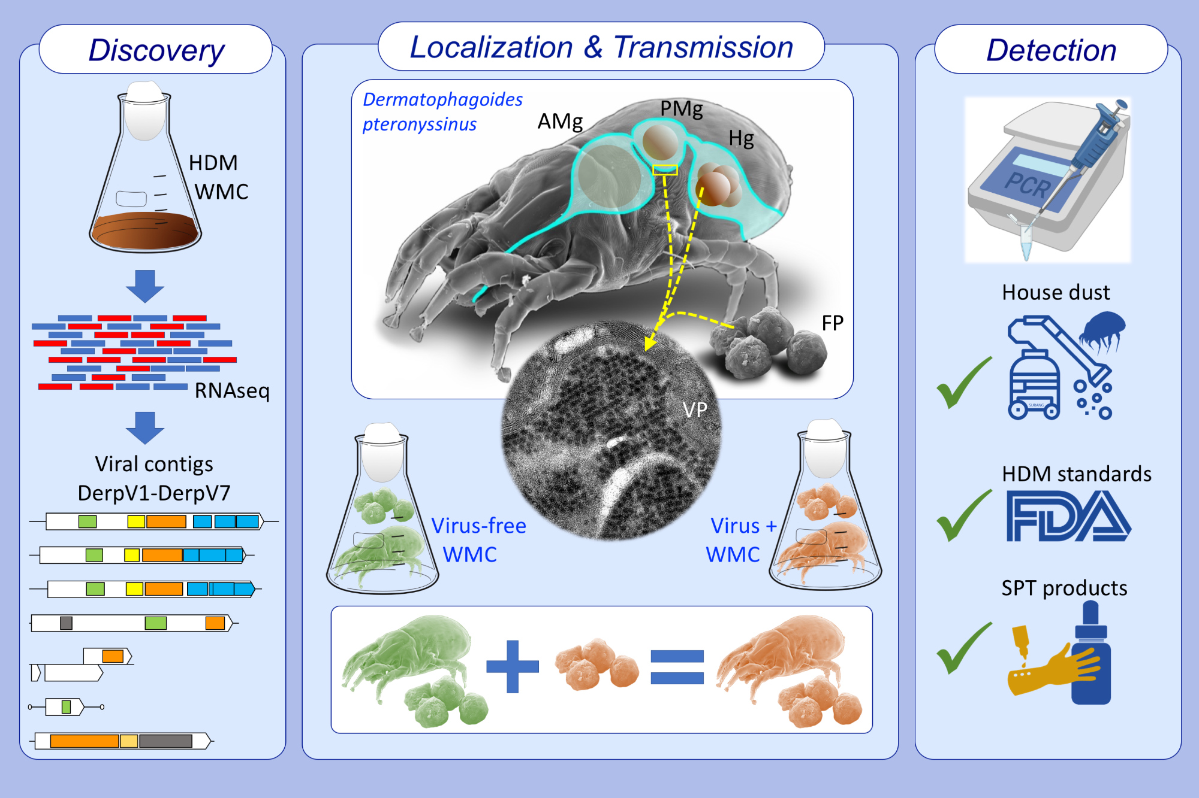
RNA viruses in the house dust mite Dermatophagoides pteronyssinus, detection in environmental samples and in commercial allergen extracts used for in vivo diagnosis
José Cristian Vidal-Quist,, Carmen Vidal,, Fernando Escolar,, Bart N. Lambrecht,, Stephane Rombauts,, et al.
Allergy. 2021; 3743-3754 https://doi.org/10.1111/all.14884
© 2019 EAACI and John Wiley and Sons A/S. Published by John Wiley and Sons Ltd.
Notes:
HIGHLIGHTS
Seven RNA viruses were identified in the transcriptome of Dermatophagoides pteronyssinus, being picorna-like viruses the most abundant.
Viral particles are found in epithelial cells of the digestive system, and in fecal pellets from which they can be horizontally transmitted to other virus-free mites.
Viral RNA was detected by RT-PCR on house dust samples, reference standards, and allergy-related pharmaceutical products.
Abbreviations: AMg, anterior midgut; FDA, food and drug administration; FP, fecal pellet; HDM, house dust mite; Hg, hindgut; PMg, posterior midgut; RNAseq

