Slide 1
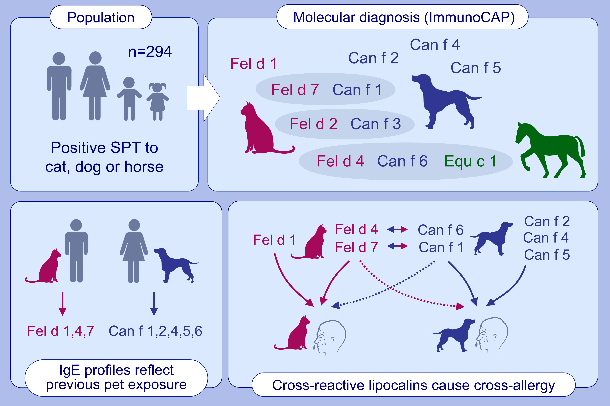
Molecular sensitization patterns in animal allergy: Relationship with clinical relevance and pet ownership
Wolfgang Hemmer,, Gabriele Sestak-Greinecker,, Tobias Braunsteiner,, Felix Wantke,, Stefan Wöhrl, et al.
Allergy. 2021; 3687-3696 https://doi.org/10.1111/all.14885
© 2019 EAACI and John Wiley and Sons A/S. Published by John Wiley and Sons Ltd.
Notes:
HIGHLIGHTS
Individual IgE profiles and sensitization to minor allergens strongly reflect previous pet ownership.
Certain lipocalins consistently cause clinically relevant cross-allergy between cat, dog and horse with each of them representing the potential primary sensitizer.
Sensitization to dog often results from cross-reactivity with cat. Its clinical relevance varies depending on the allergens involved.
Abbreviation: SPT, skin prick test

