Slide 1
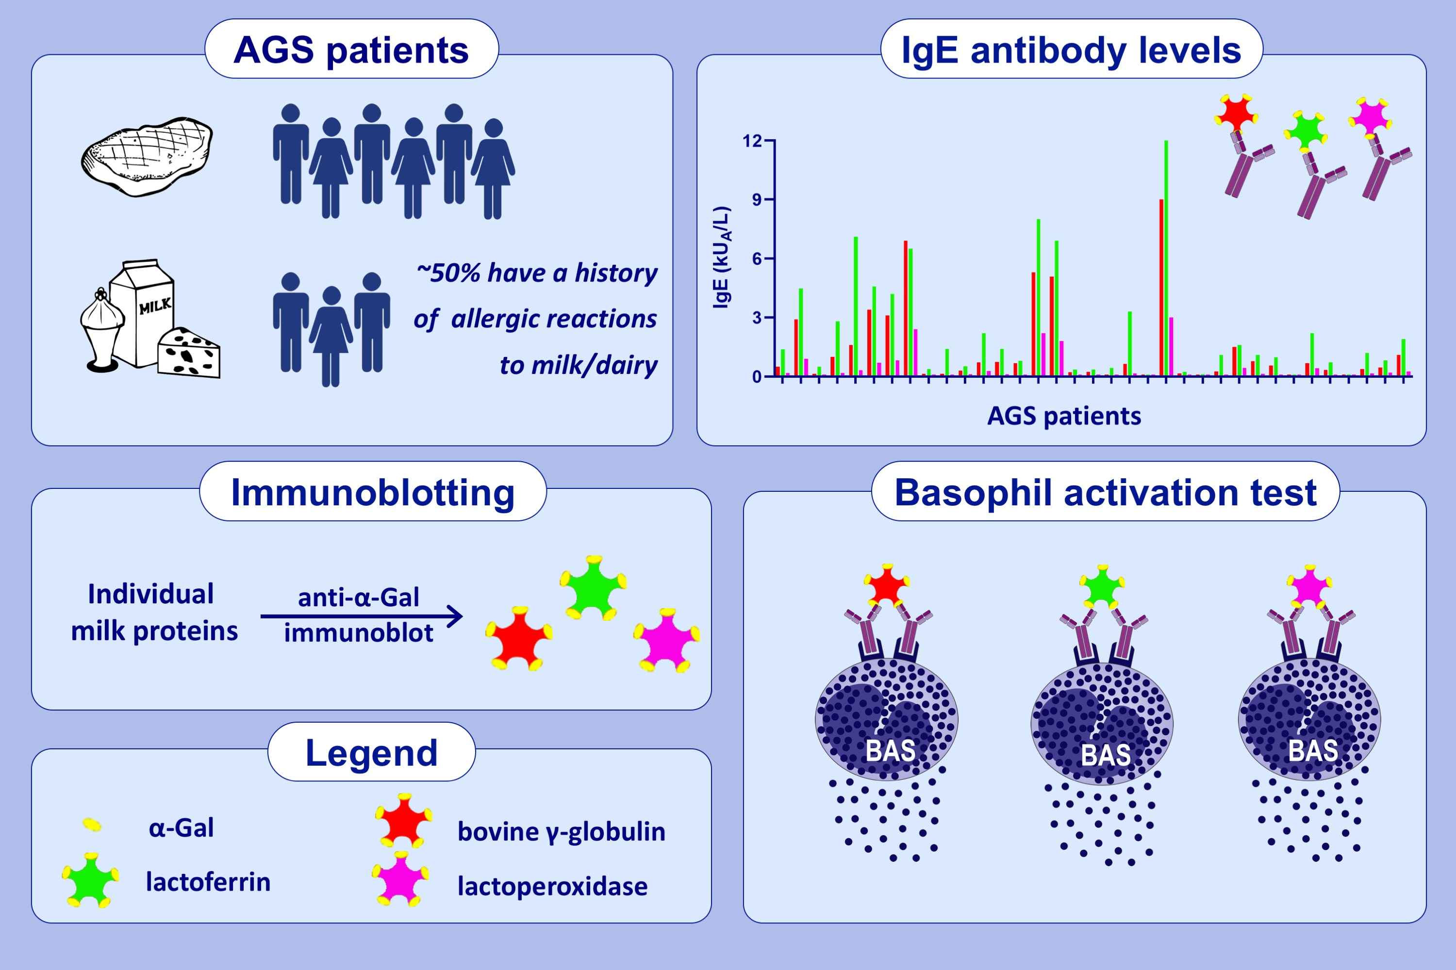
Bovine γ-globulin, lactoferrin, and lactoperoxidase are relevant bovine milk allergens in patients with α-Gal syndrome
Marija Perusko,, Danijela Apostolovic,, Mensiena Berentje Geertje Kiewiet,, Jeanette Grundström,, Carl Hamsten,, et al.
Allergy. 2021; 3766-3775 https://doi.org/10.1111/all.14889
© 2019 EAACI and John Wiley and Sons A/S. Published by John Wiley and Sons Ltd.
Notes:
HIGHLIGHTS
More than half of the AGS patients reported allergic reactions to milk or dairy products.
Bovine γ-globulin, lactoferrin and lactoperoxidase were found to be relevant milk α-Gal-containing glycoproteins that bound AGS patients’ IgE antibodies and activated their basophils.
These proteins are probably involved in the allergic reactions to milk and dairy products in AGS patients.
Abbreviations: α-Gal, galactose-α-1,3-galactose; AGS, α-Gal syndrome; kU_{A}/L, kilounits of allergen-specific IgE per liter

