Slide 1
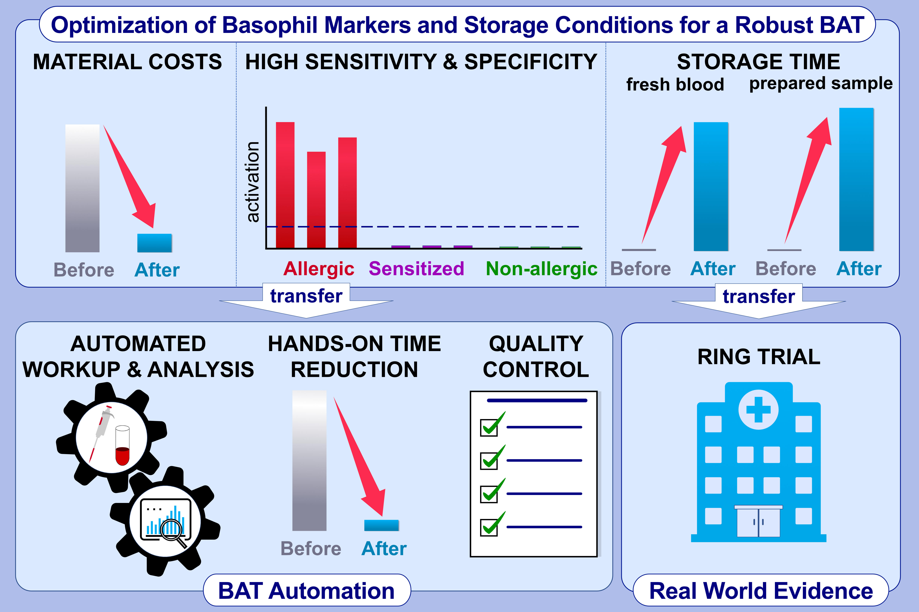
Innovative robust basophil activation test using a novel gating strategy reliably diagnosing allergy with full automation
Jochen Behrends,, Christian Schwager,, Martina Hein,, Thomas Scholzen,, Skadi Kull,, et al.
Allergy. 2021; 3776-3788 https://doi.org/10.1111/all.14900
© 2019 EAACI and John Wiley and Sons A/S. Published by John Wiley and Sons Ltd.
Notes:
HIGHLIGHTS
BAT has limits to be a routine application.
Therefore, we developed a robust innovative gating strategy and demonstrated a prolonged time frame for measurements (nationwide ring trial).
The enormous laboratory work could significantly be reduced via the automatic sample processing and measurement protocols (automated analysis template using R Studio) to reduce the hands-on time.
Abbreviation: BAT, basophil activation test

