Slide 1
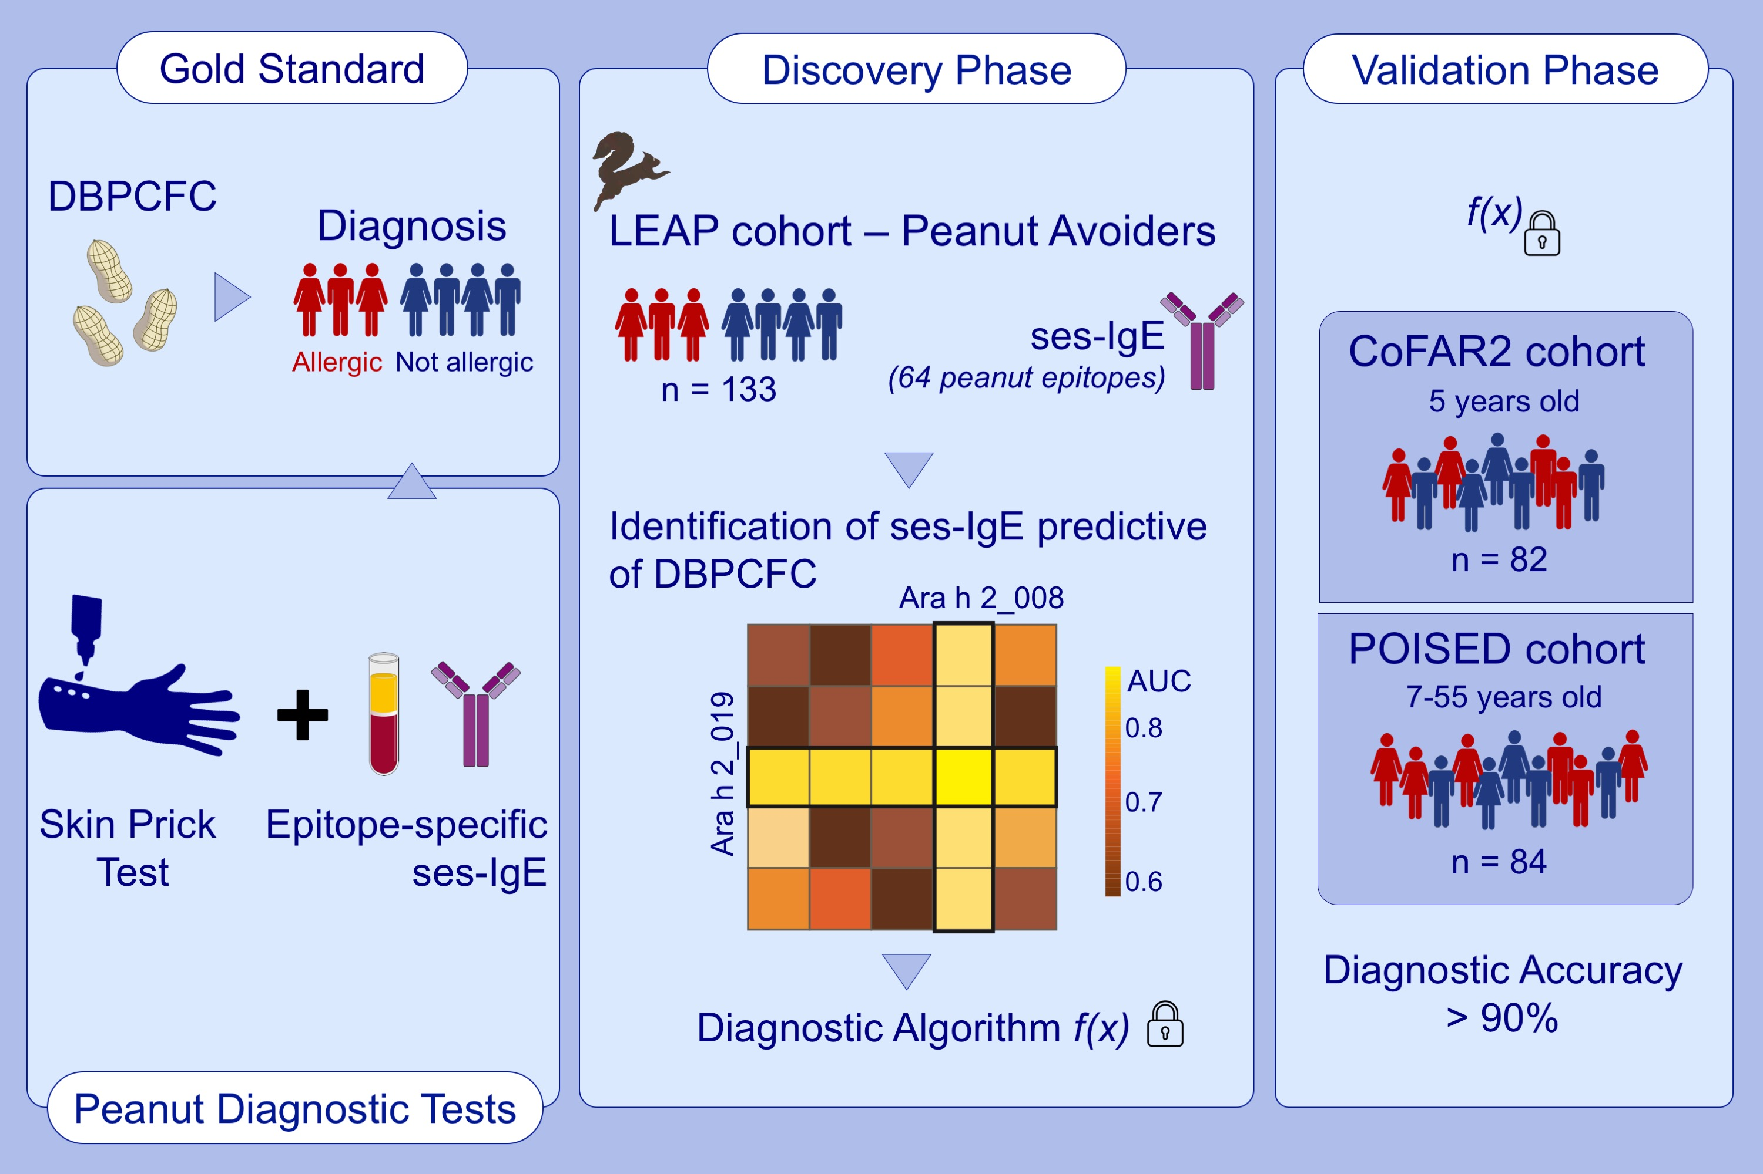
Accurate and reproducible diagnosis of peanut allergy using epitope mapping
Mayte Suárez-Fariñas,, Maria Suprun,, Paul Kearney,, Robert Getts,, Galina Grishina,, et al.
Allergy. 2021; 3789-3797 https://doi.org/10.1111/all.14905
© 2019 EAACI and John Wiley and Sons A/S. Published by John Wiley and Sons Ltd.
Notes:
HIGHLIGHTS
Identification of immunodominant sequential peanut allergen epitopes enables the diagnosis of peanut allergy with high accuracy.
High throughput peanut allergy diagnostic test validated on multiple cohorts with peanut allergy status established by DBPCFC.
Precision medicine using a novel bead-based epitope assay requires less than 0.1 ml of plasma to provide a highly accurate diagnosis of peanut allergy.
Abbrreviations: AUC, area under the curve; COFAR2, An Observational Study of Childhood Food Allergy; DBPCFC, double-blind placebo-controlled food challenge; LEAP, Promoting Tolerance to Peanut in High-Risk Children; POISED, The Peanut Oral Immunotherapy Study: Safety, Efficacy and Discovery; ses-IgE, sequential epitope-specific IgE
.

