Slide 1
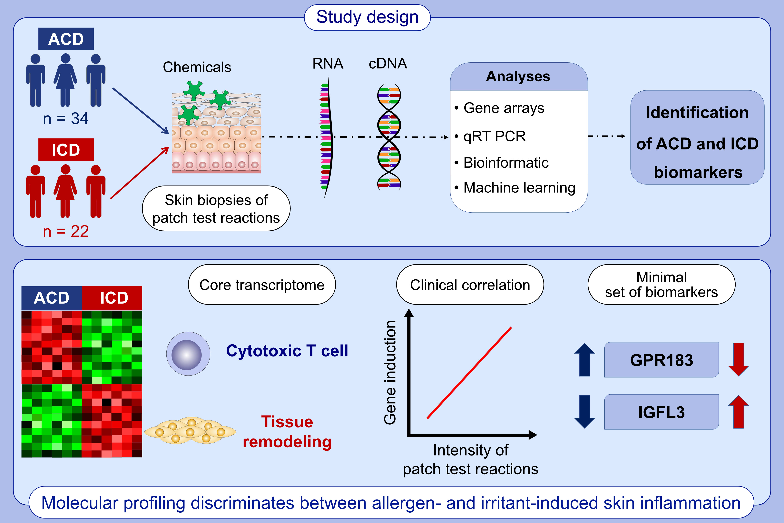
Unique molecular signatures typify skin inflammation induced by chemical allergens and irritants
Marine-Alexia Lefevre,, Audrey Nosbaum,, Aurore Rozieres,, Vanina Lenief,, Amandine Mosnier,, et al.
Allergy. 2021; 3697-3712 https://doi.org/10.1111/all.14989
© 2019 EAACI and John Wiley and Sons A/S. Published by John Wiley and Sons Ltd.
Notes:
HIGHLIGHTS
The core transcriptome of allergen- and irritant-induced reactions consists of cytotoxic T-cell- and tissue remodeling-related transcripts, respectively.
The magnitude of gene activation correlates with the intensity of the clinical reactions.
Machine-learning approach identifies several minimal combinations of biomarkers to distinguish allergic versus irritant contact dermatitis.
Abbreviations: ACD, allergic contact dermatitis; GPR183, G protein-coupled receptor 183; ICD, irritant contact dermatitis; IGFL3, insulin growth factor-like family member 3

