Slide 1
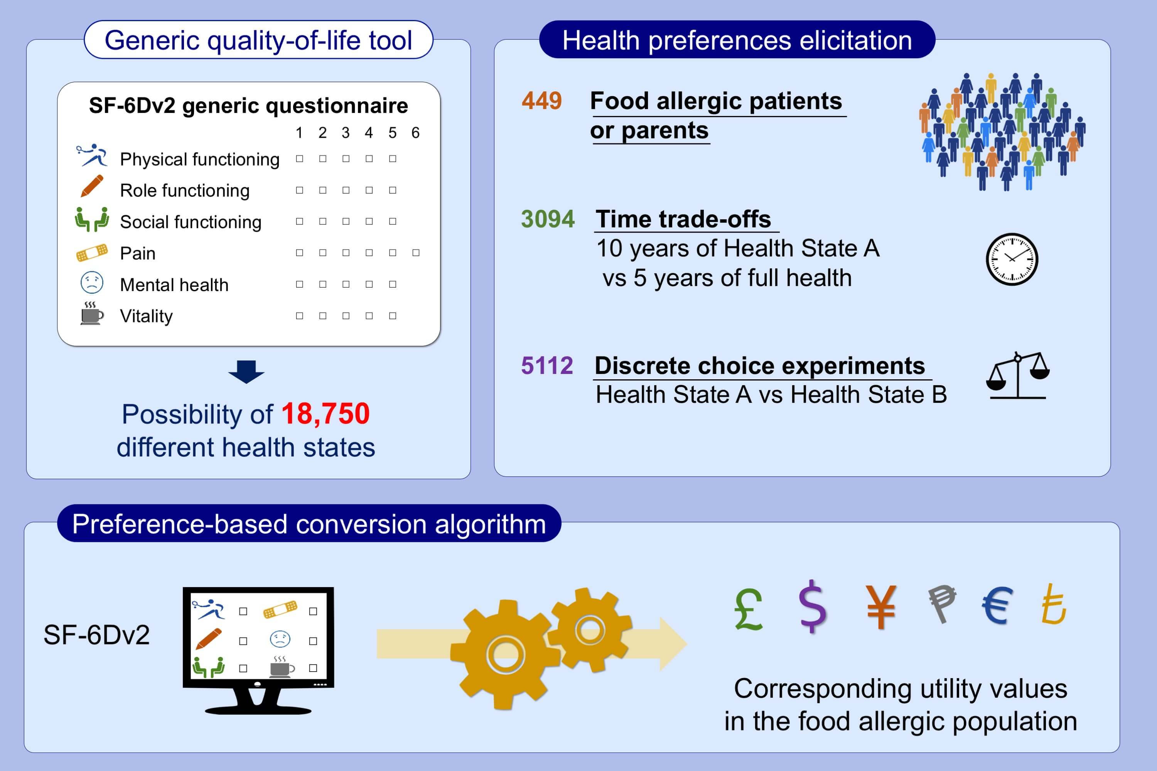
SF‐6Dv2 preference value set for health utility in food allergy
Élise Dufresne, Thomas G. Poder, Kathryn Samaan, Jonathan Lacombe‐Barrios, Louis Paradis, et al.
Allergy. 2021; 326-338 https://doi.org/10.1111/all.14444
© 2019 EAACI and John Wiley and Sons A/S. Published by John Wiley and Sons Ltd.
Notes:
HIGHLIGHTS
There is currently no validated instrument to calculate health utility in food allergy, which is a barrier to the conduct of cost-effectiveness analyses.
Using time trade-off and discrete choice experiment approaches, options of the SF-6Dv2 generic health-related quality of life questionnaire were directly valued in the Canadian food allergic population.
The resulting algorithm based on the health preferences of food allergic patients and parents can now be used to convert SF-6Dv2 answers to health utility values in this population.
Abbreviation: SF-6Dv2, Short form-six dimensions version 2

