Slide 1
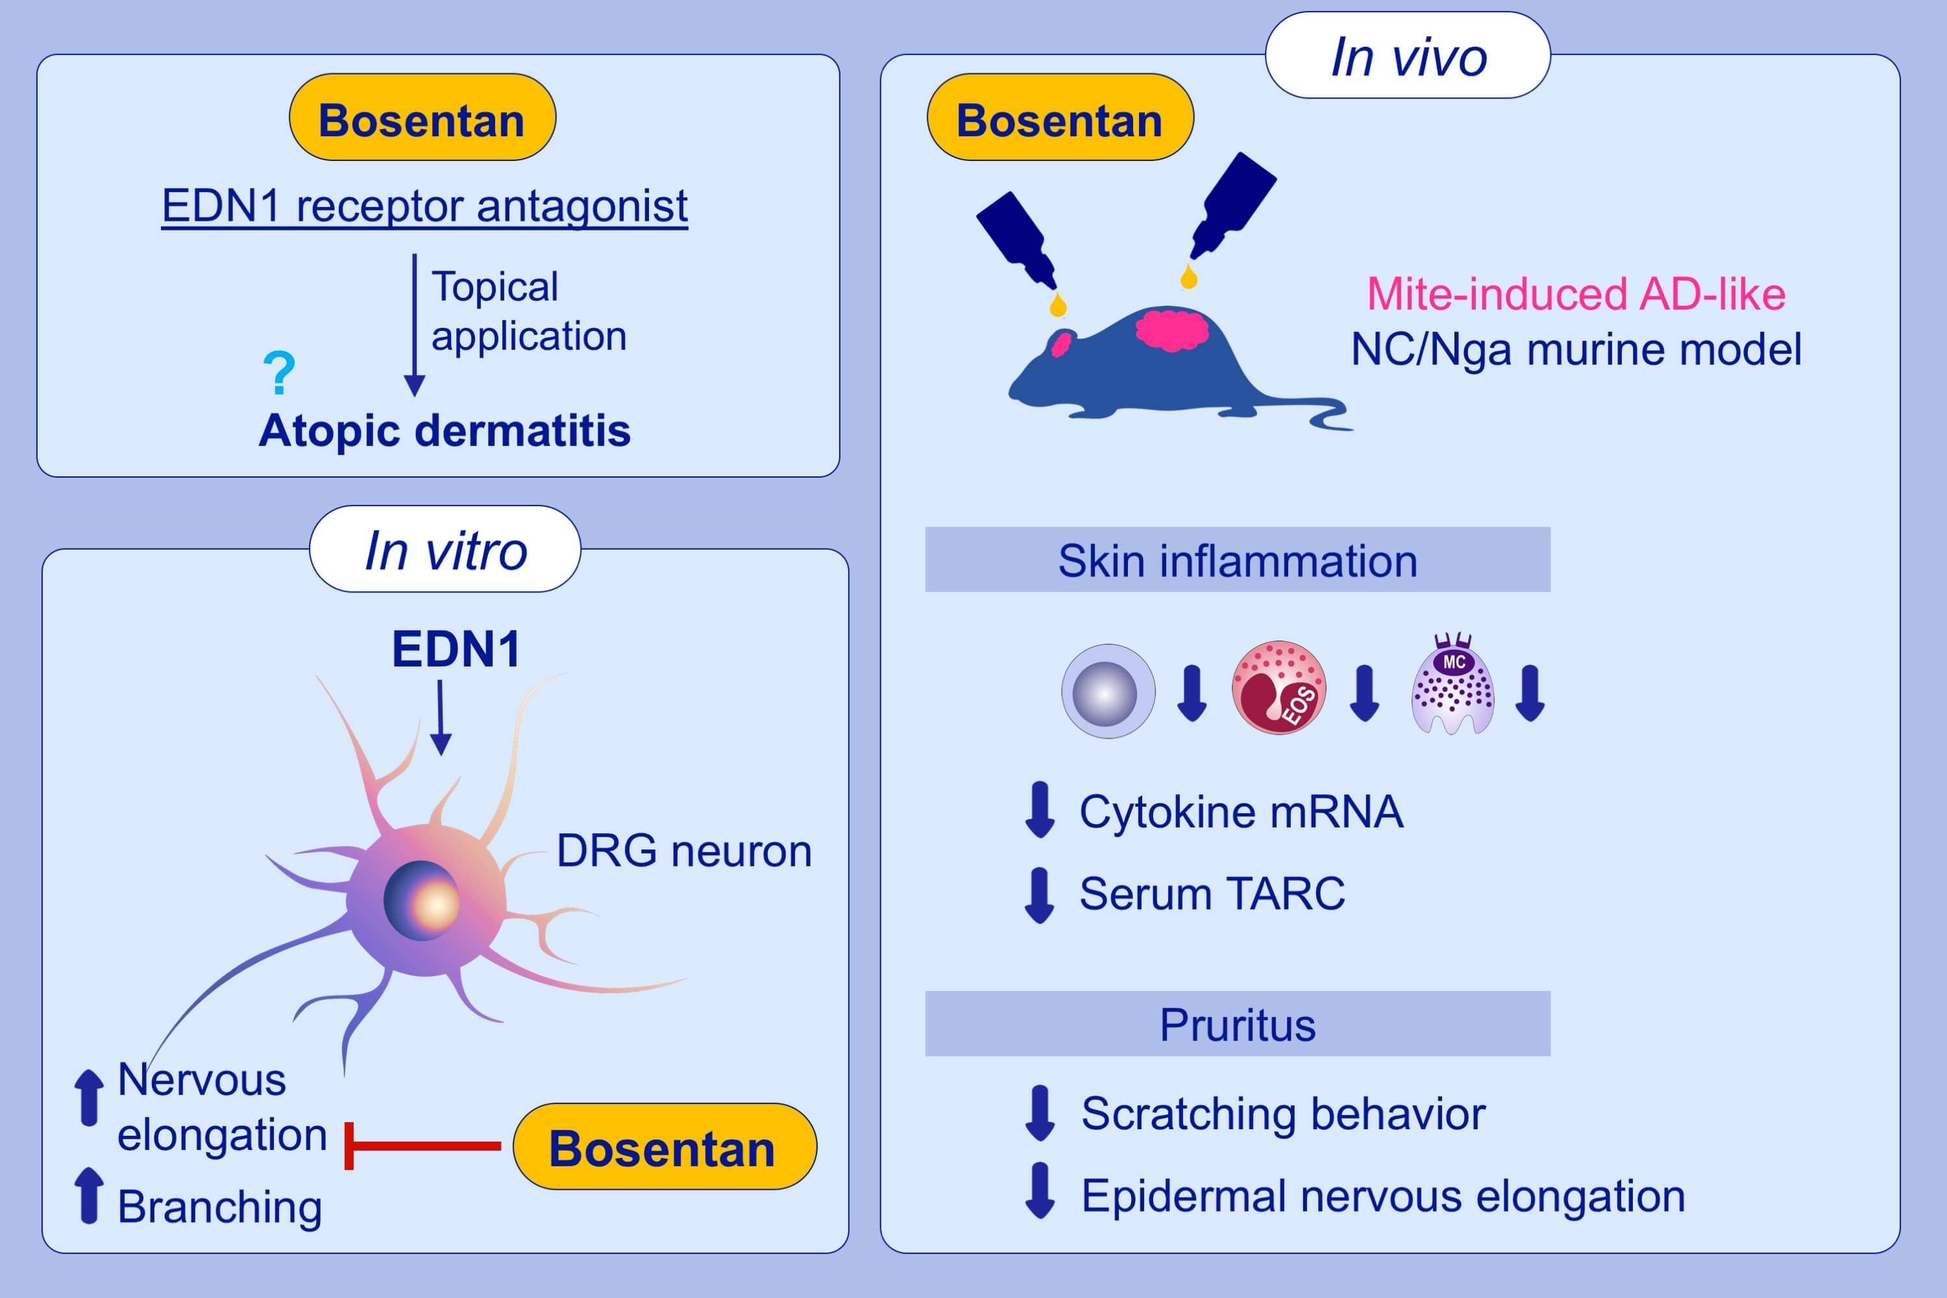
Inhibition of mite‐induced dermatitis, pruritus, and nerve sprouting in mice by the endothelin receptor antagonist bosentan
Makiko Kido‐Nakahara, Bing Wang, Fumitaka Ohno, Gaku Tsuji, Dugarmaa Ulzii, et al.
Allergy. 2021; 291-301 https://doi.org/10.1111/all.14451
© 2019 EAACI and John Wiley and Sons A/S. Published by John Wiley and Sons Ltd.
Notes:
HIGHLIGHTS
Topical application of EDN1 receptor antagonist, bosentan, significantly attenuated the development of mite-induced AD-like skin inflammation, scratching bouts and epidermal nervous elongation in NC/Nga mice.
While EDN1 significantly elongated the nerves of dorsal root ganglion cells, bosentan treatment attenuated this.
Topical bosentan is a potential protective candidate for AD.
Abbreviations: AD, atopic dermatitis; DRG, dorsal root ganglion; EDN1, endothelin 1; TARC, thymus and activation-regulated chemokine

