Slide 1
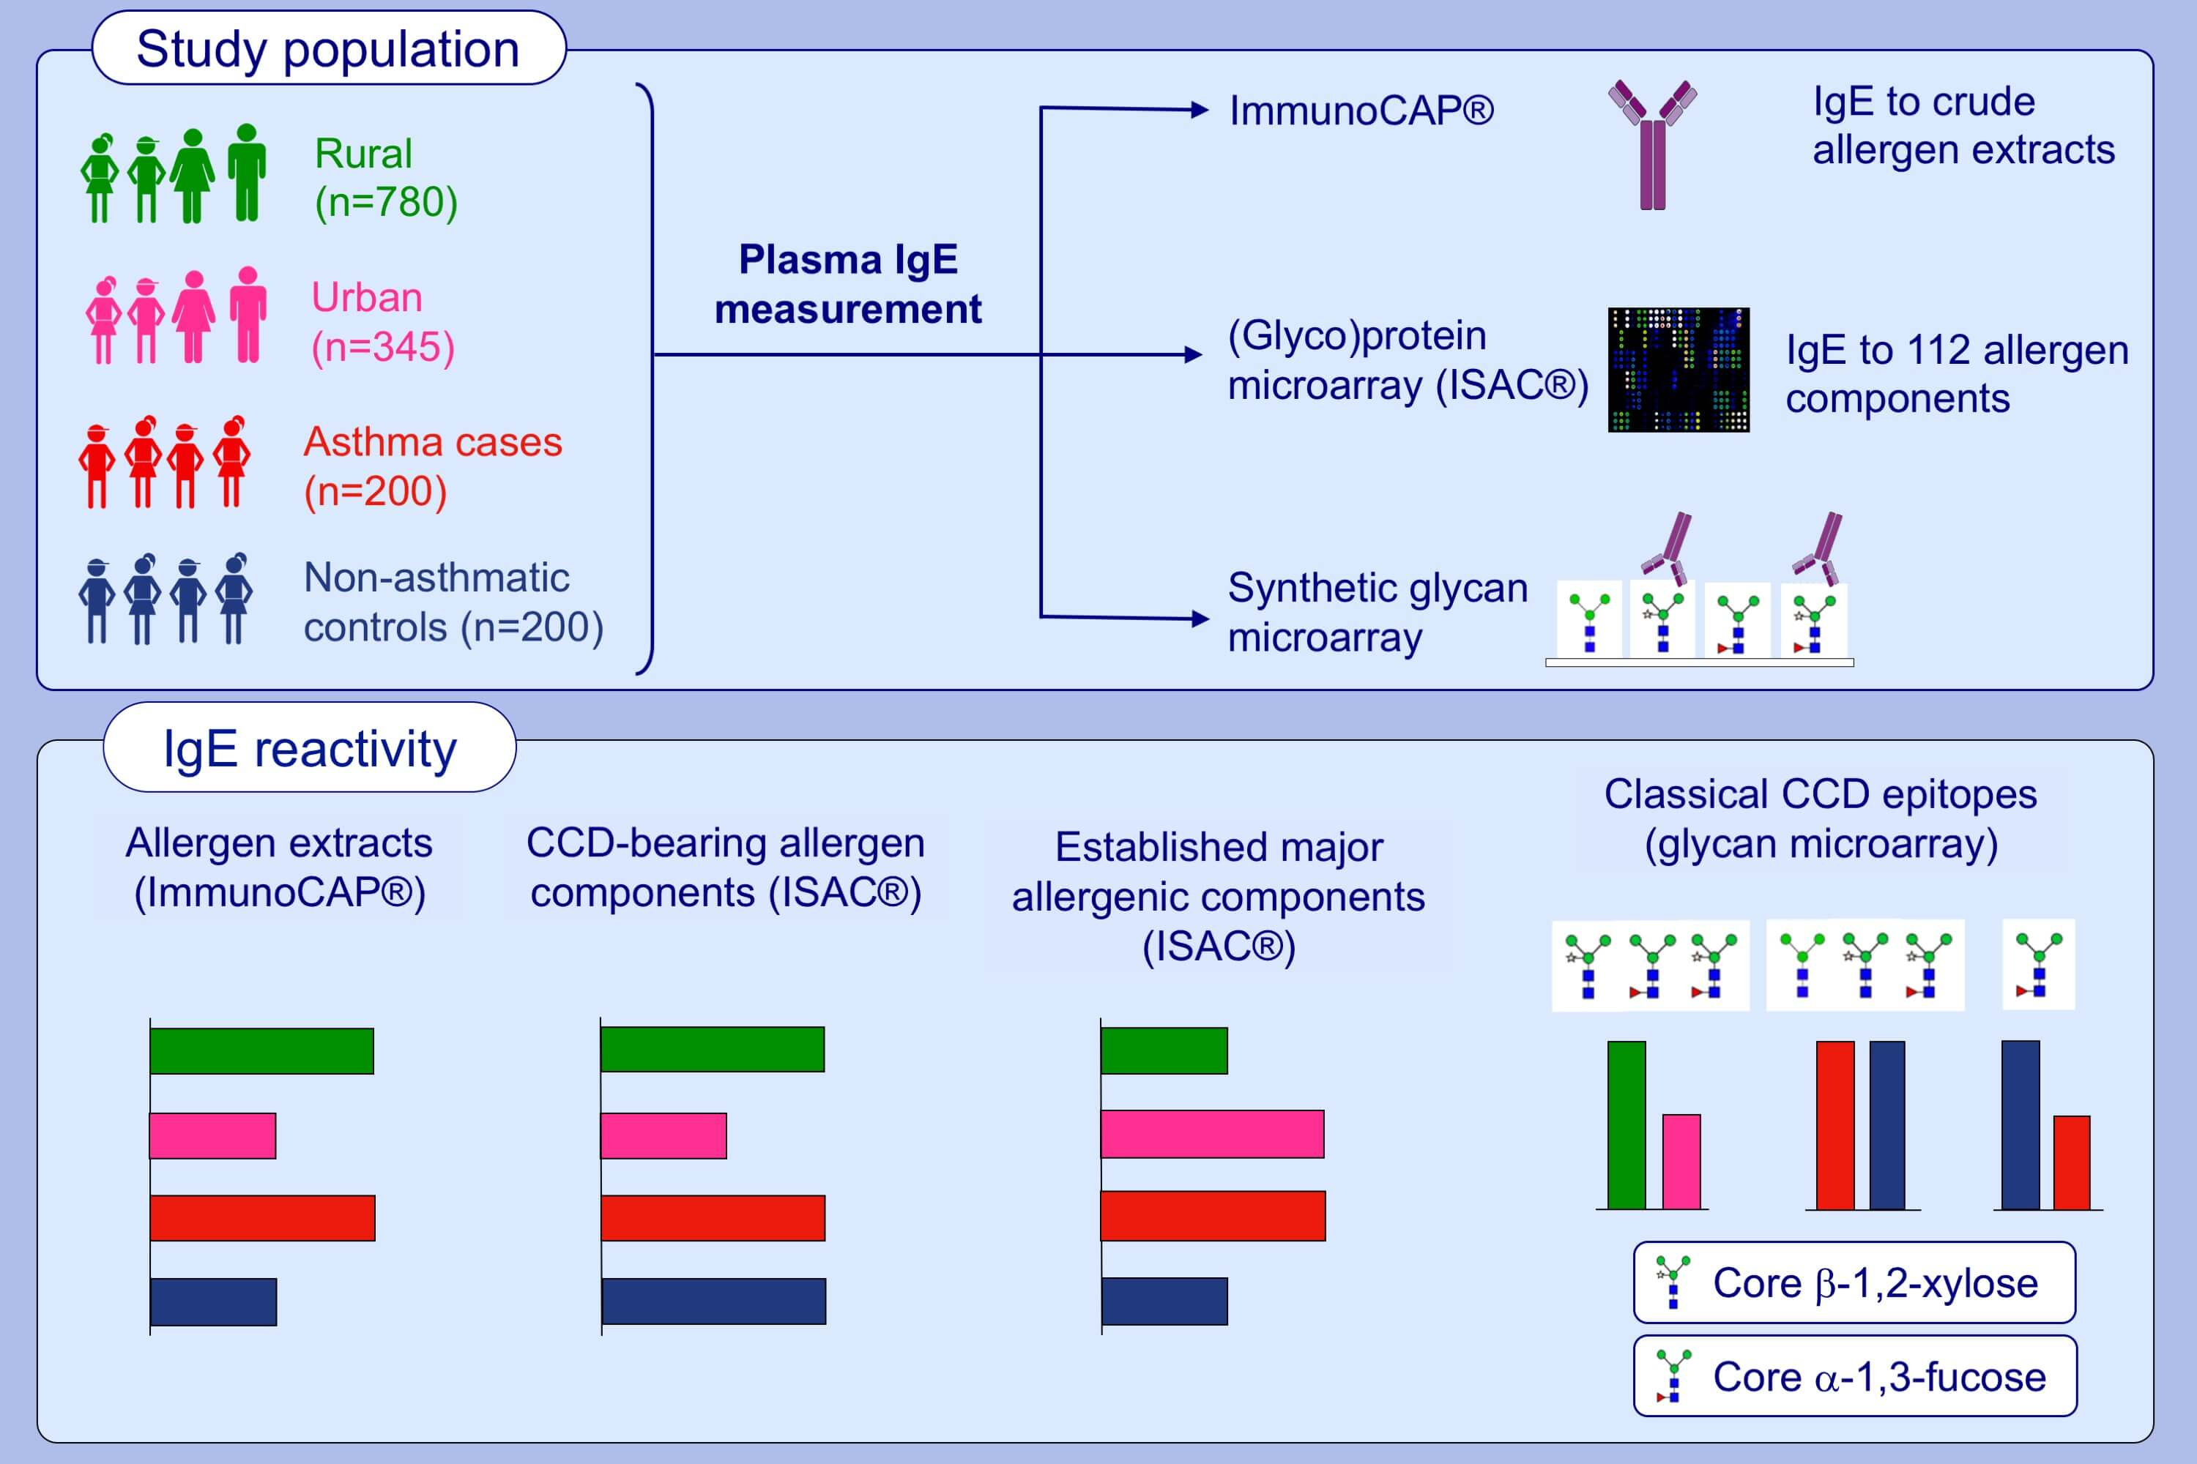
Cross‐reactive carbohydrate determinant‐specific IgE obscures true atopy and exhibits ⍺‐1,3‐fucose epitope‐specific inverse associations with asthma
Gyaviira Nkurunungi, Harriet Mpairwe, Serge A. Versteeg, Angela van Diepen, Jacent Nassuuna, et al.
Allergy. 2021; 233-246 https://doi.org/10.1111/all.14469
© 2019 EAACI and John Wiley and Sons A/S. Published by John Wiley and Sons Ltd.
Notes:
HIGHLIGHTS
Reactivity to crude allergen extracts and classical CCD epitope (core β-1,2-xylose, α-1,3-fucose)-modified N-glycans is positively associated with the rural, Schistosoma mansoni-endemic environment.
However, a higher proportion of urban, compared to rural participants, recognise recombinant established major allergenic components.
There are inverse associations between reactivity to a subset of core α-1,3-fucose-substituted N-glycans and asthma, but not for CCD-specific IgE in general.
Abbreviation: CCD, cross-reactive carbohydrate determinant

