Slide 1
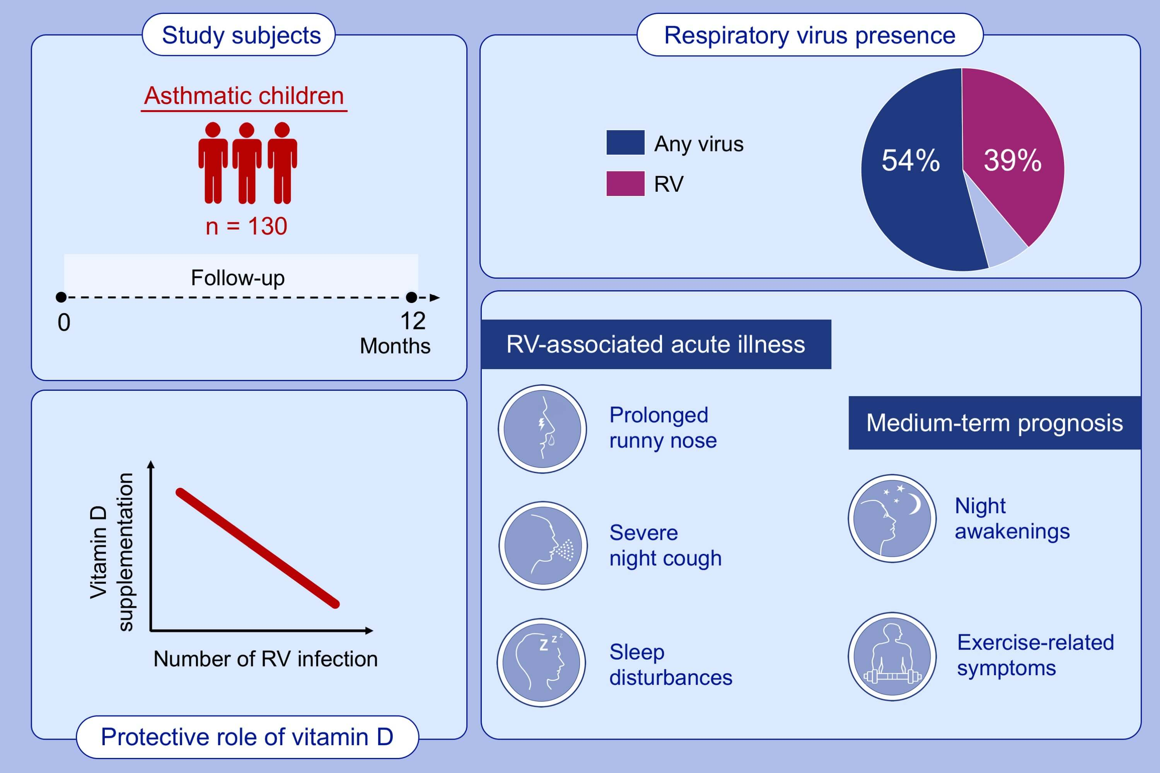
Clinical correlates of rhinovirus infection in preschool asthma
Tuomas Jartti, Unna Liimatainen, Paraskevi Xepapadaki, Tero Vahlberg, Claus Bachert, et al.
Allergy. 2021; 247-254 https://doi.org/10.1111/all.14479
© 2019 EAACI and John Wiley and Sons A/S. Published by John Wiley and Sons Ltd.
Notes:
HIGHLIGHTS
This study investigated the role of rhinovirus (RV) infections in preschool asthma
in 130 asthmatic children from PreDicta cohort over 1-year follow-up. During all visits, RV was the most commonly detected virus.
Vitamin D supplementation was associated with decreased number of rhinovirus infections in preschool children with asthma.
Detection of RV was associated with more severe course of acute illness (more severe nighttime coughing, more sleep disturbances and more days with runny nose) and more compromised medium-term prognosis (more nights with awakenings and more days of exercise-related symptoms).

