Slide 1
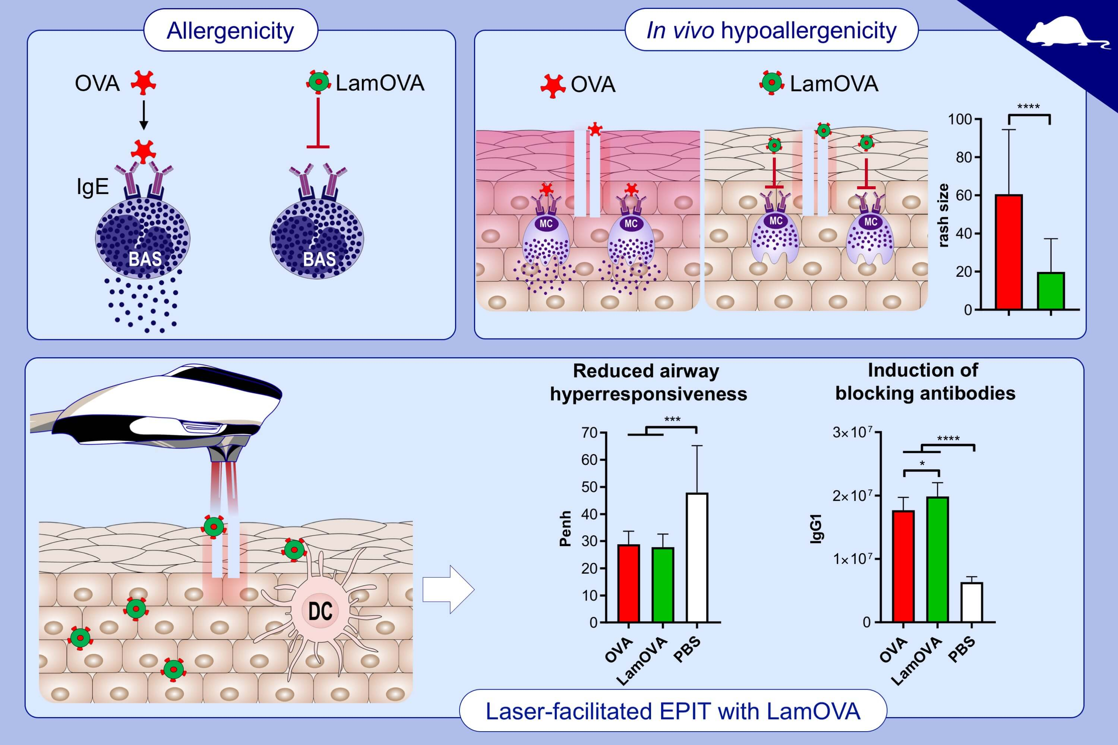
Laser‐facilitated epicutaneous immunotherapy with hypoallergenic beta‐glucan neoglycoconjugates suppresses lung inflammation and avoids local side effects in a mouse model of allergic asthma
Evgeniia Korotchenko, Viktoria Schießl, Sandra Scheiblhofer, Mario Schubert, Elfriede Dall, et al.
Allergy. 2021; 210-222 https://doi.org/10.1111/all.14481
© 2019 EAACI and John Wiley and Sons A/S. Published by John Wiley and Sons Ltd.
Notes:
HIGHLIGHTS
Conjugation of laminarin to ovalbumin reduced allergenicity of the protein via blocking its binding to IgE, but increased immunogenicity in terms of IgG generation.
EPIT with LamOVA was equally effective as SCIT in suppression of lung inflammation and airway hyperresponsiveness.
Application of LamOVA on laser-microporated skin induced less local side effects than OVA in sensitized animals.
Abbreviations: EPIT, epicutaneous immunotherapy; LamOVA, laminarin-ovalbumin conjugates; OVA, ovalbumin; PBS, phosphate buffered saline; Penh, resistance and compliance data are shown as area under the curve (AUC) of a methacholine challenge dose response curve; SCIT, subcutaneous immunotherapy

