Slide 1
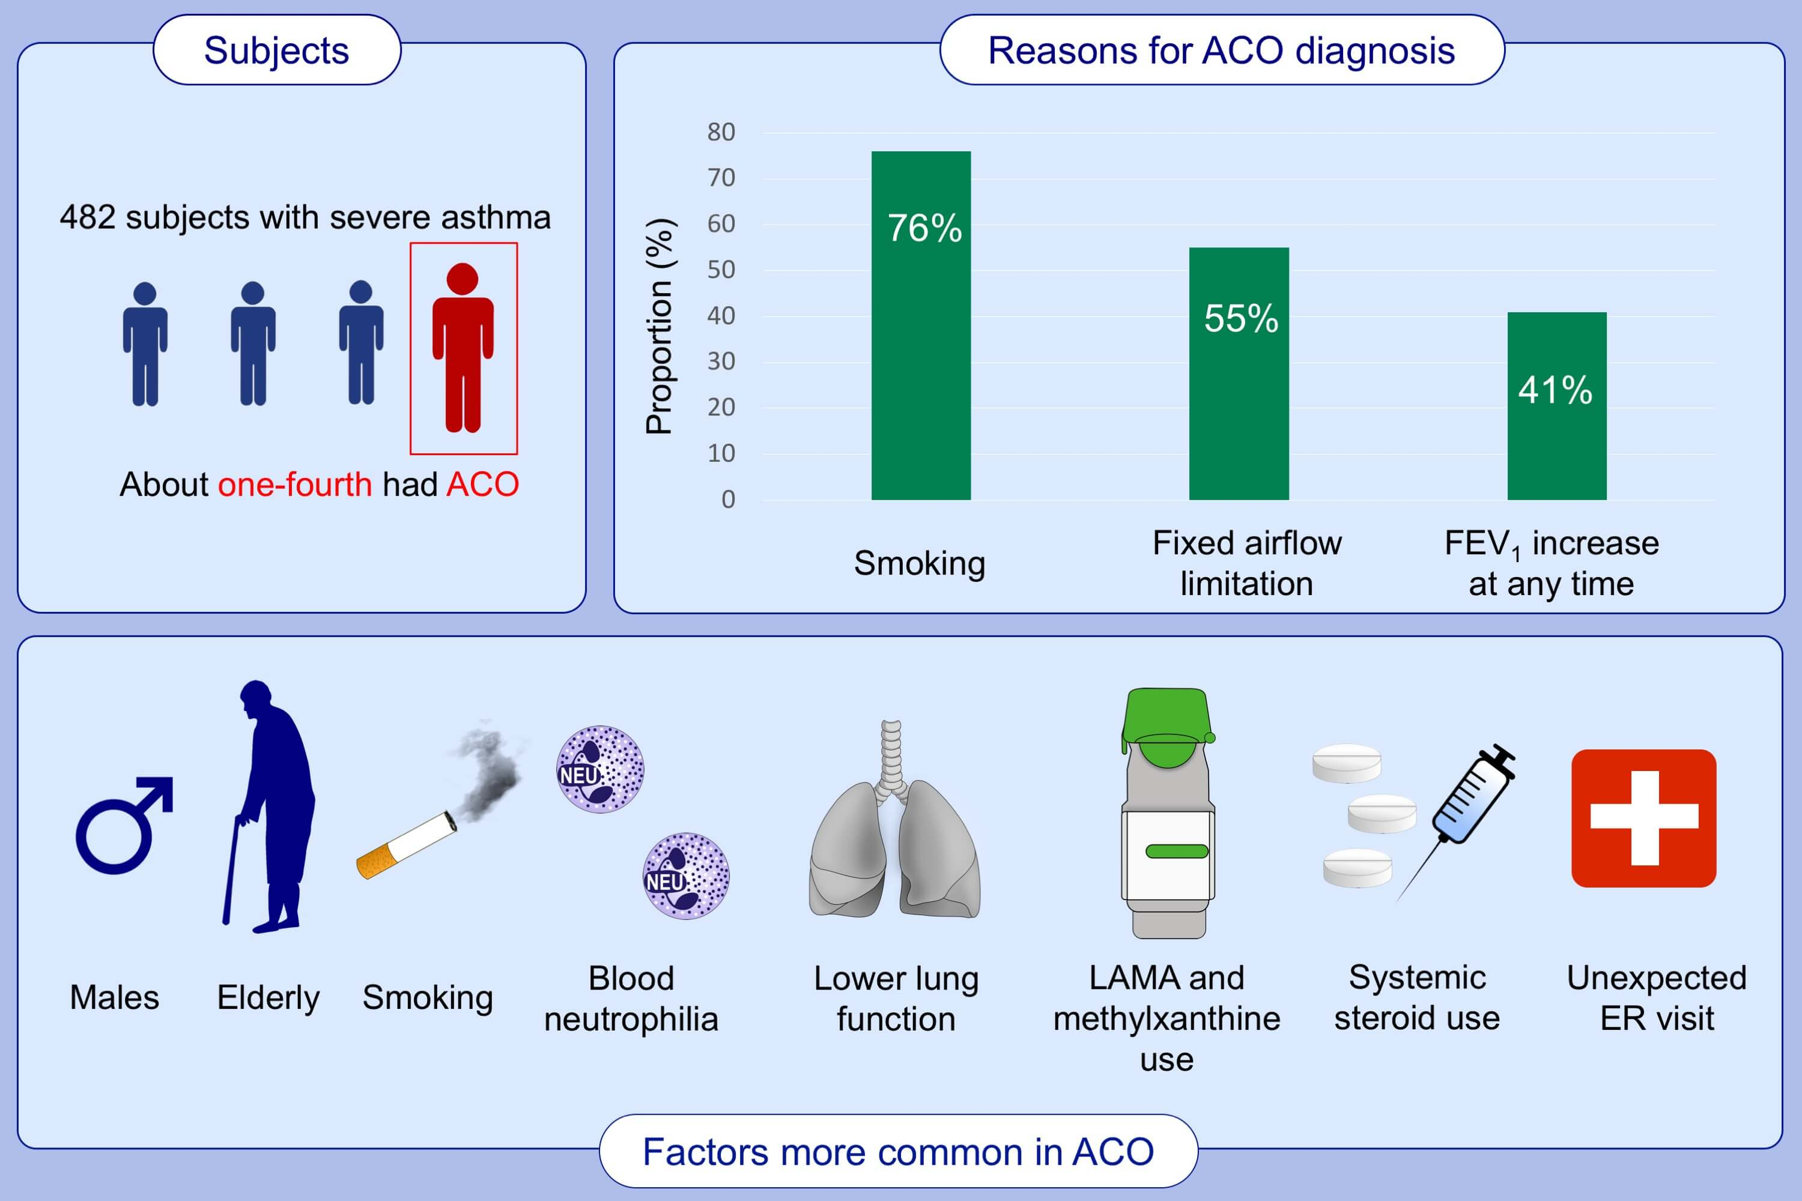
Characteristics of Specialist‐Diagnosed Asthma‐COPD Overlap in Severe Asthma: Observations from the Korean Severe Asthma Registry (KoSAR)
Hyun Lee, Sang‐Heon Kim, Byung‐Keun Kim, Youngsoo Lee, Hwa Young Lee, et al.
Allergy. 2021; 223-232 https://doi.org/10.1111/all.14483
© 2019 EAACI and John Wiley and Sons A/S. Published by John Wiley and Sons Ltd.
Notes:
HIGHLIGHTS
Among patients with severe asthma, about one-fourth was diagnosed with ACO by specialists, and the most common reason for ACO diagnosis was smoking history.
Severe asthma patients with ACO were older, predominantly male, and were more likely to have a smoking history than those without ACO.
Severe asthma patients with ACO used more systemic corticosteroids and had more frequent exacerbations related to emergency department visits than those without ACO.
Abbreviations: ACO, asthma-COPD overlap; ER, emergency room; FEV1, forced expiratory volume in one second

