Slide 1
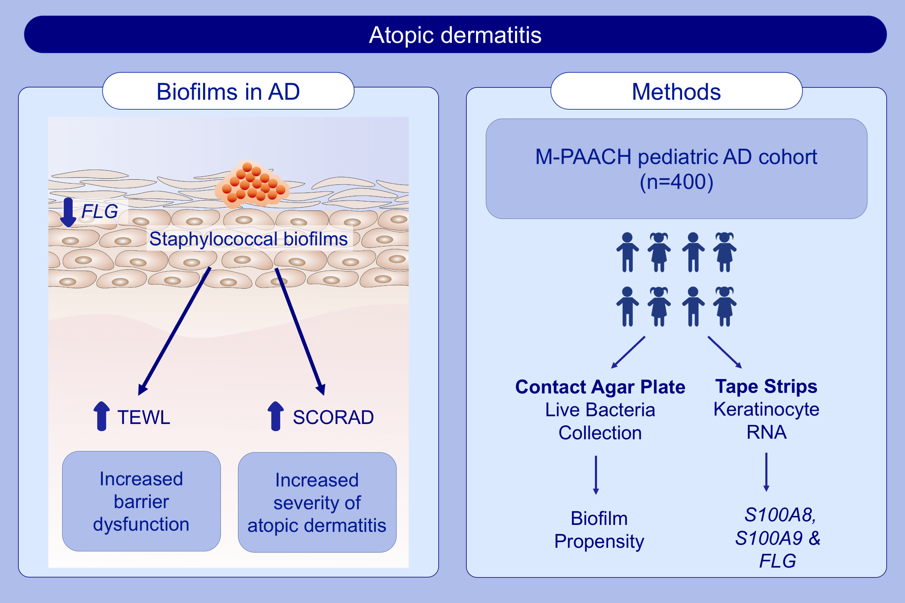
Biofilm propensity of Staphylococcus aureus skin isolates is associated with increased atopic dermatitis severity and barrier dysfunction in the MPAACH pediatric cohort
Tammy Gonzalez, Mariana L. Stevens, Asel Baatyrbek kyzy, Rosario Alarcon, Hua He, et al.
Allergy. 2021; 302-313 https://doi.org/10.1111/all.14489
© 2019 EAACI and John Wiley and Sons A/S. Published by John Wiley and Sons Ltd.
Notes:
HIGHLIGHTS
Staphylococcal biofilms are observed on the skin of children with AD in the MPAACH cohort.
S. aureus strains showing higher relative biofilm propensity (compared to S. epidermidis from the same subject) are associated with increased AD severity.
S. aureus strains showing higher relative biofilm propensity are associated with increased lesional and non-lesional transepidermal water loss.
Abbreviations: AD, atopic dermatitis; FLG, filaggrin; MPAACH, Mechanisms of Progression of Atopic Dermatitis to Asthma in Children; SCORAD, scoring atopic dermatitis index; S100A8, S100 Calcium-Binding Protein A8; S100A9, Calcium-Binding Protein A9; TEWL, trans-epidermal water loss

