Slide 1
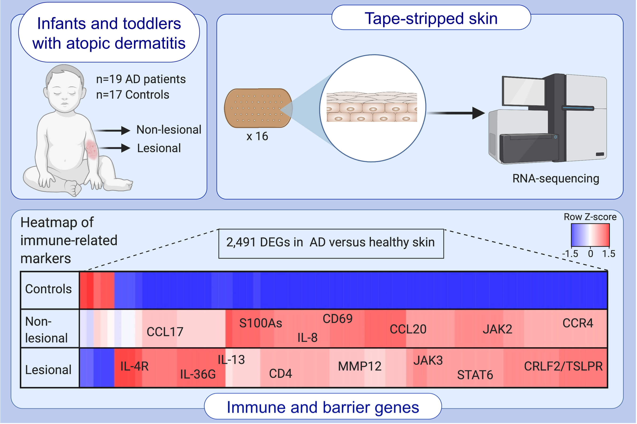
Tape strips from early‐onset pediatric atopic dermatitis highlight disease abnormalities in nonlesional skin
Ana B. Pavel, Yael Renert‐Yuval, Jianni Wu, Ester Del Duca, Aisleen Diaz, et al.
Allergy. 2021; 314-325 https://doi.org/10.1111/all.14490
© 2019 EAACI and John Wiley and Sons A/S. Published by John Wiley and Sons Ltd.
Notes:
HIGHLIGHTS
Tape-strips are collected for RNA-seq profiling from 19 infants/toddlers (ages 0-5 years; lesional and non-lesional) with early-onset (≤6 months), moderate-to-severe AD and 17 healthy controls.
We identify 2,491 differentially expressed genes in AD versus healthy skin.
We observe significant dysregulation of Th2 and Th22/Th17-related markers, largely lacking Th1 skewing. Significant decreases in barrier-related genes are seen primarily in lesional skin.
Abbreviations: AD, atopic dermatitis; DEGs, differentially expressed genes

