Slide 1
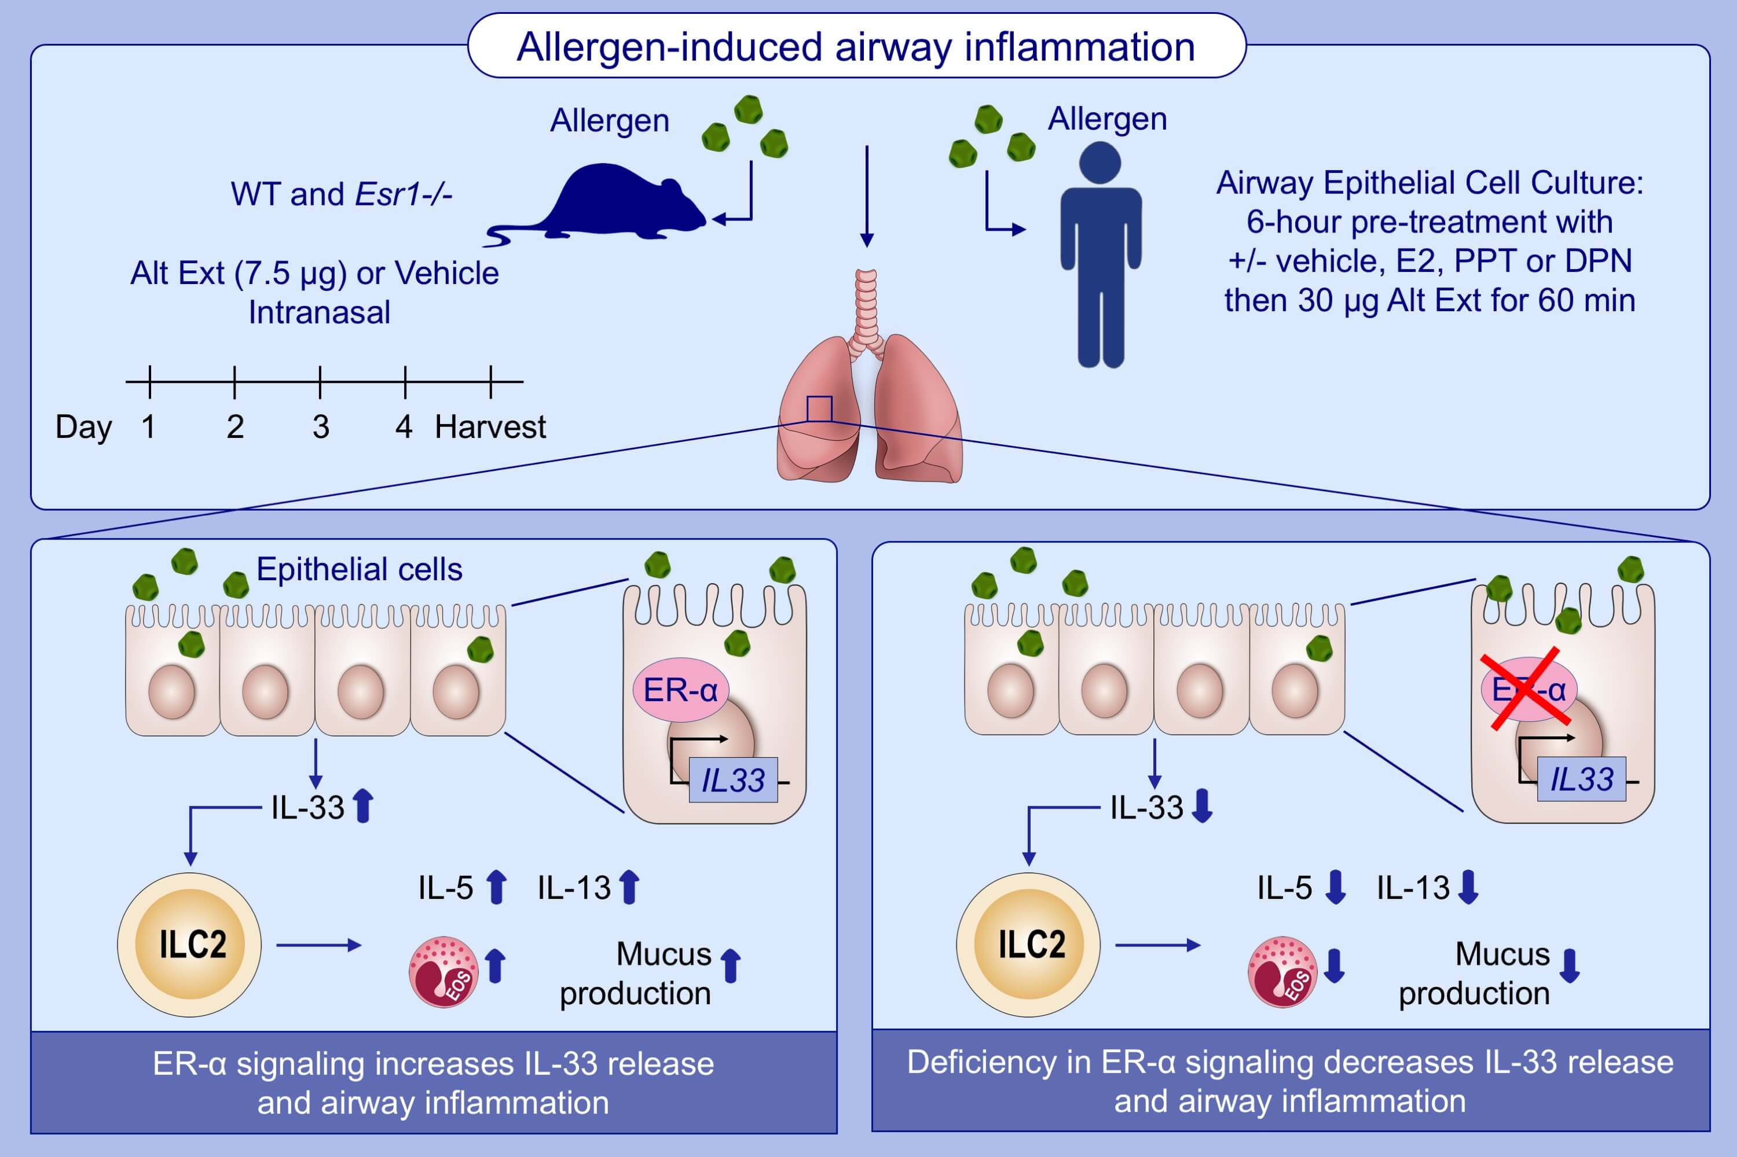
Estrogen receptor‐α signaling increases allergen‐induced IL‐33 release and airway inflammation
Jacqueline‐Yvonne Cephus, Vivek D. Gandhi, Ruchi Shah, Jordan Brooke Davis, Hubaida Fuseini, et al.
Allergy. 2021; 255-268 https://doi.org/10.1111/all.14491
© 2019 EAACI and John Wiley and Sons A/S. Published by John Wiley and Sons Ltd.
Notes:
HIGHLIGHTS
Allergen-induced airway inflammation is increased by estrogen signaling.
Compared to WT mice, Alt Ext challenged Esr1-/- mice have decreased IL-5 and IL-13 production, eosinophils number, and IL-33 release.
Estrogen receptor-α signaling has no direct effect on ILC2 proliferation or cytokine expression.
Abbreviations: Alt Ext, Alternaria extract; DPN, diarylpropionitrile; E2, 17β-estradiol; Eos, eosinophils; Esr1-/-, estrogen receptor alpha deficient mice; ER-α, estrogen receptor α; ILC2, group 2 innate lymphoid cells; PPT, propyl-pyrazole-triol; WT, wild-type

