Slide 1
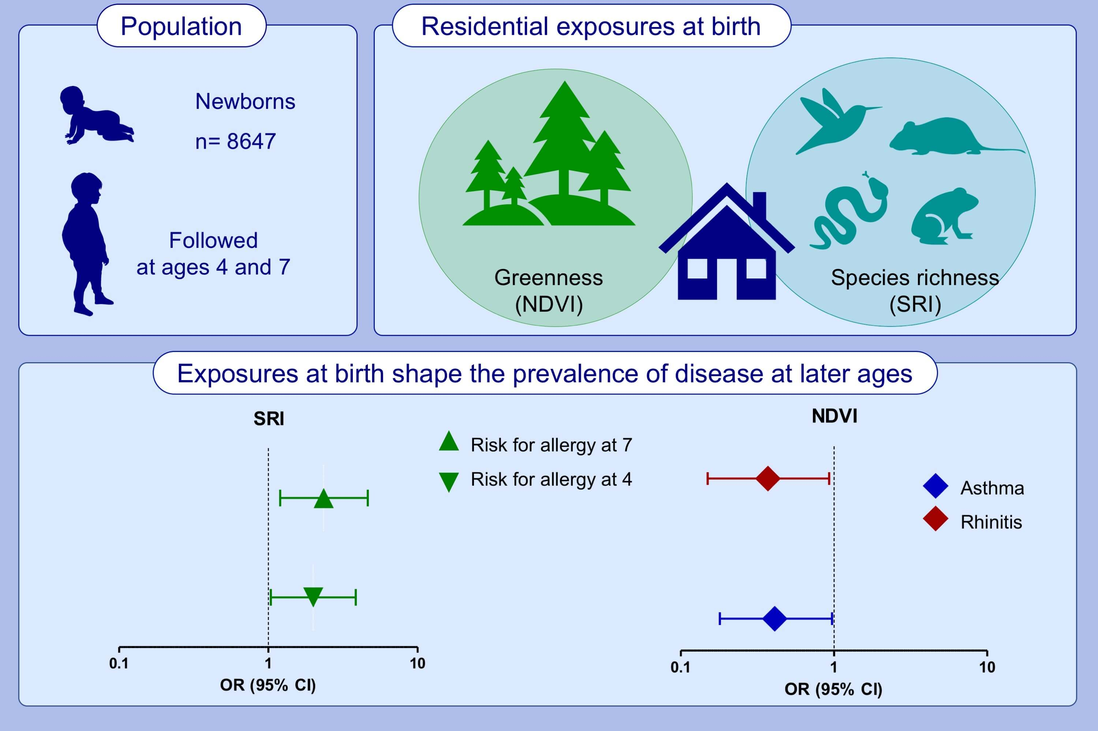
The neighbourhood natural environment is associated with asthma in children: A birth cohort study
João Cavaleiro Rufo, Inês Paciência, Elaine Hoffimann, André Moreira, Henrique Barros, et al.
Allergy. 2021; 348-358 https://doi.org/10.1111/all.14493
© 2019 EAACI and John Wiley and Sons A/S. Published by John Wiley and Sons Ltd.
Notes:
HIGHLIGHTS
Living in a greener neighbourhood at birth is associated with a lower prevalence of asthma and rhinitis at the age of seven.
Living in a neighbourhood with high numbers of fauna species is associated with an increased risk for allergic diseases and asthma in children.
The associations between the contact with nature and the development of asthma are stronger among children with a later onset of disease.
Abbreviations: CI, confidence intervals; OR, odds ratio; NDVI, normalized difference vegetation index; SRI, species richness index

