Slide 1
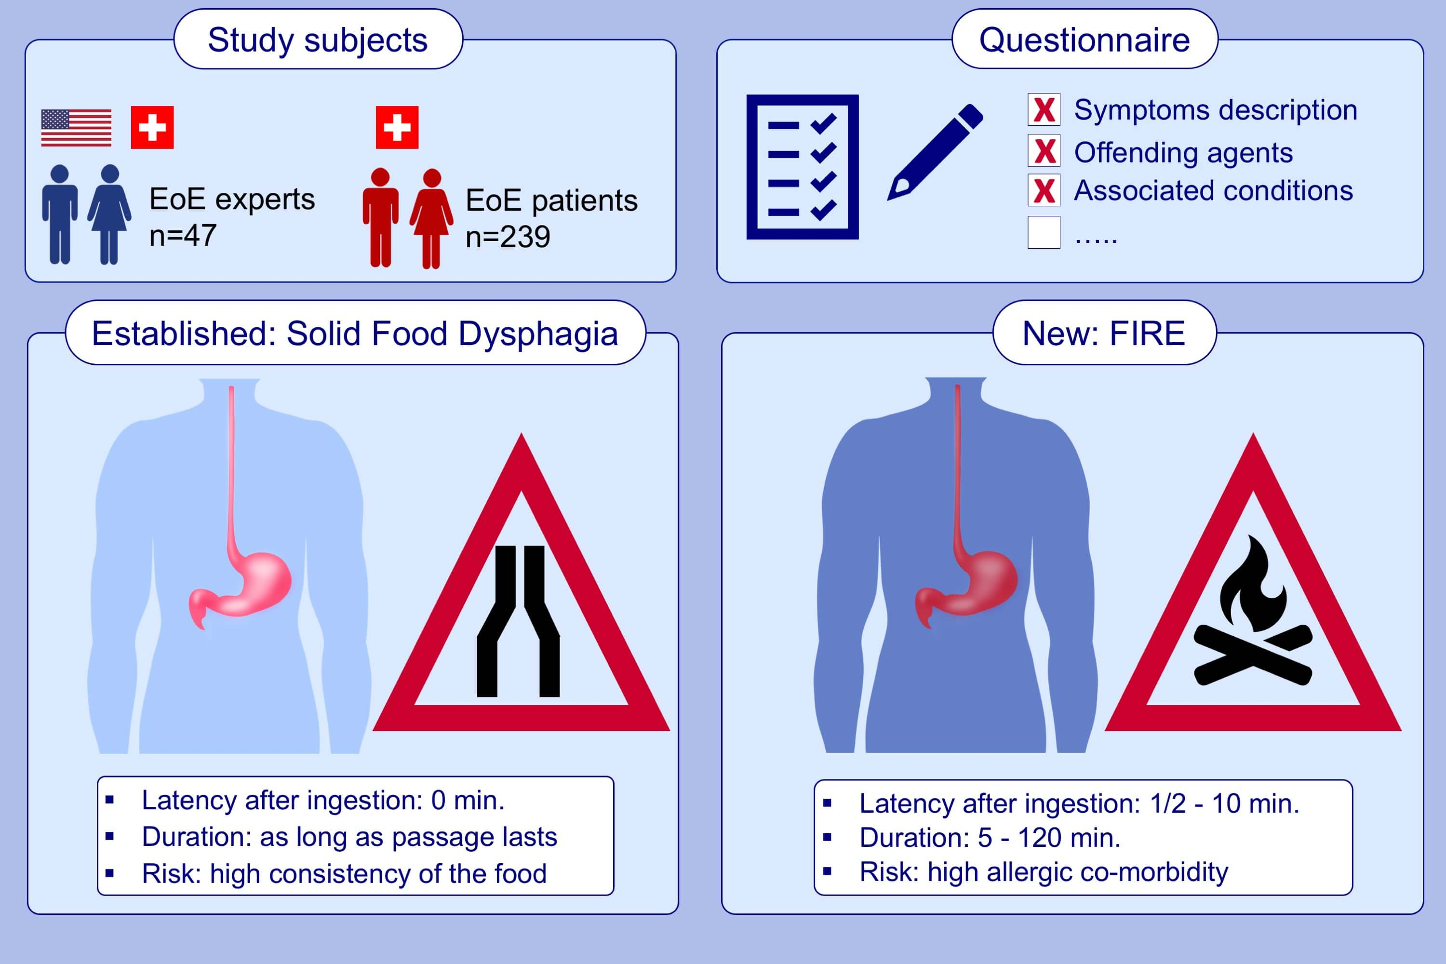
Food‐induced immediate response of the esophagus—A newly identified syndrome in patients with eosinophilic esophagitis
Luc Biedermann, Mark Holbreich, Dan Atkins, Mirna Chehade, Evan S. Dellon, et al.
Allergy. 2021; 339-347 https://doi.org/10.1111/all.14495
© 2019 EAACI and John Wiley and Sons A/S. Published by John Wiley and Sons Ltd.
Notes:
HIGHLIGHTS
This study describes FIRE, a novel syndrome frequently reported in EoE patients.
EoE expert physicians’ and patients’ surveys were performed to characterize FIRE.
A burning and choking unpleasant or painful sensation with rapid occurrence upon ingestion of trigger food is typical of FIRE, occurring in a considerable fraction of EoE patients unrelated from classical solid food dysphagia.
Abbreviations: EoE, eosinophilic esophagitis; FIRE, food-induced immediate response of the esophagus

