Slide 1
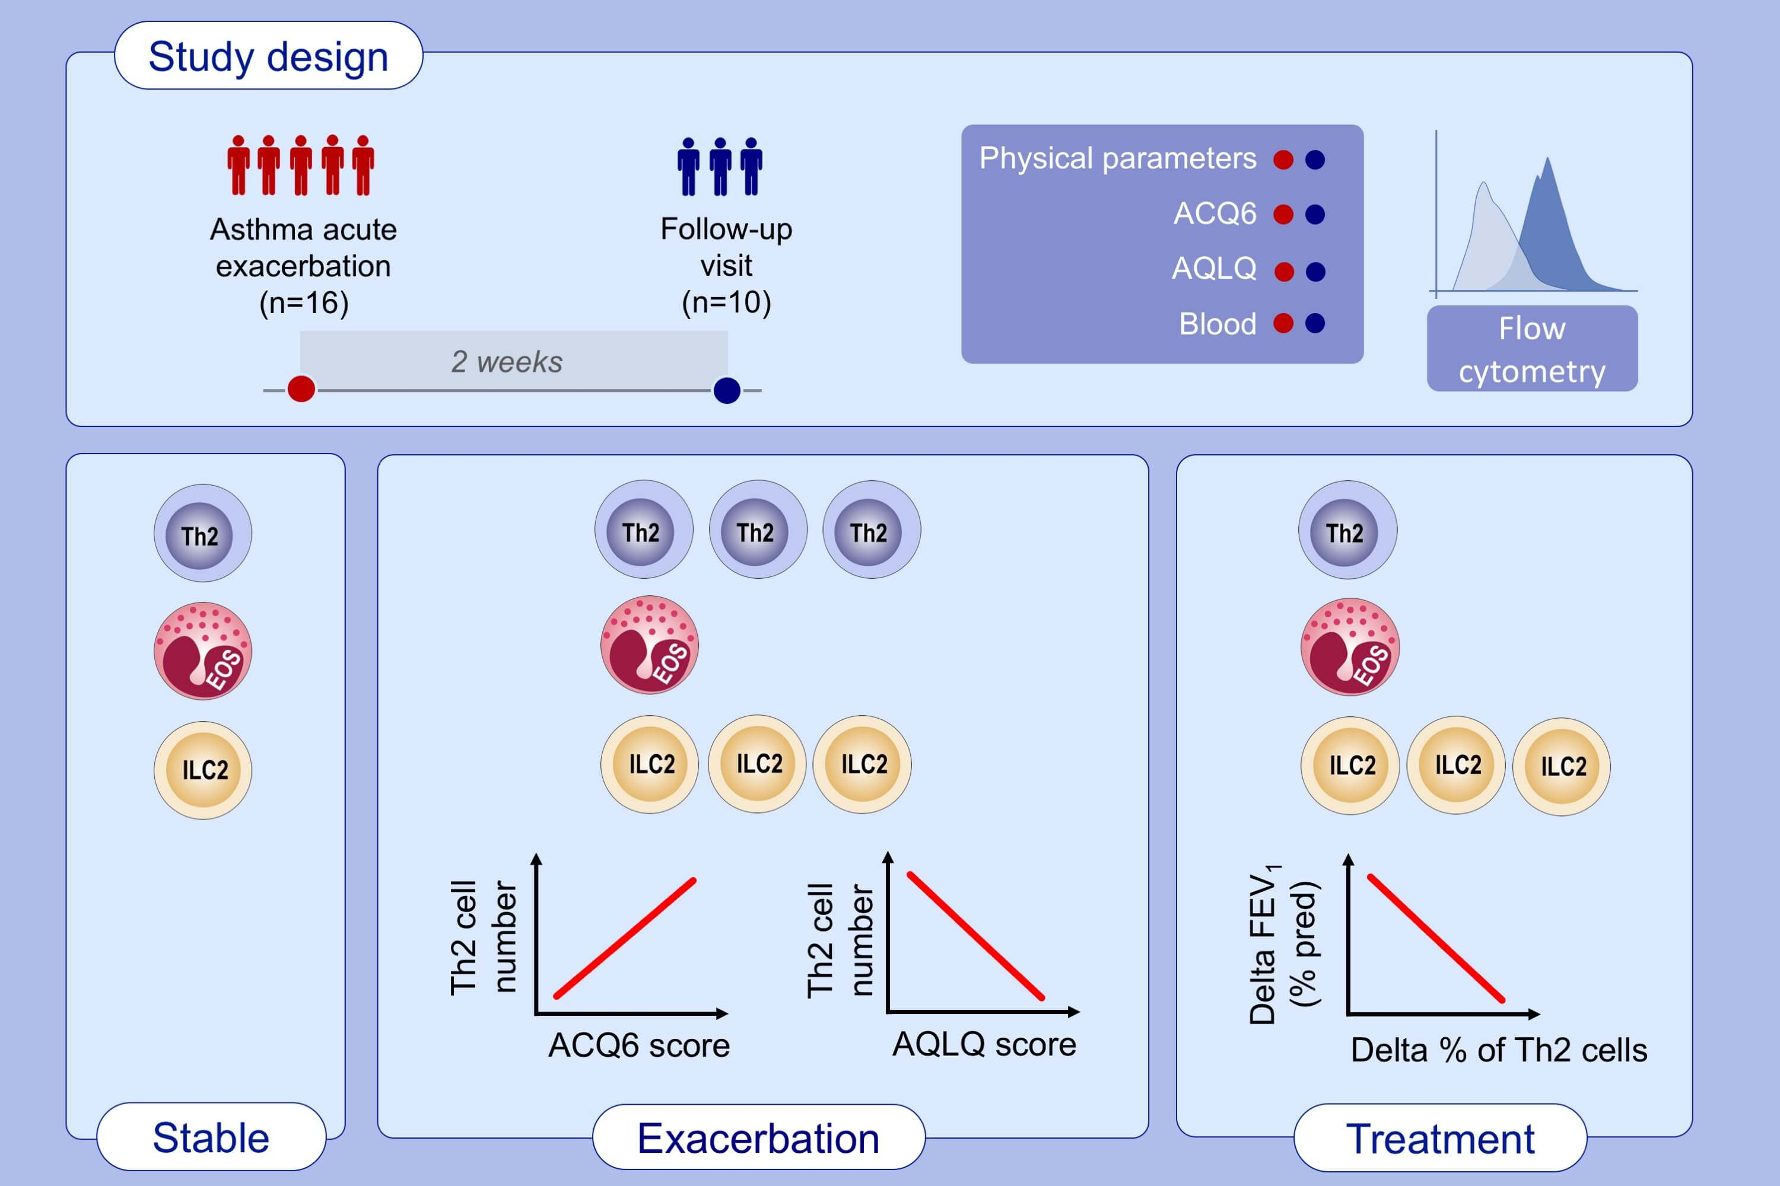
Th2 cell markers in peripheral blood increase during an acute asthma exacerbation
Nami Shrestha Palikhe, Yingqi Wu, Emily Konrad, Vivek Dipak Gandhi, Brian H. Rowe, et al.
Allergy. 2021; 281-290 https://doi.org/10.1111/all.14543
© 2019 EAACI and John Wiley and Sons A/S. Published by John Wiley and Sons Ltd.
Notes:
HIGHLIGHTS
Th2 cell number in peripheral blood correlates with asthma control and quality of life during asthma exacerbations.
Patients with asthma exacerbations have a higher % of Th2 cells (CD4⁺ T cells expressing CRTh2) in peripheral blood compared to patients with stable asthma, and this parameter decreases after treatment. Eosinophils and ILC2 cells in peripheral blood do not change during asthma exacerbations.
The decrease in the % of Th2 cells seen during the follow up visit correlates with the improvement in lung function.
Abbreviations: ACQ, asthma control questionnaire; AQLQ, asthma quality of life questionnaire; FEV₁, forced expiratory volume in 1 sec; ILC2: group 2 innate lymphoid cell; pred, predicted

