Slide 1
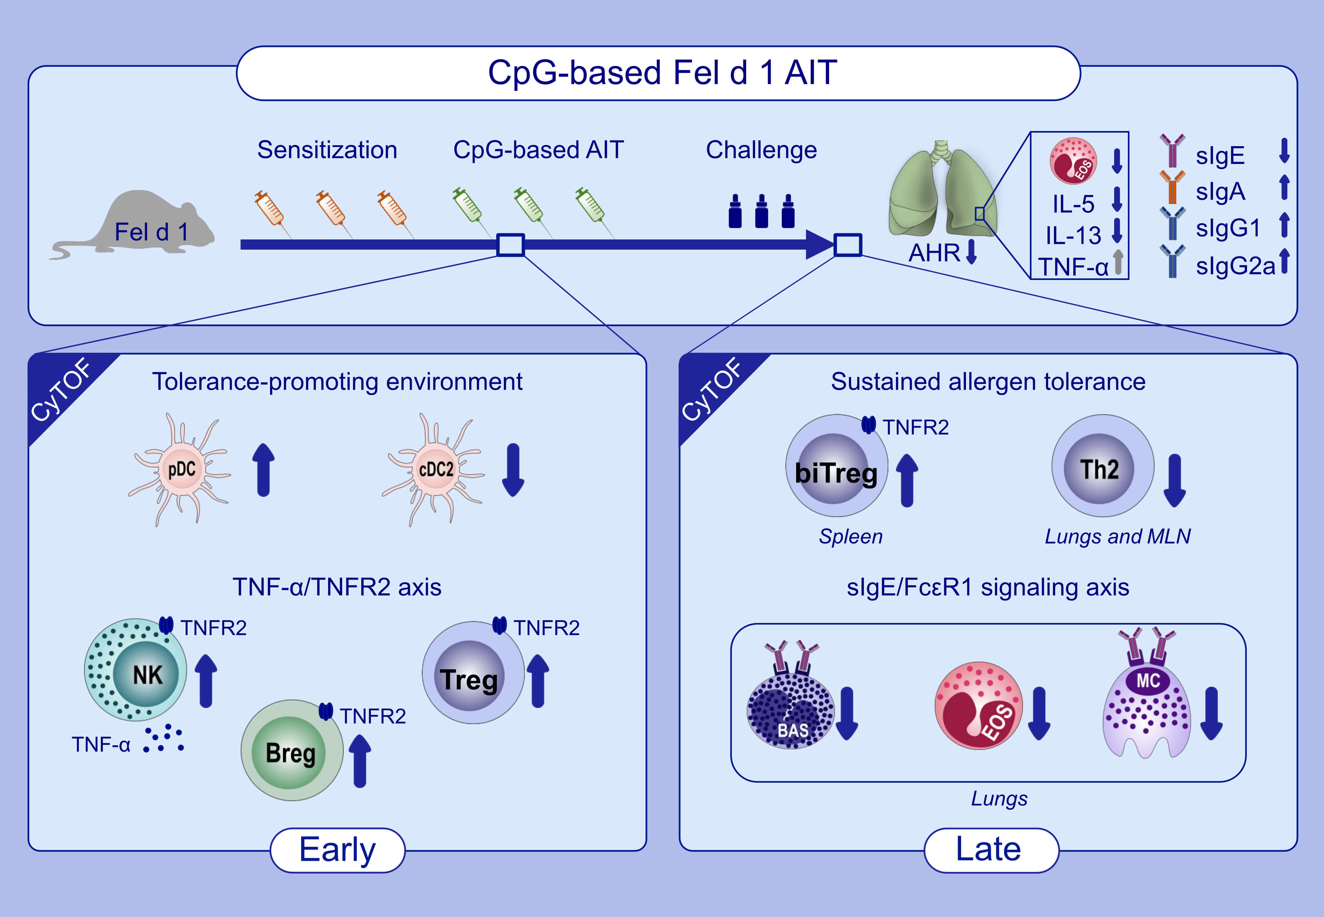
Comprehensive mapping of immune tolerance yields a regulatory TNF receptor 2 signature in a murine model of successful Fel d 1-specific immunotherapy using high-dose CpG adjuvant
Cathy Leonard,, Guillem Montamat,, Caroline Davril,, Olivia Domingues,, Oliver Hunewald,, et al.
Allergy. 2021; 2153-2165 https://doi.org/10.1111/all.14716
© 2019 EAACI and John Wiley and Sons A/S. Published by John Wiley and Sons Ltd.
Notes:
HIGHLIGHTS
AIT with a high and safe dose of CpG as adjuvant revertes the major hallmarks of cat allergy without inducing any Th1/Th17 profile.
The use of endotoxin-free Fel d 1 and B-Type CpG in AIT induces a pDC-NK cell-Breg-Treg axis with characteristic TNFR2 expression.
A novel double positive FoxP3⁺ GATA3⁺ Treg subpopulation appears upon AIT.
Abbreviations: AHR, airway hyper reactivity; AIT, allergen specitific immunotherapy; biTreg, double positive FoxP3+ GATA3+ Treg; CyTOF, cytometry by time-of-flight; CpG, oligodeoxynucleotides containing unmethylated CpG motifs; Fel d 1, Felis domesticus 1, major cat allergen; TNFR2, tumor necrosis factor receptor 2

