Slide 1
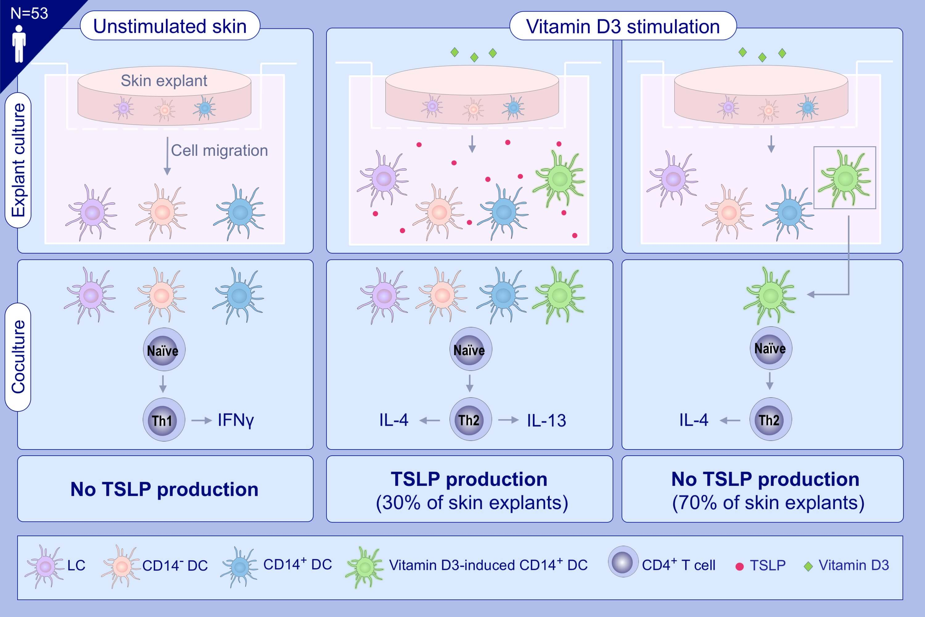
Vitamin D3–elicited CD14+ human skin dendritic cells promote thymic stromal lymphopoietin–independent type 2 T-helper responses
Adrien Brulefert,, Astrid Hoste,, Quentin Muller,, Jean-Daniel Fauny,, Christopher G. Mueller,, et al.
Allergy. 2021; 2044-2056 https://doi.org/10.1111/all.14718
© 2019 EAACI and John Wiley and Sons A/S. Published by John Wiley and Sons Ltd.
Notes:
HIGHLIGHTS
Vitamin D3 consistently upregulates CD14 on human skin DCs, yet induces TSLP production in only 30% of skin explants.
Skin DCs from TSLP-producing donors shift naïve T cells into IL-13+/IL-4+ Th2 cells.
Vitamin D3-elicited CD14+ DCs from donors that fail to release TSLP are sufficient to generate IL-4+ Th2 cells.
Abbreviations: DC, dendritic cells; LC, Langerhans cell; TSLP, thymic stromal lymphopoietin

