Slide 1
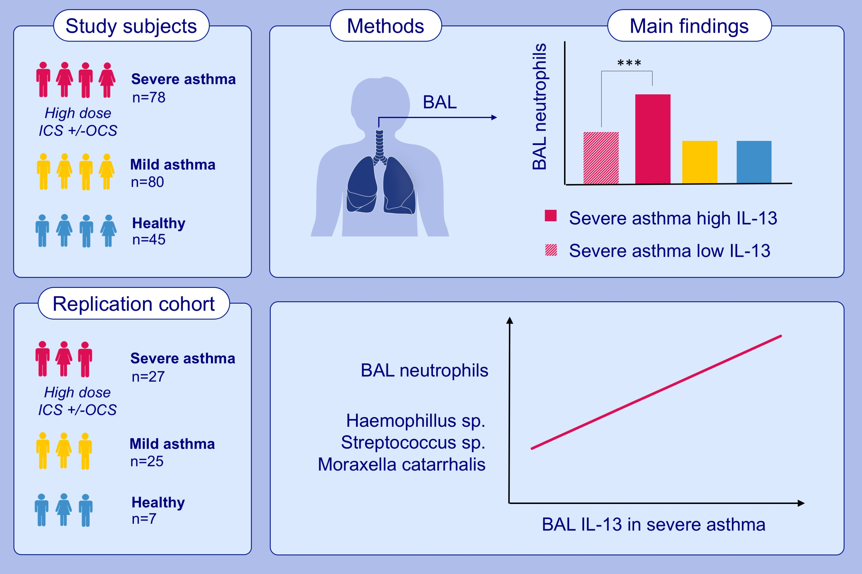
Peripheral airways type 2 inflammation, neutrophilia and microbial dysbiosis in severe asthma
Adnan Azim,, Ben Green,, Laurie Lau,, Hitasha Rupani,, Nivenka Jayasekera,, et al.
Allergy. 2021; 2070-2078 https://doi.org/10.1111/all.14732
© 2019 EAACI and John Wiley and Sons A/S. Published by John Wiley and Sons Ltd.
Notes:
HIGHLIGHTS
In this study, we stratified biologic naïve severe asthma patients treated with high dose inhaled corticosteroid therapy by their bronchoalveolar lavage IL-13.
Patients with high bronchoalveolar lavage IL-13, despite steroid therapy, have a higher percentage of bronchoalveolar lavage neutrophils.
We replicated these findings in a second smaller cohort, which also associated high bronchoalveolar lavage IL-13 with bacterial dysbiosis.
Abbreviations: BAL, bronchoalveolar lavage; ICS, inhaled corticosteroids; OCS, oral corticosteroids
.

