Slide 1
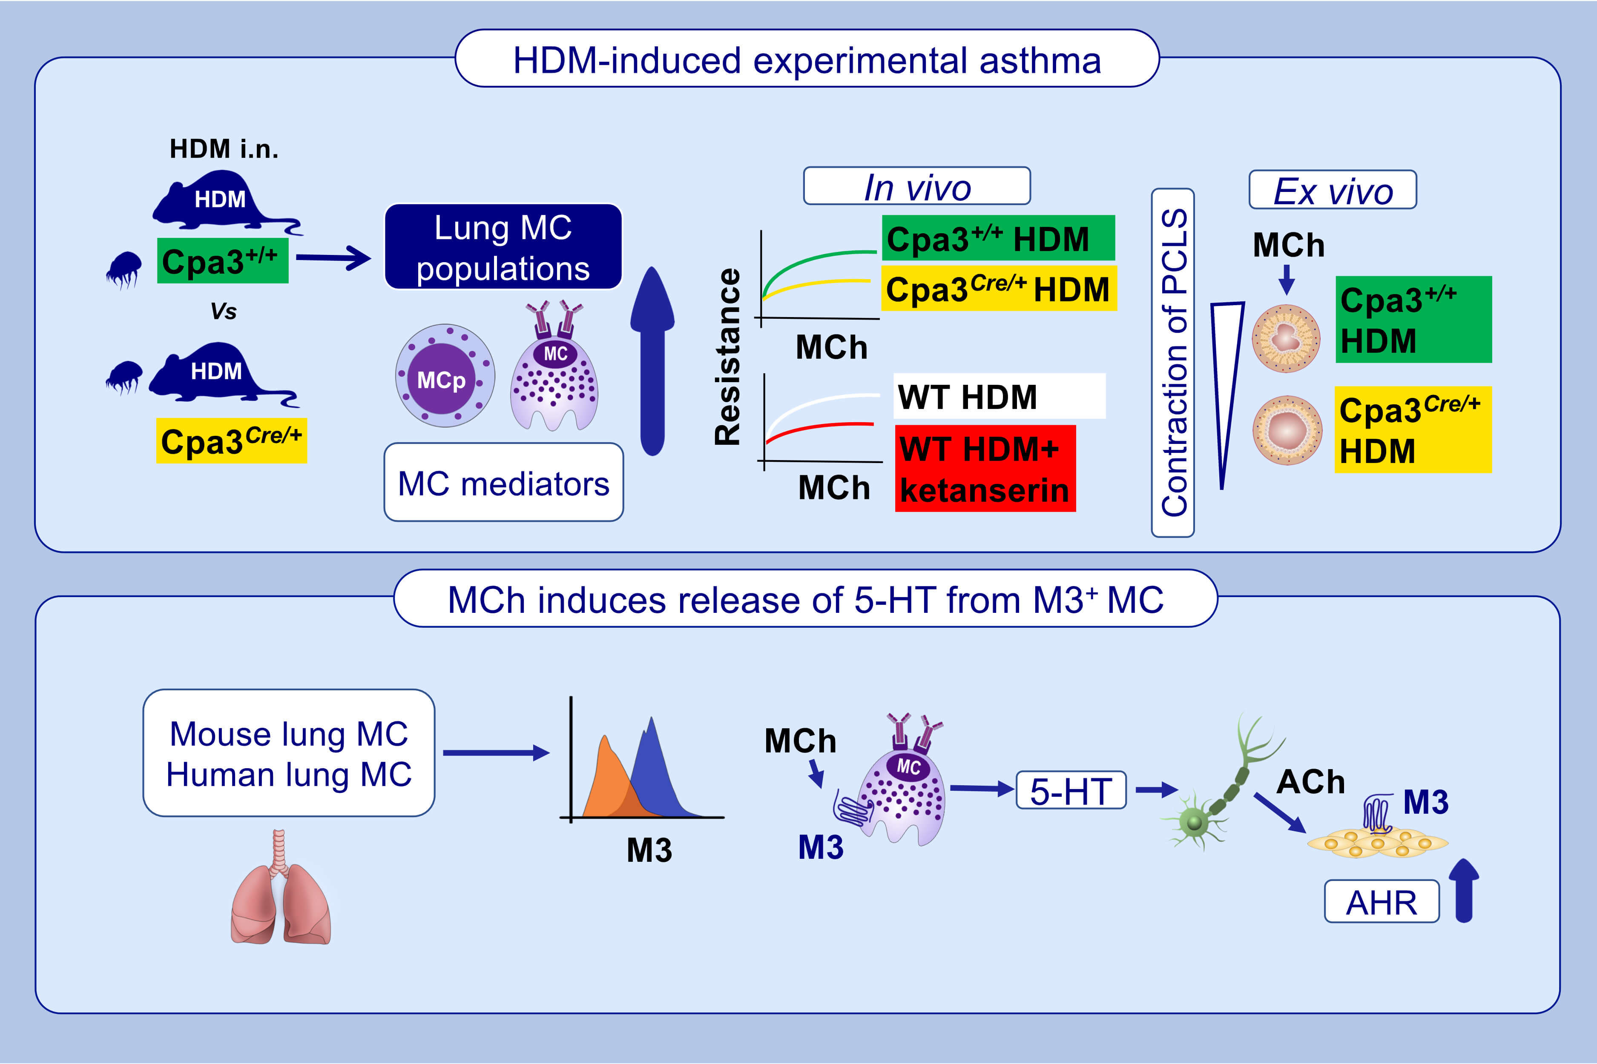
Mast cell-derived serotonin enhances methacholine-induced airway hyperresponsiveness in house dust mite-induced experimental asthma
Erika Mendez-Enriquez,, Perla Abigail Alvarado-Vazquez,, Willem Abma,, Oscar E. Simonson,, Sergey Rodin,, et al.
Allergy. 2021; 2057-2069 https://doi.org/10.1111/all.14748
© 2019 EAACI and John Wiley and Sons A/S. Published by John Wiley and Sons Ltd.
Notes:
HIGHLIGHTS
Lung mast cells expand and release mediators in mice with HDM-induced experimental asthma, and ketanserin (antagonizing 5-HT_{2A} receptors) blocks HDM-induced increased airway resistance to MCh in vivo.
Mast cell deficient Cpa3^{Cre/+} mice show decreased HDM-induced airway resistance to MCh in vivo (AHR), reduced contraction of airways to MCh ex vivo, and have impaired lung-associated 5-HT levels.
Lung mast cells express muscarinic M3 receptors and respond to MCh by releasing 5-HT, which likely acts on nerves to release ACh, thereby enhancing the contraction of bronchioles and AHR.
Abbreviations: ACh, acetylcholine; AHR, airway hyperresponsiveness; Cpa3, carboxypeptidase A3; 5-HT, serotonin; HDM, house dust mite; M3, muscarinic receptor 3; MC, mast cell; MCh, methacholine; MCp, mast cell progenitor; PCLS, precision cut lung slices

