Slide 1
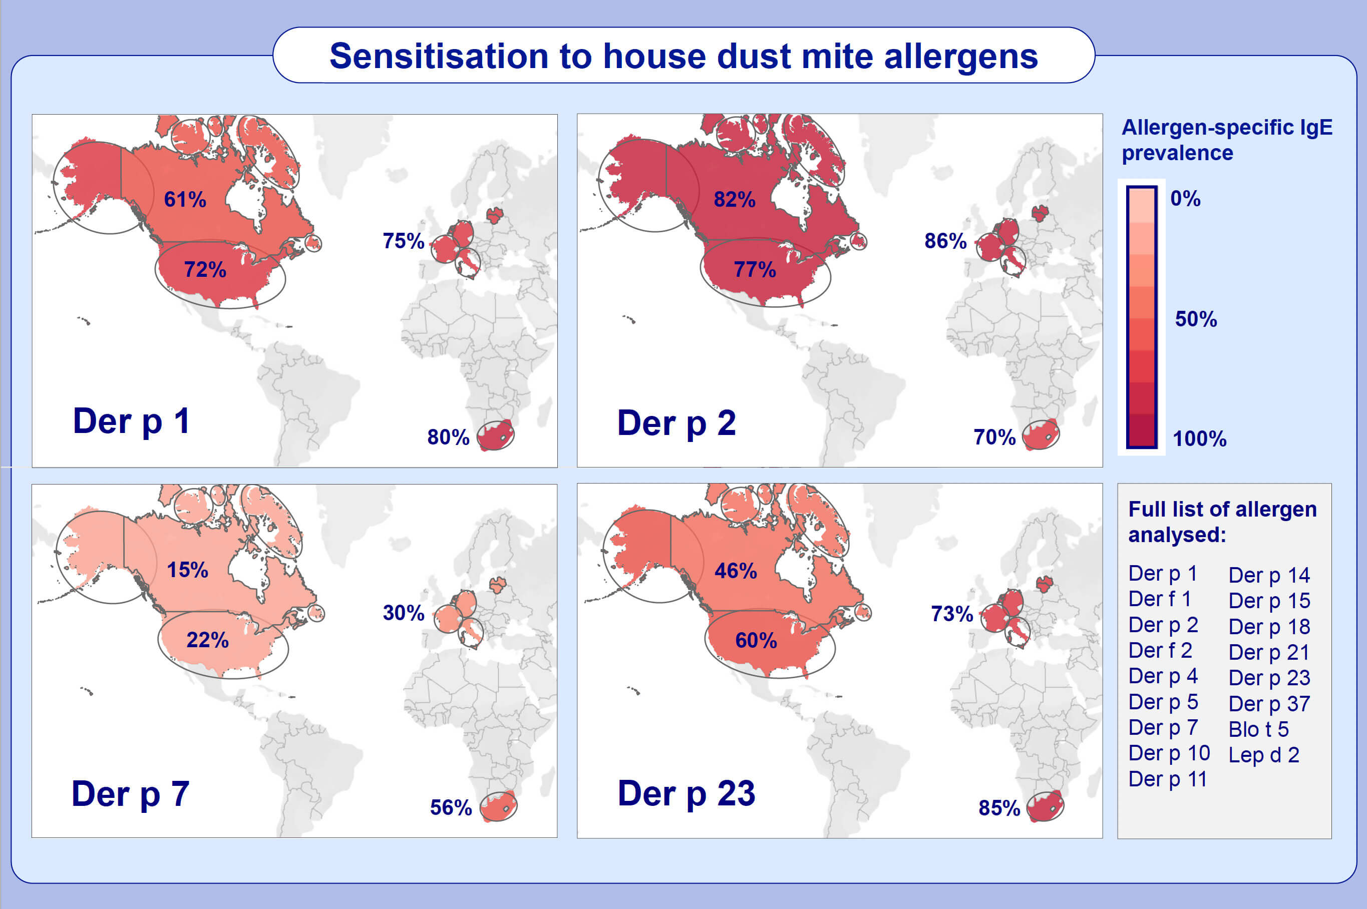
Comparison of house dust mite sensitization profiles in allergic adults from Canada, Europe, South Africa and USA
Varun Muddaluru,, Rudolf Valenta,, Susanne Vrtala,, Thomas Schlederer,, James Hindley,, et al.
Allergy. 2021; 2177-2188 https://doi.org/10.1111/all.14749
© 2019 EAACI and John Wiley and Sons A/S. Published by John Wiley and Sons Ltd.
Notes:
HIGHLIGHTS
IgE sensitization to major house dust mite allergens varies by geographic region.
Der p 23 is the dominant house dust mite allergen in South Africa.
Der p 7 is a major allergen in South Africa.

