Slide 1
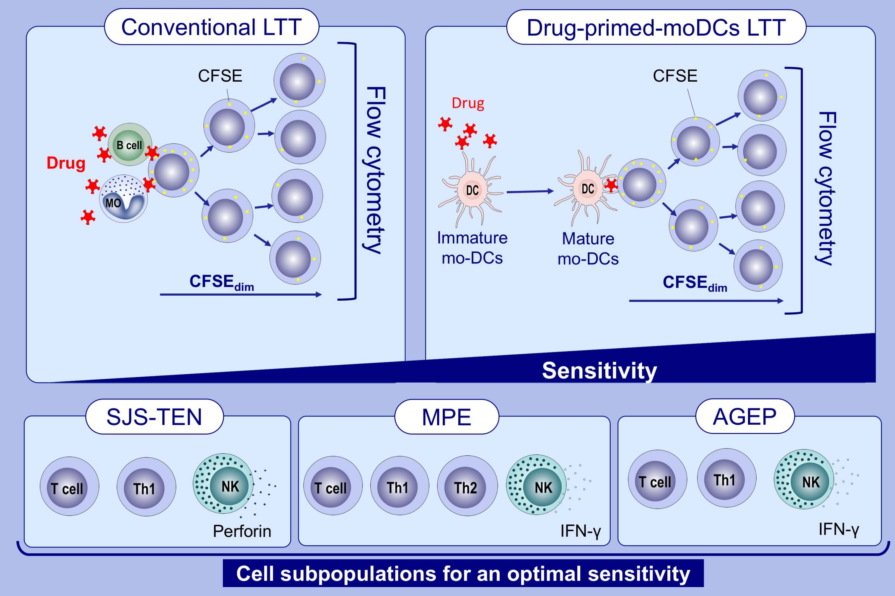
Dendritic cells inclusion and cell-subset assessment improve flow-cytometry-based proliferation test in non-immediate drug hypersensitivity reactions
Ruben Fernandez-Santamaria,, Gador Bogas,, Francisca Palomares,, Maria Salas,, Tahia D. Fernandez,, et al.
Allergy. 2021; 2123-2134 https://doi.org/10.1111/all.14755
© 2019 EAACI and John Wiley and Sons A/S. Published by John Wiley and Sons Ltd.
Notes:
HIGHLIGHTS
The use of monocyte-derived dendritic cells as drug presenting cells improves the sensitivity of LTT, being promising especially for evaluating severe NIDHRs.
The assessment of proliferative response in specific cell subpopulations depending on the clinical entity increases LTT sensitivity, is not good enough for MPE compared to severe reactions.
Flow cytometry-based LTT allows to evaluate NIDHRs with high sensitivity using a unique cellular in vitro test without the need of using radiolabelled reagents, especially for severe reactions.
Abbreviations: AGEP, acute generalised exanthematous pustulosis; CFSE, carboxyfluorescein diacetate succinimidyl ester; LTT, lymphocyte transformation test; mo-DCs, monocyte-derived dendritic cells; MPE, maculopapular exantemas; NIDHRs, non-immediate drug hypersensitivity reactions; SJS-TEN, Stevens-Johnson syndrome-toxic epidermal necrolysis

