Slide 1
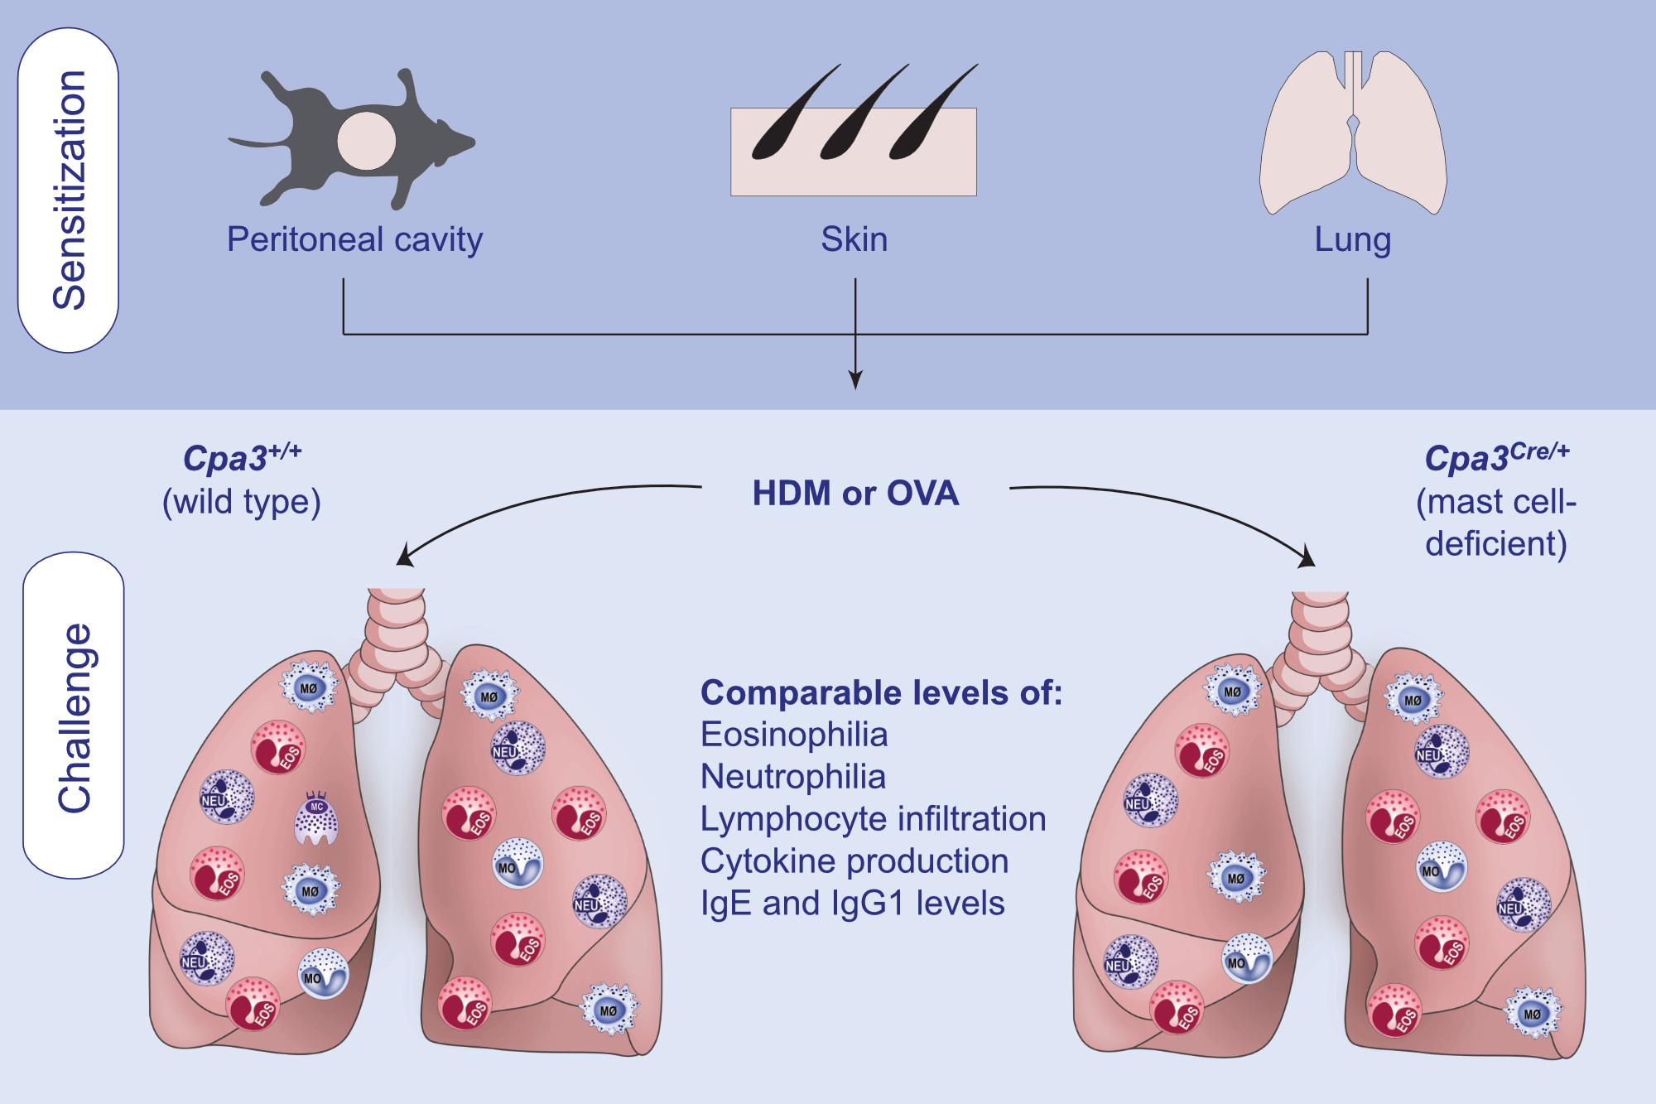
Comparative analysis of the role of mast cells in murine asthma models using Kit-sufficient mast cell-deficient animals
Lea Pohlmeier,, Sanchaita Sriwal Sonar,, Hans-Reimer Rodewald,, Manfred Kopf,, Luigi Tortola, et al.
Allergy. 2021; 2030-2043 https://doi.org/10.1111/all.14765
© 2019 EAACI and John Wiley and Sons A/S. Published by John Wiley and Sons Ltd.
Notes:
HIGHLIGHTS
Mast cell-deficient mice show similar levels of eosinophilia, neutrophilia and lymphocyte infiltration compared to wild-type littermates in several murine models of acute and chronic asthma.
The lack of mast cells does not alter cytokine production, IgE or IgG1 levels in any model.
Airway hyperresponsiveness or goblet cell hyperplasia is unaffected by the absence of mast cells in all models.
Abbreviations: Cpa3, carboxypeptidase A3; HDM, house dust mite; Ig, immunoglobulin; OVA, ovalbumin

