Slide 1
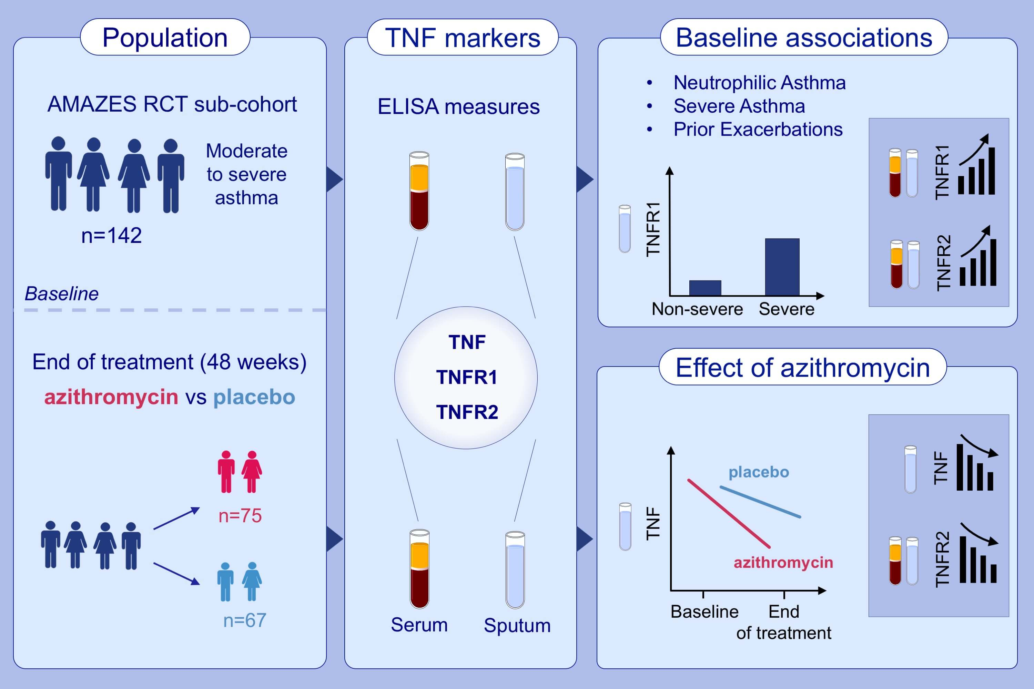
Sputum TNF markers are increased in neutrophilic and severe asthma and are reduced by azithromycin treatment
Natalie M. Niessen,, Peter G. Gibson,, Katherine J. Baines,, Daniel Barker,, Ian A. Yang,, et al.
Allergy. 2021; 2090-2101 https://doi.org/10.1111/all.14768
© 2019 EAACI and John Wiley and Sons A/S. Published by John Wiley and Sons Ltd.
Notes:
HIGHLIGHTS
Increased sputum and serum TNF markers are associated with neutrophilic asthma, severe asthma, and frequent exacerbation history.
Azithromycin treatment reduces airway and systemic TNF markers, suggesting an anti-inflammatory mechanism.
Azithromycin effect on TNF markers is most pronounced in non-eosinophilic asthma. Effect on serum but not sputum markers is related to sputum bacteria-positive culture, linking antibiotic effect to modulation of systemic inflammation.
Abbreviations: AMAZES-RCT, Asthma and Macrolides: The Azithromycin Efficacy and Safety study – Randomized Control Trial; TNF, tumor necrosis factor; TNFR, TNF receptor

