Slide 1
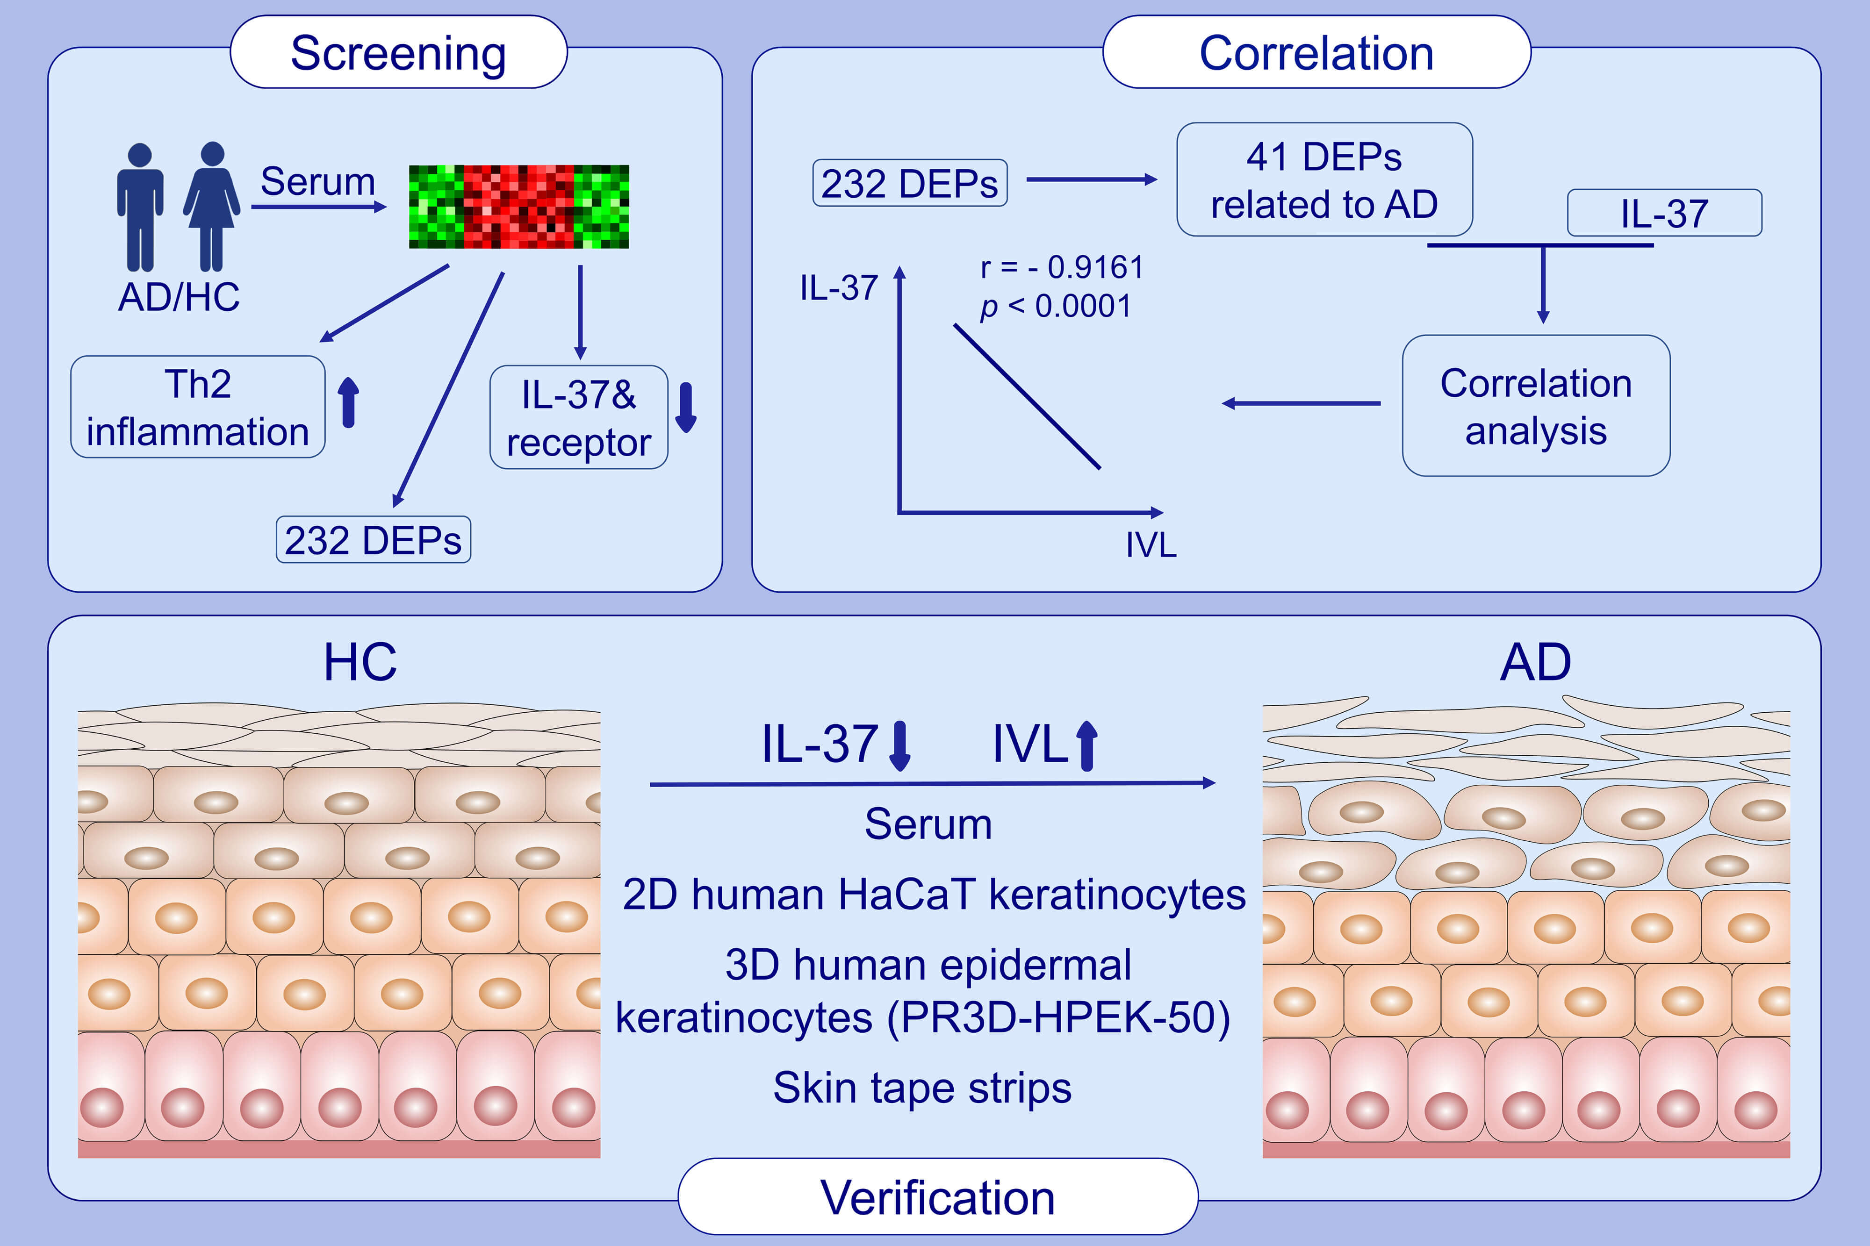
Skewed inflammation is associated with aberrant interleukin-37 signaling pathway in atopic dermatitis
Tianheng Hou,, Miranda Sin-Man Tsang,, Ida Miu-Ting Chu,, Lea Ling-Yu Kan,, Kam-Lun Hon,, et al.
Allergy. 2021; 2102-2114 https://doi.org/10.1111/all.14769
© 2019 EAACI and John Wiley and Sons A/S. Published by John Wiley and Sons Ltd.
Notes:
HIGHLIGHTS
Patients with AD show dysregulation of IL-37 and its receptor IL18Rɑ, Th2 inflammation and serum proteins compared to healthy controls.
IL-37 exhibit the strongest negative correlation with keratinizing epithelial IVL, one of the DEPs.
In vitro and ex vivo investigation suggest that decrease in IL-37 is negatively correlating with increase in IVL in damaged AD skin.
Abbreviations: AD, atopic dermatitis; DEPs, differentially expressed proteins; HC, healthy controls; IVL, involucrin

