Slide 1
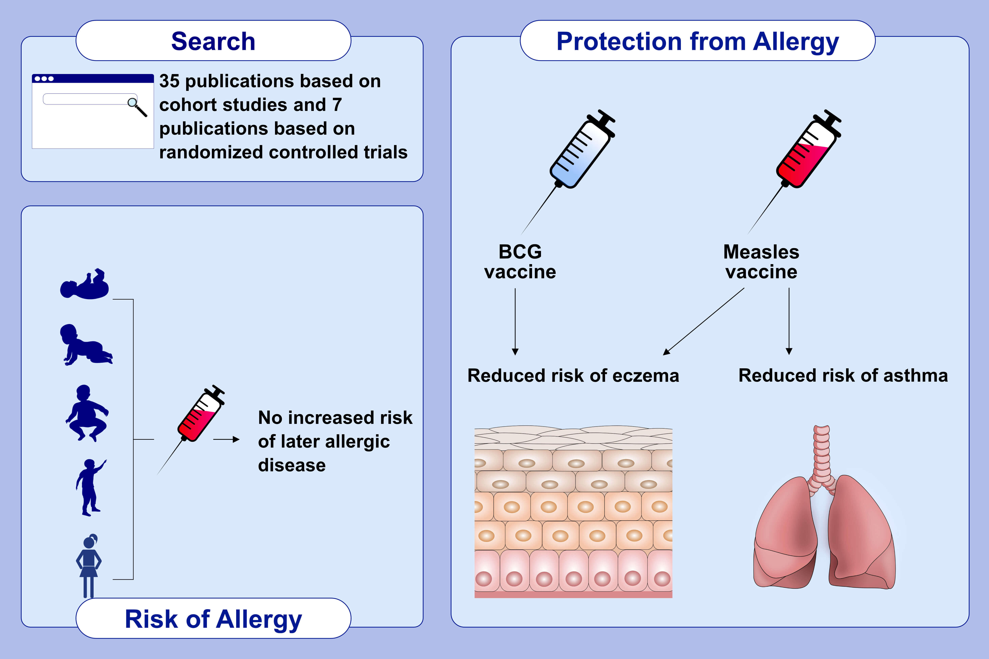
Childhood vaccination and allergy: A systematic review and meta-analysis
Samidi Navaratna,, Marie J. Estcourt,, John Burgess,, Nilakshi Waidyatillake,, Elizabeth Enoh,, et al.
Allergy. 2021; 2135-2152 https://doi.org/10.1111/all.14771
© 2019 EAACI and John Wiley and Sons A/S. Published by John Wiley and Sons Ltd.
Notes:
HIGHLIGHTS
A total of 35 publications based on cohort studies and 7 publications based on RCTs met the inclusion criteria for this systematic review.
We found no evidence that childhood vaccination with commonly administered vaccines are associated with increased risk of later allergic disease.
Our results from pooled analysis of both RCTs and cohort studies suggest that vaccination with BCG, and measles vaccines are associated with a reduced risk of eczema. In addition, childhood measles vaccination is associated with|
a reduced risk of asthma.
Abbreviations: BCG, Bacillus Calmette-Guérin; RTC, randomised controlled studies

