Slide 1
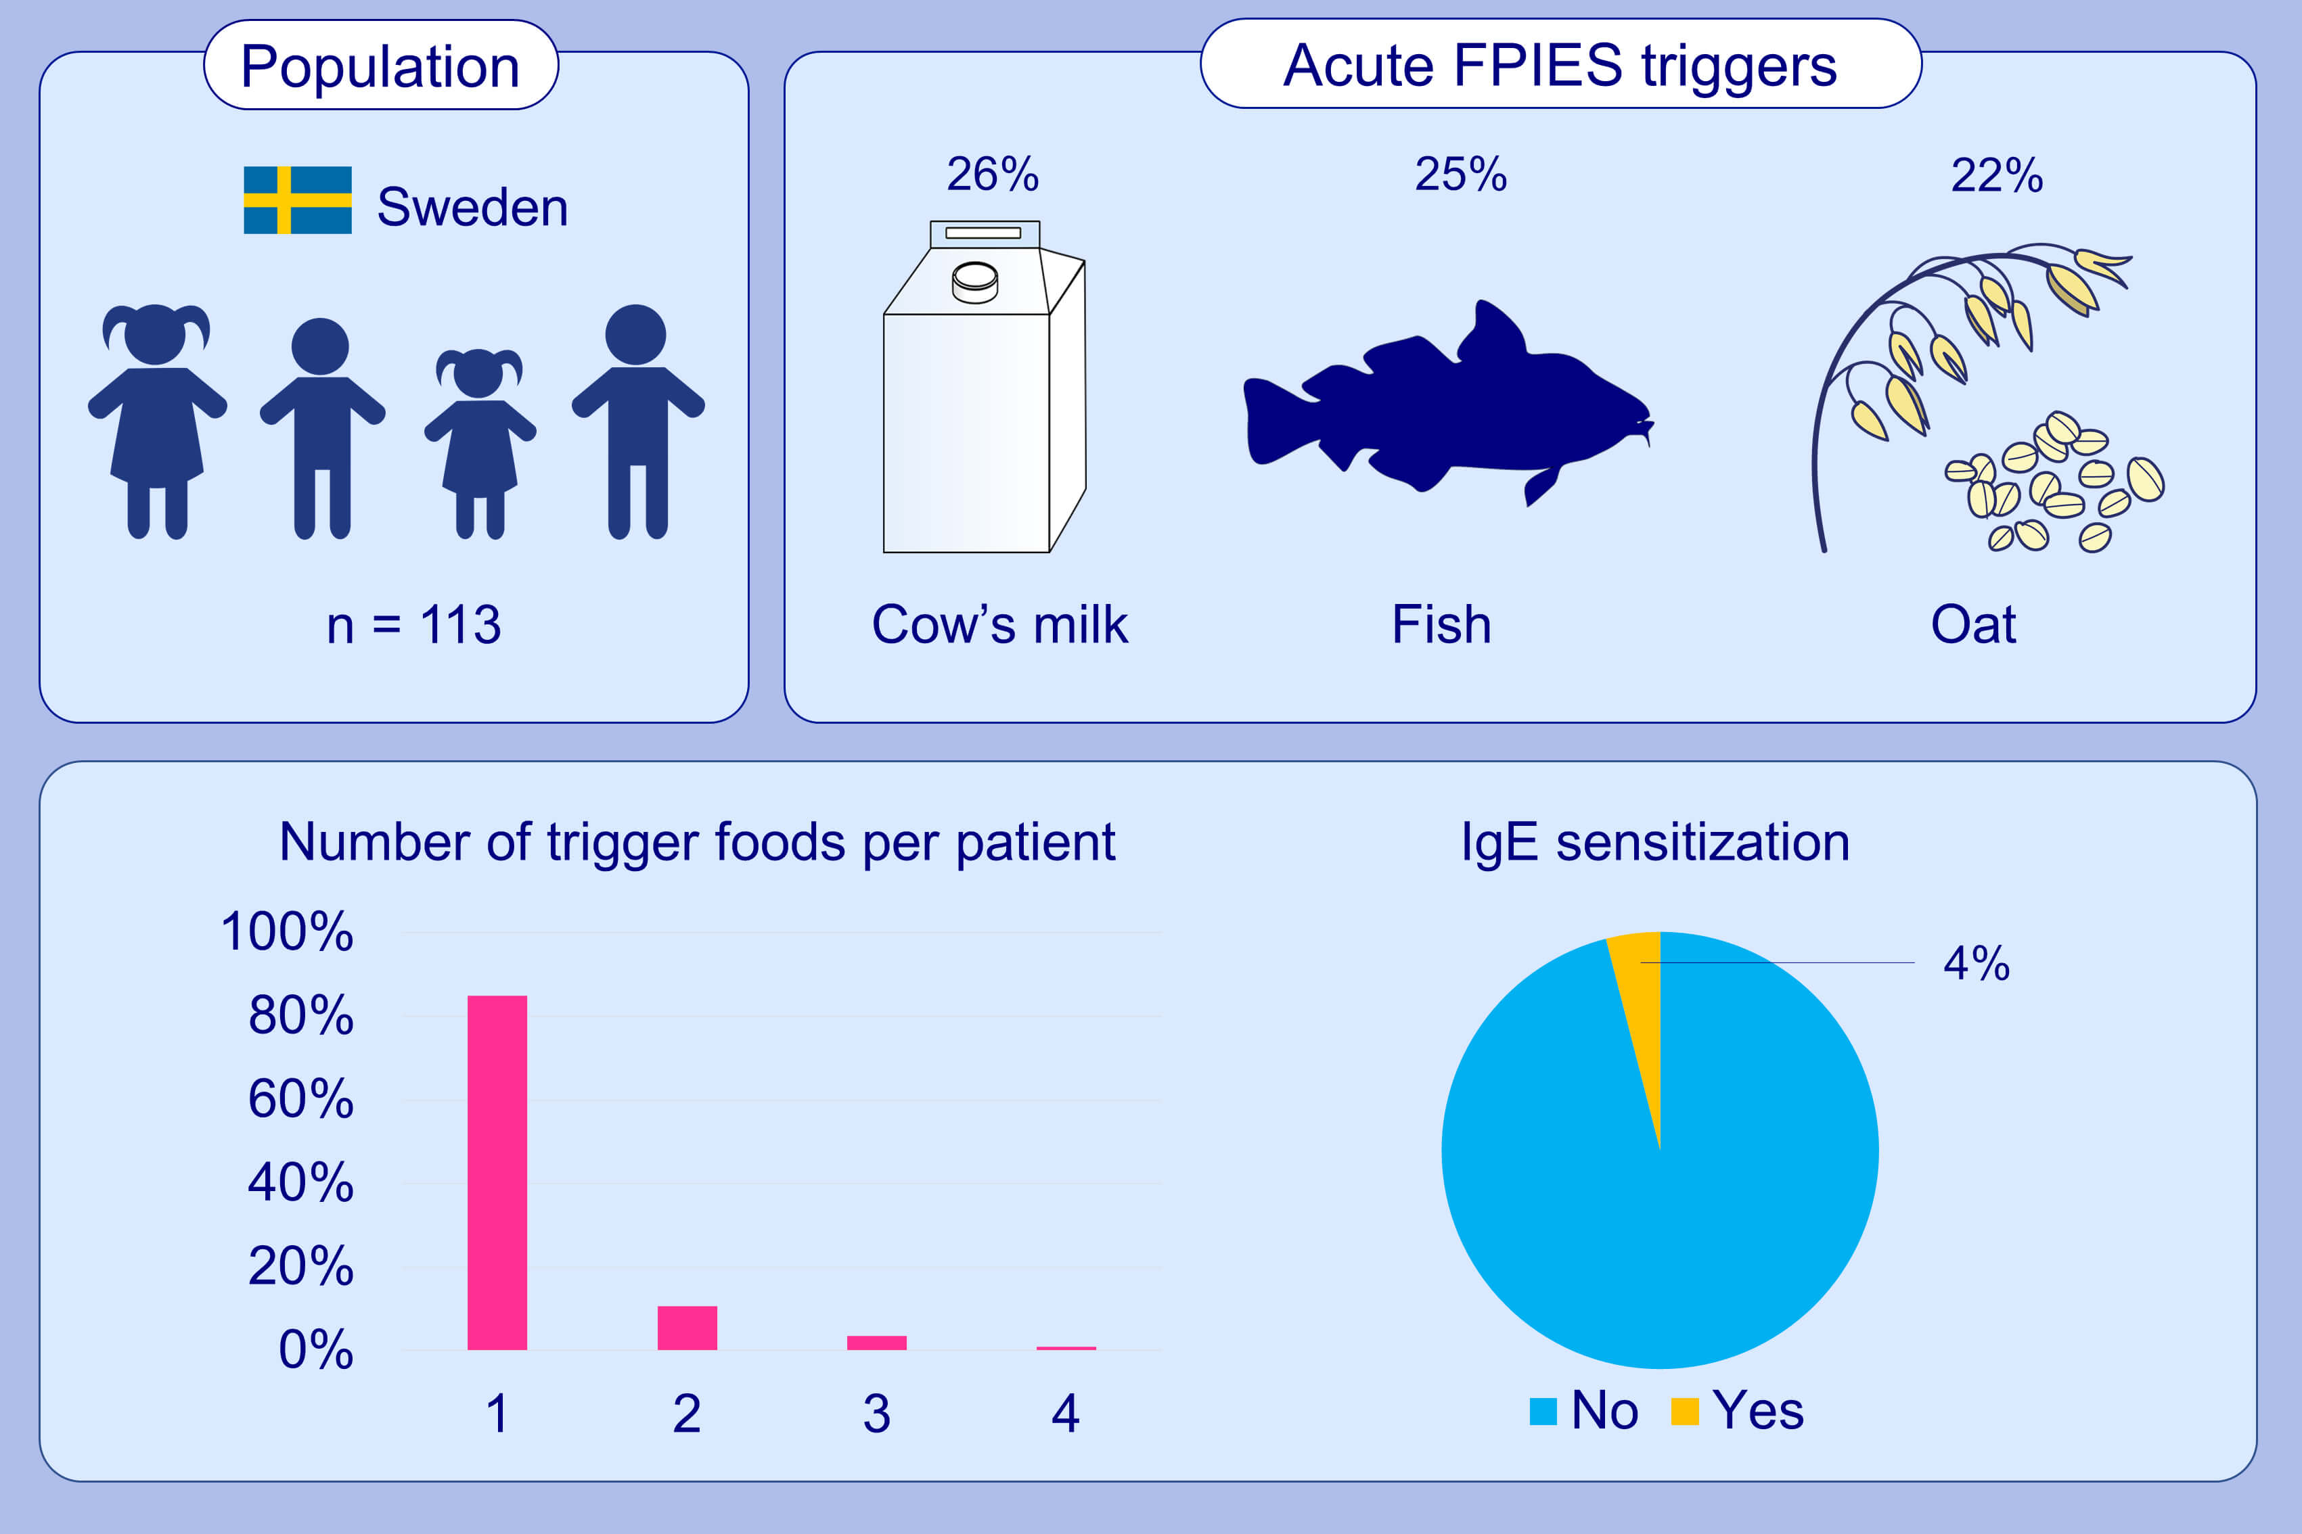
Clinical presentation and management of food protein-induced enterocolitis syndrome in 113 Swedish children
Josefin Ullberg,, Mareike Fech-Bormann,, Ulrika L. Fagerberg
Allergy. 2021; 2115-2122 https://doi.org/10.1111/all.14784
© 2019 EAACI and John Wiley and Sons A/S. Published by John Wiley and Sons Ltd.
Notes:
HIGHLIGHTS
Cow’s milk (26%), fish (25%) and oat (22%) are the most frequent acute FPIES triggers in our Swedish pediatric study of 113 patients.
Most children react to a single food (85 %).
IgE sensitization is rare (4 %).
Abbreviations: FPIES, food protein-induced enterocolitis syndrome

