Slide 1
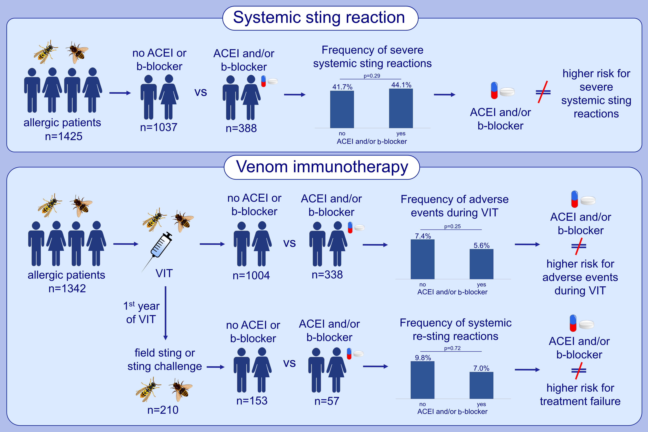
β-blockers and ACE inhibitors are not a risk factor for severe systemic sting reactions and adverse events during venom immunotherapy
Gunter Johannes Sturm,, Sereina Annik Herzog,, Werner Aberer,, Teresa Alfaya Arias,, Darío Antolín-Amérigo,, et al.
Allergy. 2021; 2166-2176 https://doi.org/10.1111/all.14785
© 2019 EAACI and John Wiley and Sons A/S. Published by John Wiley and Sons Ltd.
Notes:
HIGHLIGHTS
Patients under antihypertensive treatment with β-blockers and ACEI do not have a higher risk for severe insect sting reactions.
The intake of β-blockers and ACEI does not increase the frequency of systemic adverse events during VIT.
Results suggest that β-blockers and ACEI do not impair VIT effectiveness.
Abbreviations: ACEI, angiotensin converting enzyme inhibitor; VIT, venom immunotherapy
.

