Slide 1
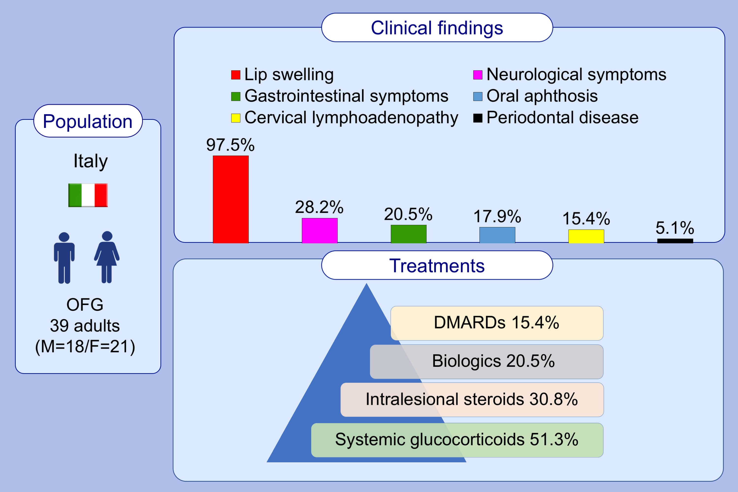
Orofacial granulomatosis: Clinical and therapeutic features in an Italian cohort and review of the literature
Maria R. Galdiero,, Filomena Maio,, Francesco Arcoleo,, Elisa Boni,, Laura Bonzano,, et al.
Allergy. 2021; 2189-2200 https://doi.org/10.1111/all.14799
© 2019 EAACI and John Wiley and Sons A/S. Published by John Wiley and Sons Ltd.
Notes:
HIGHLIGHTS
This article provides a description of clinical features of 39 patients with OFG, a granulomatous inflammatory disease of soft tissues of maxillofacial regions.
In the majority of patients, lip swelling is the first clinical manifestation of disease.
Intralesional corticosteroids are a cornerstone of treatment and show the highest response rate in these patients.
Abbreviation: DMARDs, disease-modifying anti-rheumatic drugs; OFG, orofacial granulomatosis

