Slide 1
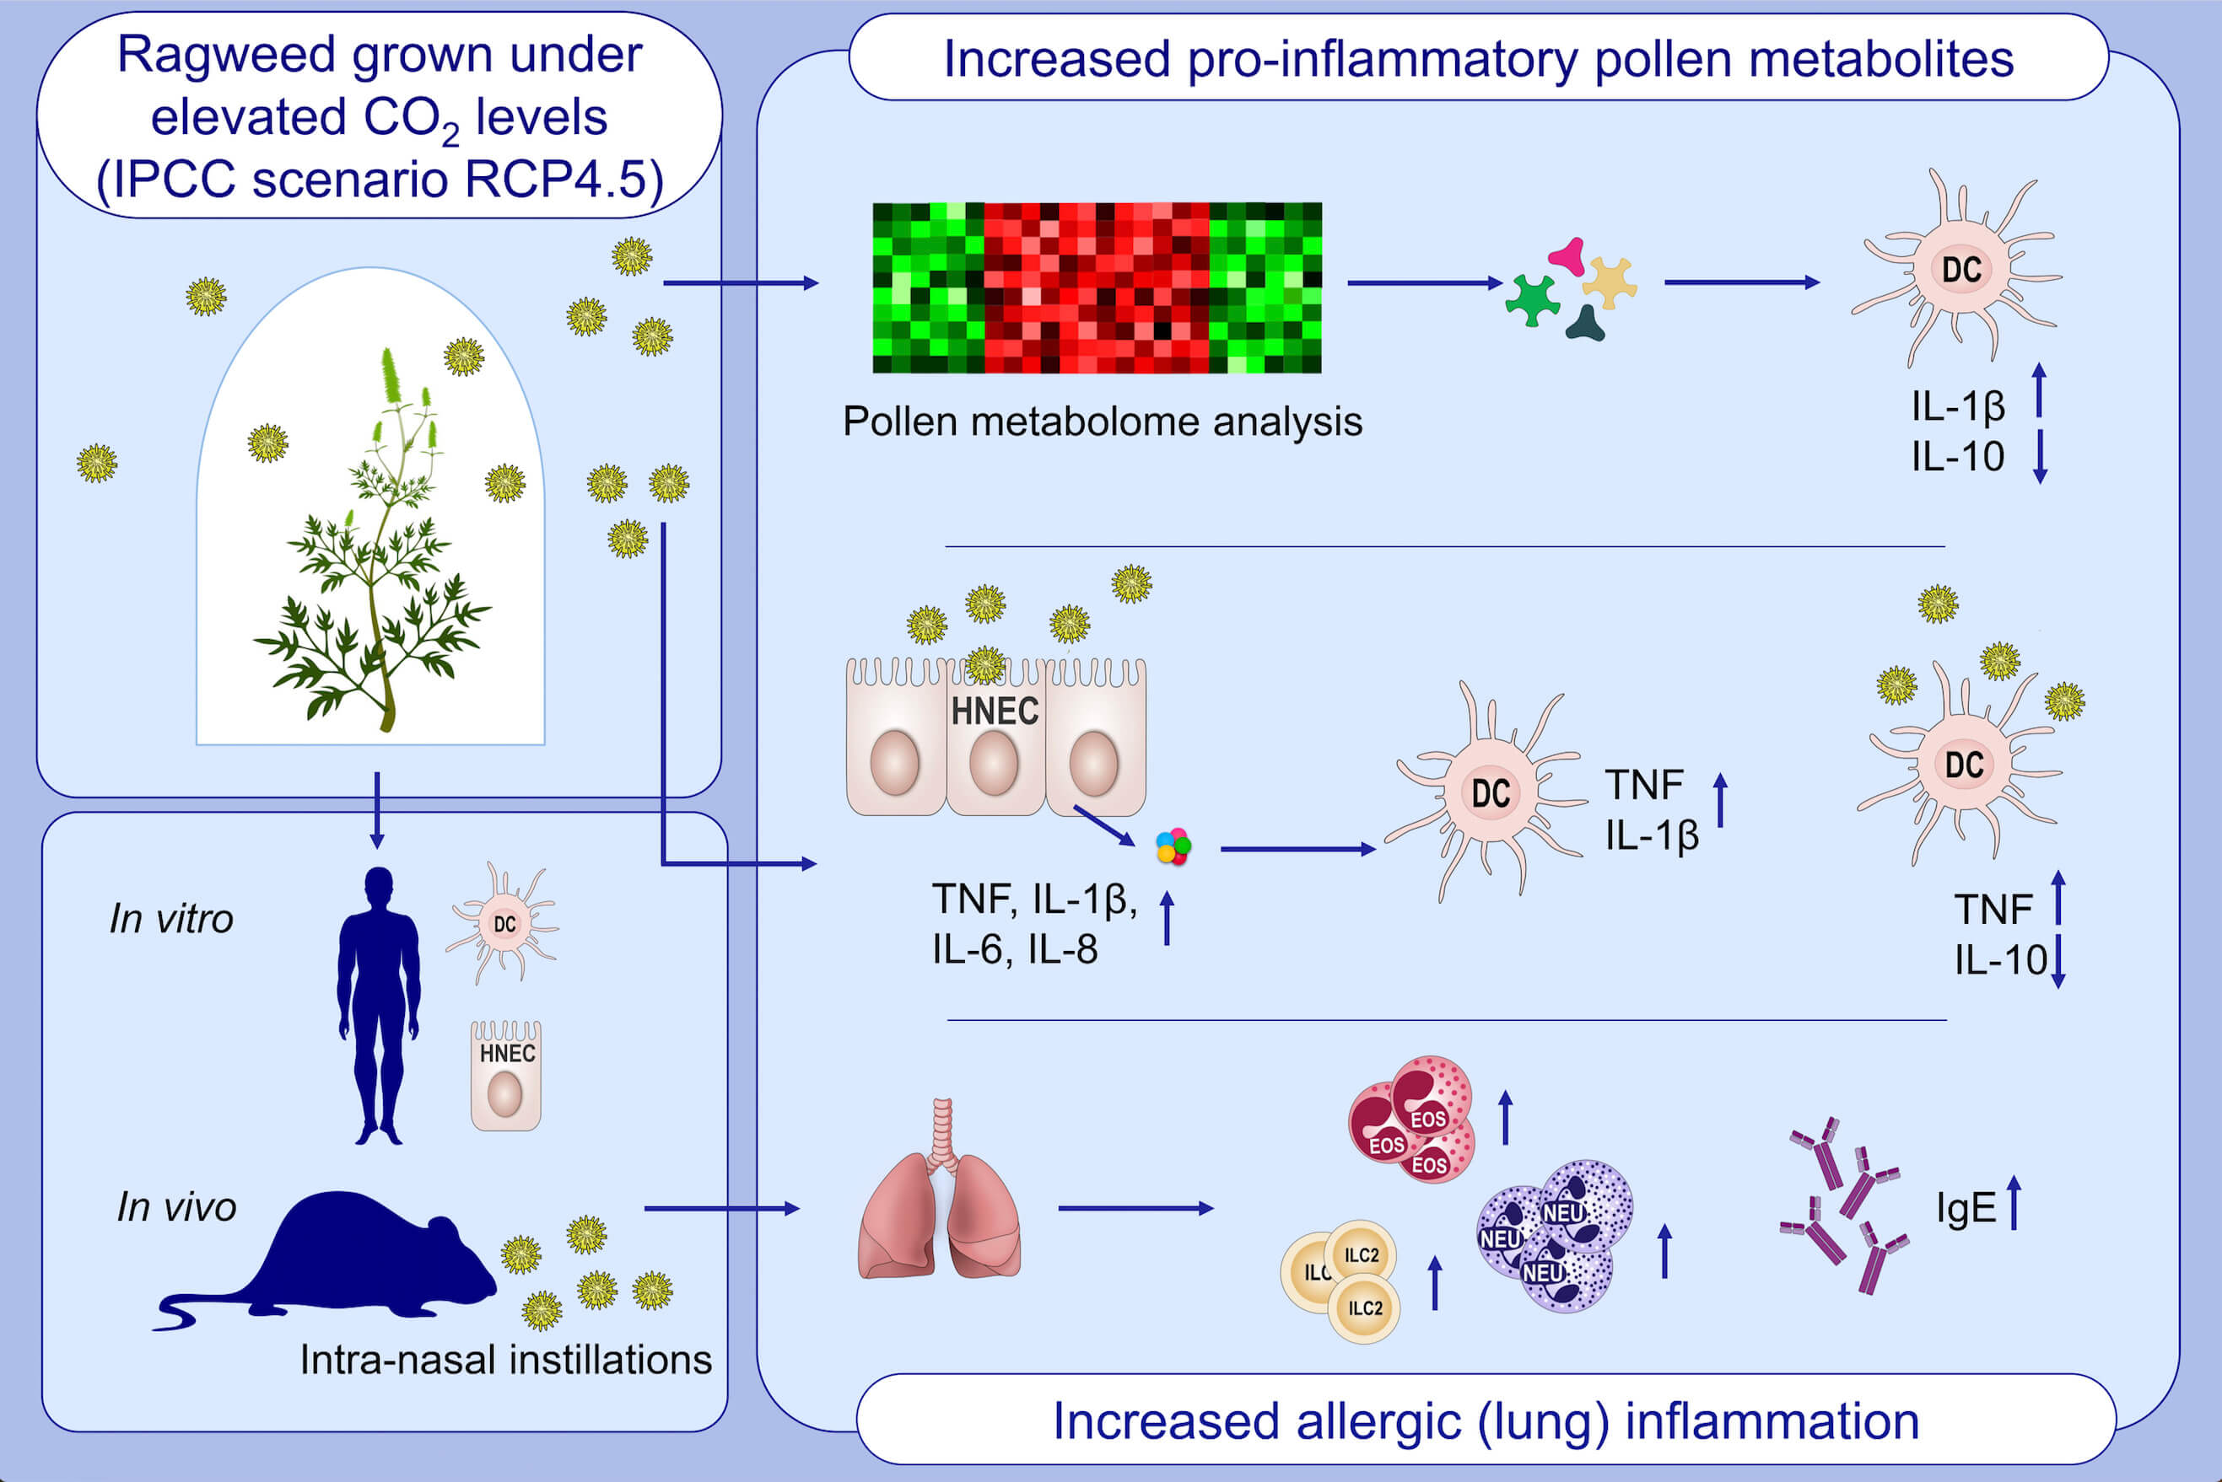
Ragweed plants grown under elevated CO2 levels produce pollen which elicit stronger allergic lung inflammation
Denise Rauer,, Stefanie Gilles,, Maria Wimmer,, Ulrike Frank,, Constanze Mueller,, et al.
Allergy. 2021; 1718-1730 https://doi.org/10.1111/all.14618
© 2019 EAACI and John Wiley and Sons A/S. Published by John Wiley and Sons Ltd.
Notes:
HIGHLIGHTS
Pollen from ragweed grown under elevated CO₂ levels (700 ppm, based on RCP4.5 scenario) elicit a stronger allergic inflammatory response in vitro and in vivo by:
Enhancing pro-inflammatory cytokine release in DCs stimulated with RWE or RWE-conditioned HNEC supernatants
Increasing lung inflammatory infiltrate and serum total IgE
Increased allergenicity of CO₂-RWE depends on the interplay of multiple metabolites.
Abbreviations: DC, human monocyte-derived dendritic cells; HNEC, human nasal epithelial cells; RWE, ragweed pollen extract; ILC, innate lymphoid cells; TNF, tumor necrosis factor; IPCC, Intergovernmental Panel on Climate Change; RCP, representative concentration pathway

