Slide 1
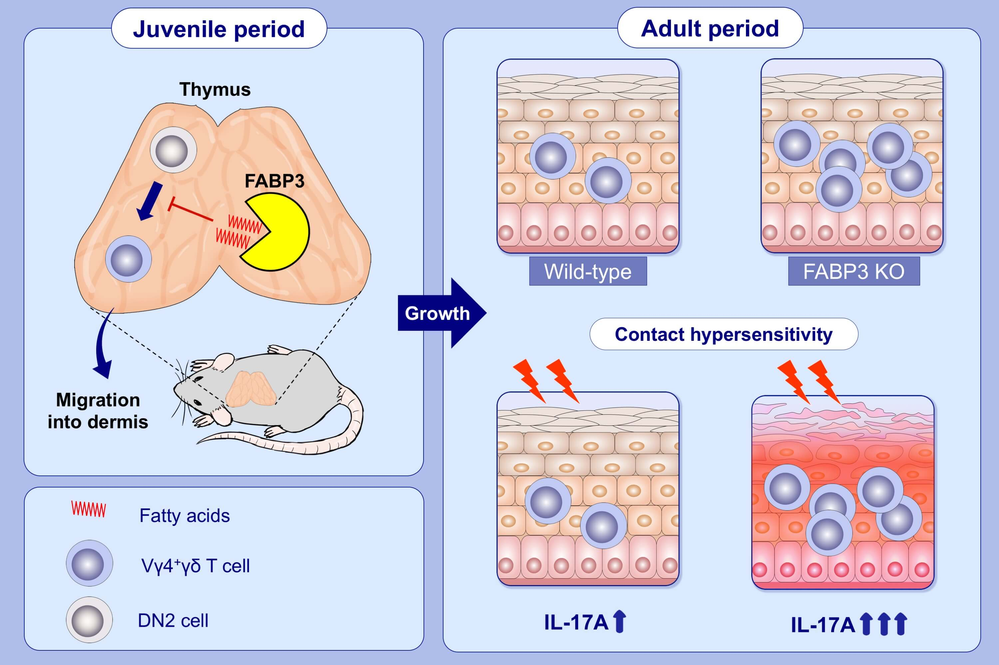
Fatty acid-binding protein 3 controls contact hypersensitivity through regulating skin dermal Vγ4+ γ/δ T cell in a murine model
Shuhei Kobayashi,, Hai The Phung,, Yoshiteru Kagawa,, Hirofumi Miyazaki,, Yu Takahashi,, et al.
Allergy. 2021; 1776-1788 https://doi.org/10.1111/all.14630
© 2019 EAACI and John Wiley and Sons A/S. Published by John Wiley and Sons Ltd.
Notes:
HIGHLIGHTS
FABP3 negatively regulates the differentiation of thymic DN2 cells into Vγ4⁺ γ/δ T cells.
FABP3-deficient mice exhibit higher frequency of Vγ4⁺ γ/δ T cells in skin of both juvenile and adults.
FABP3 deficiency in Vγ4⁺ γ/δ T cells enhances production of high amounts of IL-17A, which contributes to the pathogenesis of contact hypersensitivity.
Abbreviations: DN2, double negative cell; FABP3, fatty acid-binding protein 3; KO, knockout

