Slide 1
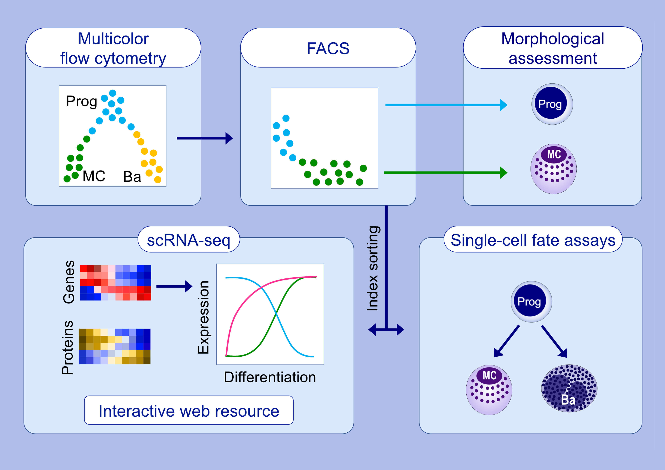
Single-cell molecular profiling provides a high-resolution map of basophil and mast cell development
Fiona K. Hamey,, Winnie W.Y. Lau,, Iwo Kucinski,, Xiaonan Wang,, Evangelia Diamanti,, et al.
Allergy. 2021; 1731-1742 https://doi.org/10.1111/all.14633
© 2019 EAACI and John Wiley and Sons A/S. Published by John Wiley and Sons Ltd.
Notes:
HIGHLIGHTS
Flow cytometry and single-cell gene expression data reconstruct a roadmap
of mouse basophil and mast cell differentiation.
Cell fate assays show that previously uncharacterized peritoneal progenitors can differentiate into both basophils and mast cells.
An interactive web resource enables the wider research community to explore the gene expression dynamics of differentiating cells.
Abbreviations: Ba, basophil; FACS, fluorescence-activated cell sorting; MC, mast cell; Prog, progenitor; scRNA-seq, single-cell RNA sequencing.

