Slide 1
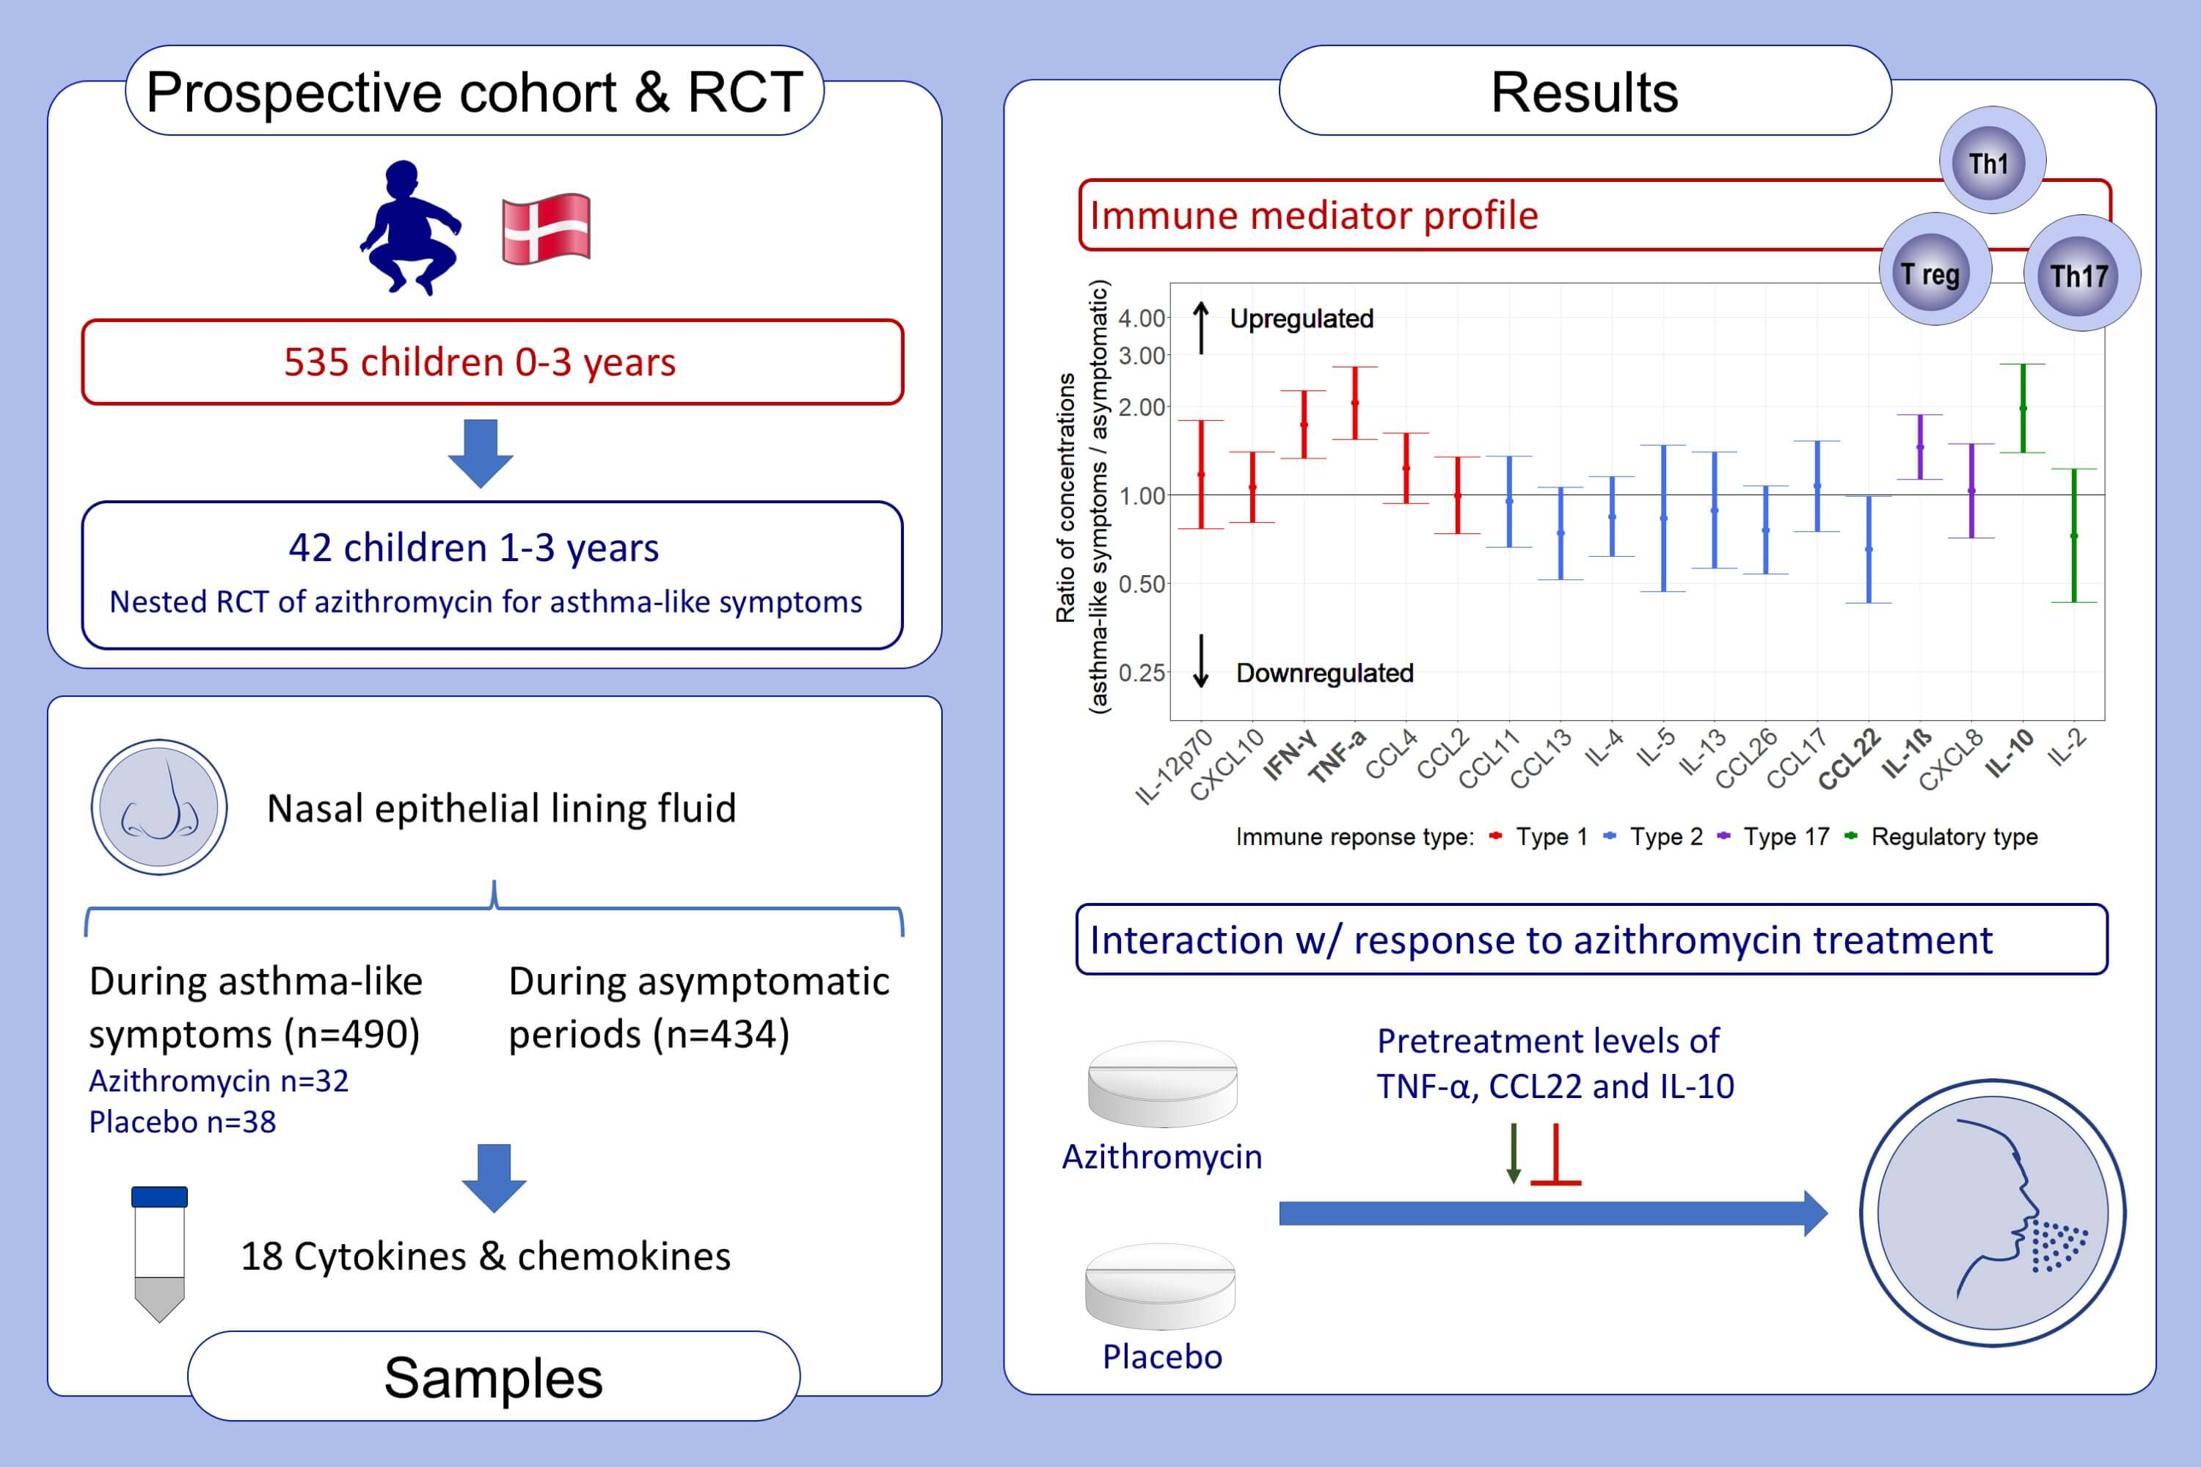
Airway immune mediator levels during asthma-like symptoms in young children and their possible role in response to azithromycin
Christian J. Carlsson,, Morten A. Rasmussen,, Susanne B. Pedersen,, Ni Wang,, Jakob Stokholm,, et al.
Allergy. 2021; 1754-1764 https://doi.org/10.1111/all.14651
© 2019 EAACI and John Wiley and Sons A/S. Published by John Wiley and Sons Ltd.
Notes:
HIGHLIGHTS
IFN-ɣ, TNF-α, IL-1β and IL-10 were upregulated in the upper airway mucosa whereas CCL22 was relatively downregulated during episodes of asthma-like symptoms compared to asymptomatic periods in young children.
The immune mediator profile is consistent with neutrophilic inflammation as the primary acute disease process during such episodes.
TNF-α, IL-10 and CCL22 predicted treatment effect of azithromycin for episodes of asthma-like symptoms, with improved responses in episodes where the child was unable to mount a sufficient response of TNF-α and IL-10 while having a relatively increased expression of CCL22 (i.e. mediator levels opposite to what was typically observed during episodes of asthma-like symptoms). $
Abbreviations: CCL22, C-C motif chemokine 22; IFN-ɣ, interferon gamma; IL-10, interleukin 10; RCT, randomized controlled trial; TNF-α, tumor necrosis factor alpha

