Slide 1
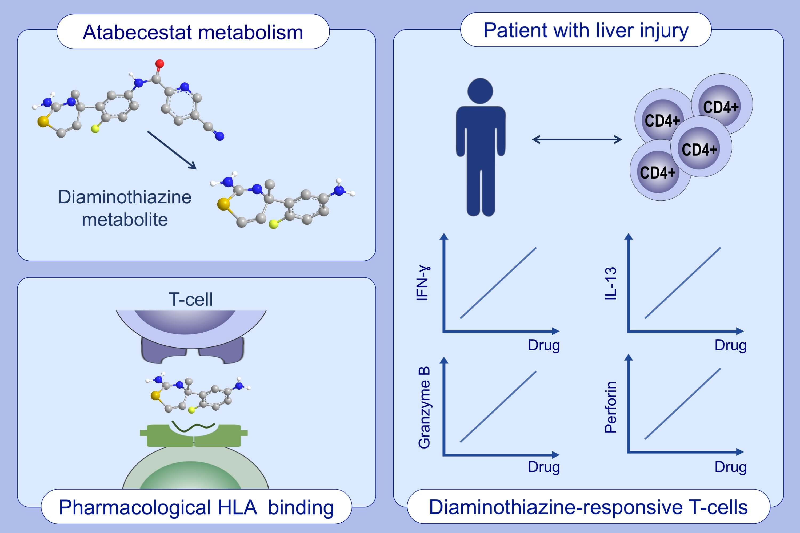
Drug-specific T-cell responses in patients with liver injury following treatment with the BACE inhibitor atabecestat
Paul J. Thomson,, Laila Kafu,, Xiaoli Meng,, Jan Snoeys,, An De Bondt,, et al.
Allergy. 2021; 1825-1835 https://doi.org/10.1111/all.14652
© 2019 EAACI and John Wiley and Sons A/S. Published by John Wiley and Sons Ltd.
Notes:
HIGHLIGHTS
The atabecestat diaminothiazine metabolite activates T-cells from patients with atabecestat-associated liver injury.
CD4+ T-cell clones are activated through a direct, non-covalent drug (metabolite)-HLA class II interaction with no requirement for protein processing.
It is likely that the adverse reactions experienced by these patients while on treatment with atabecestat were mediated at least in part by drug-responsive CD4+ T-cells.

