Slide 1
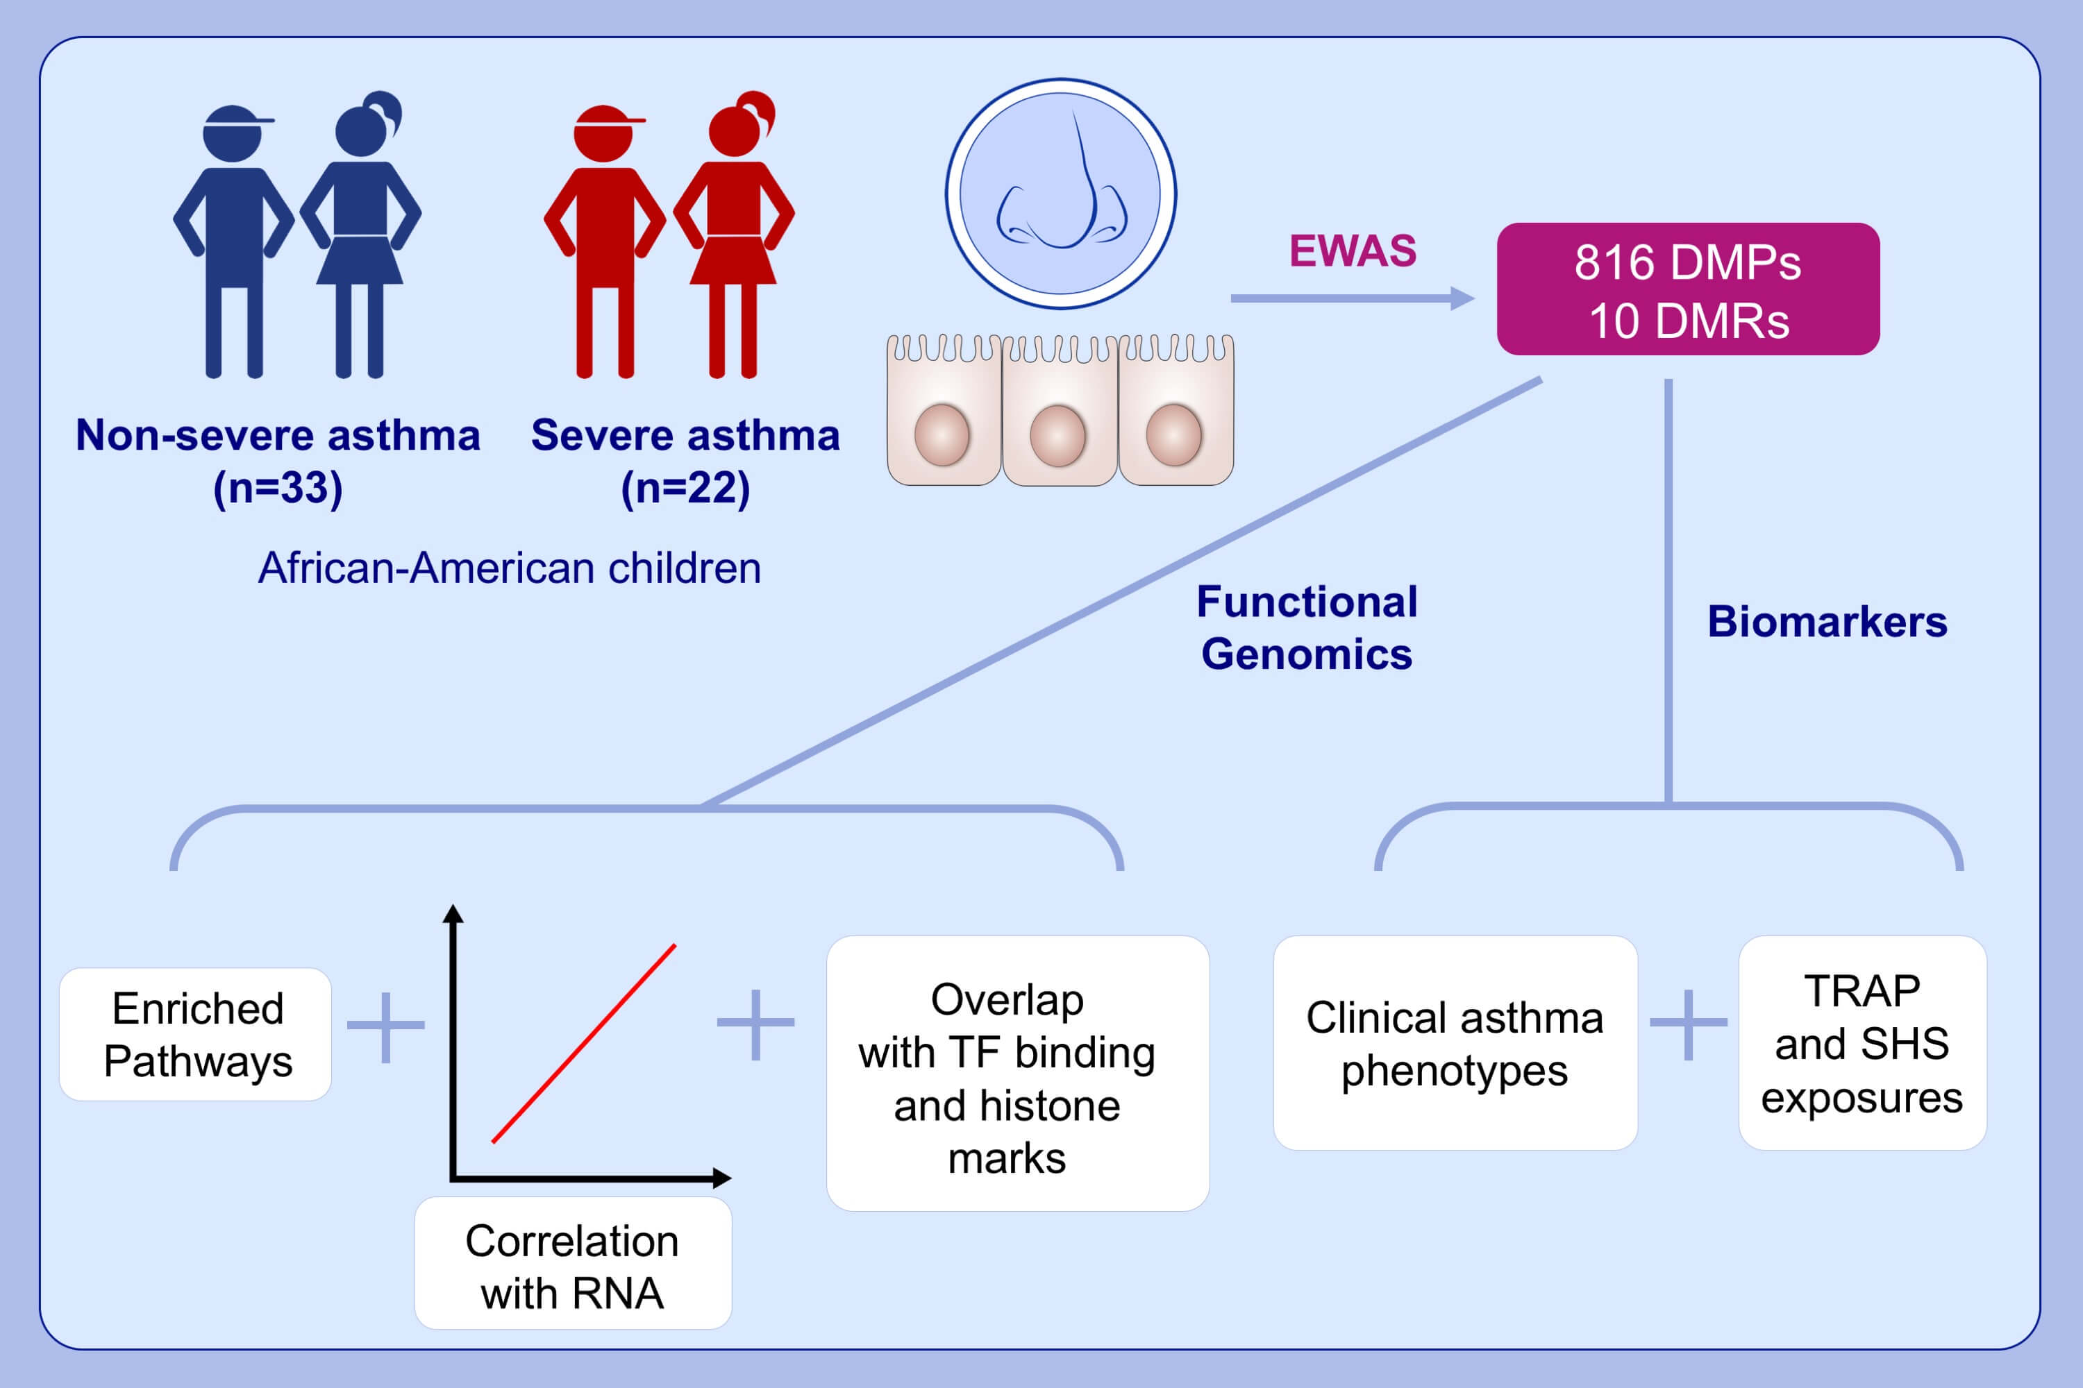
Nasal DNA methylation differentiates severe from non-severe asthma in African-American children
Tao Zhu,, Xue Zhang,, Xiaoting Chen,, Anthony P. Brown,, Matthew T. Weirauch,, et al.
Allergy. 2021; 1836-1845 https://doi.org/10.1111/all.14655
© 2019 EAACI and John Wiley and Sons A/S. Published by John Wiley and Sons Ltd.
Notes:
HIGHLIGHTS
816 DMPs and 10 DMRs associated with asthma severity were identified in nasal epithelial cells from children.
Asthma-severity-associated DMPs correlate with gene expression and locate near TF binding sites and regulatory histone marks.
Three DMPs showed potential in predicting severe asthma. Six DMPs were associated with clinical asthma phenotypes. Twenty-seven DMPs were associated with TRAP or SHS.
Abbreviations: DMPs, differentially methylated CpG positions; DMRs, differential ethylated regions; EWAS, epigenome-wide association studies; TF, transcription factor; TRAP, traffic-related air pollution; SHS, secondhand smoke

