Slide 1
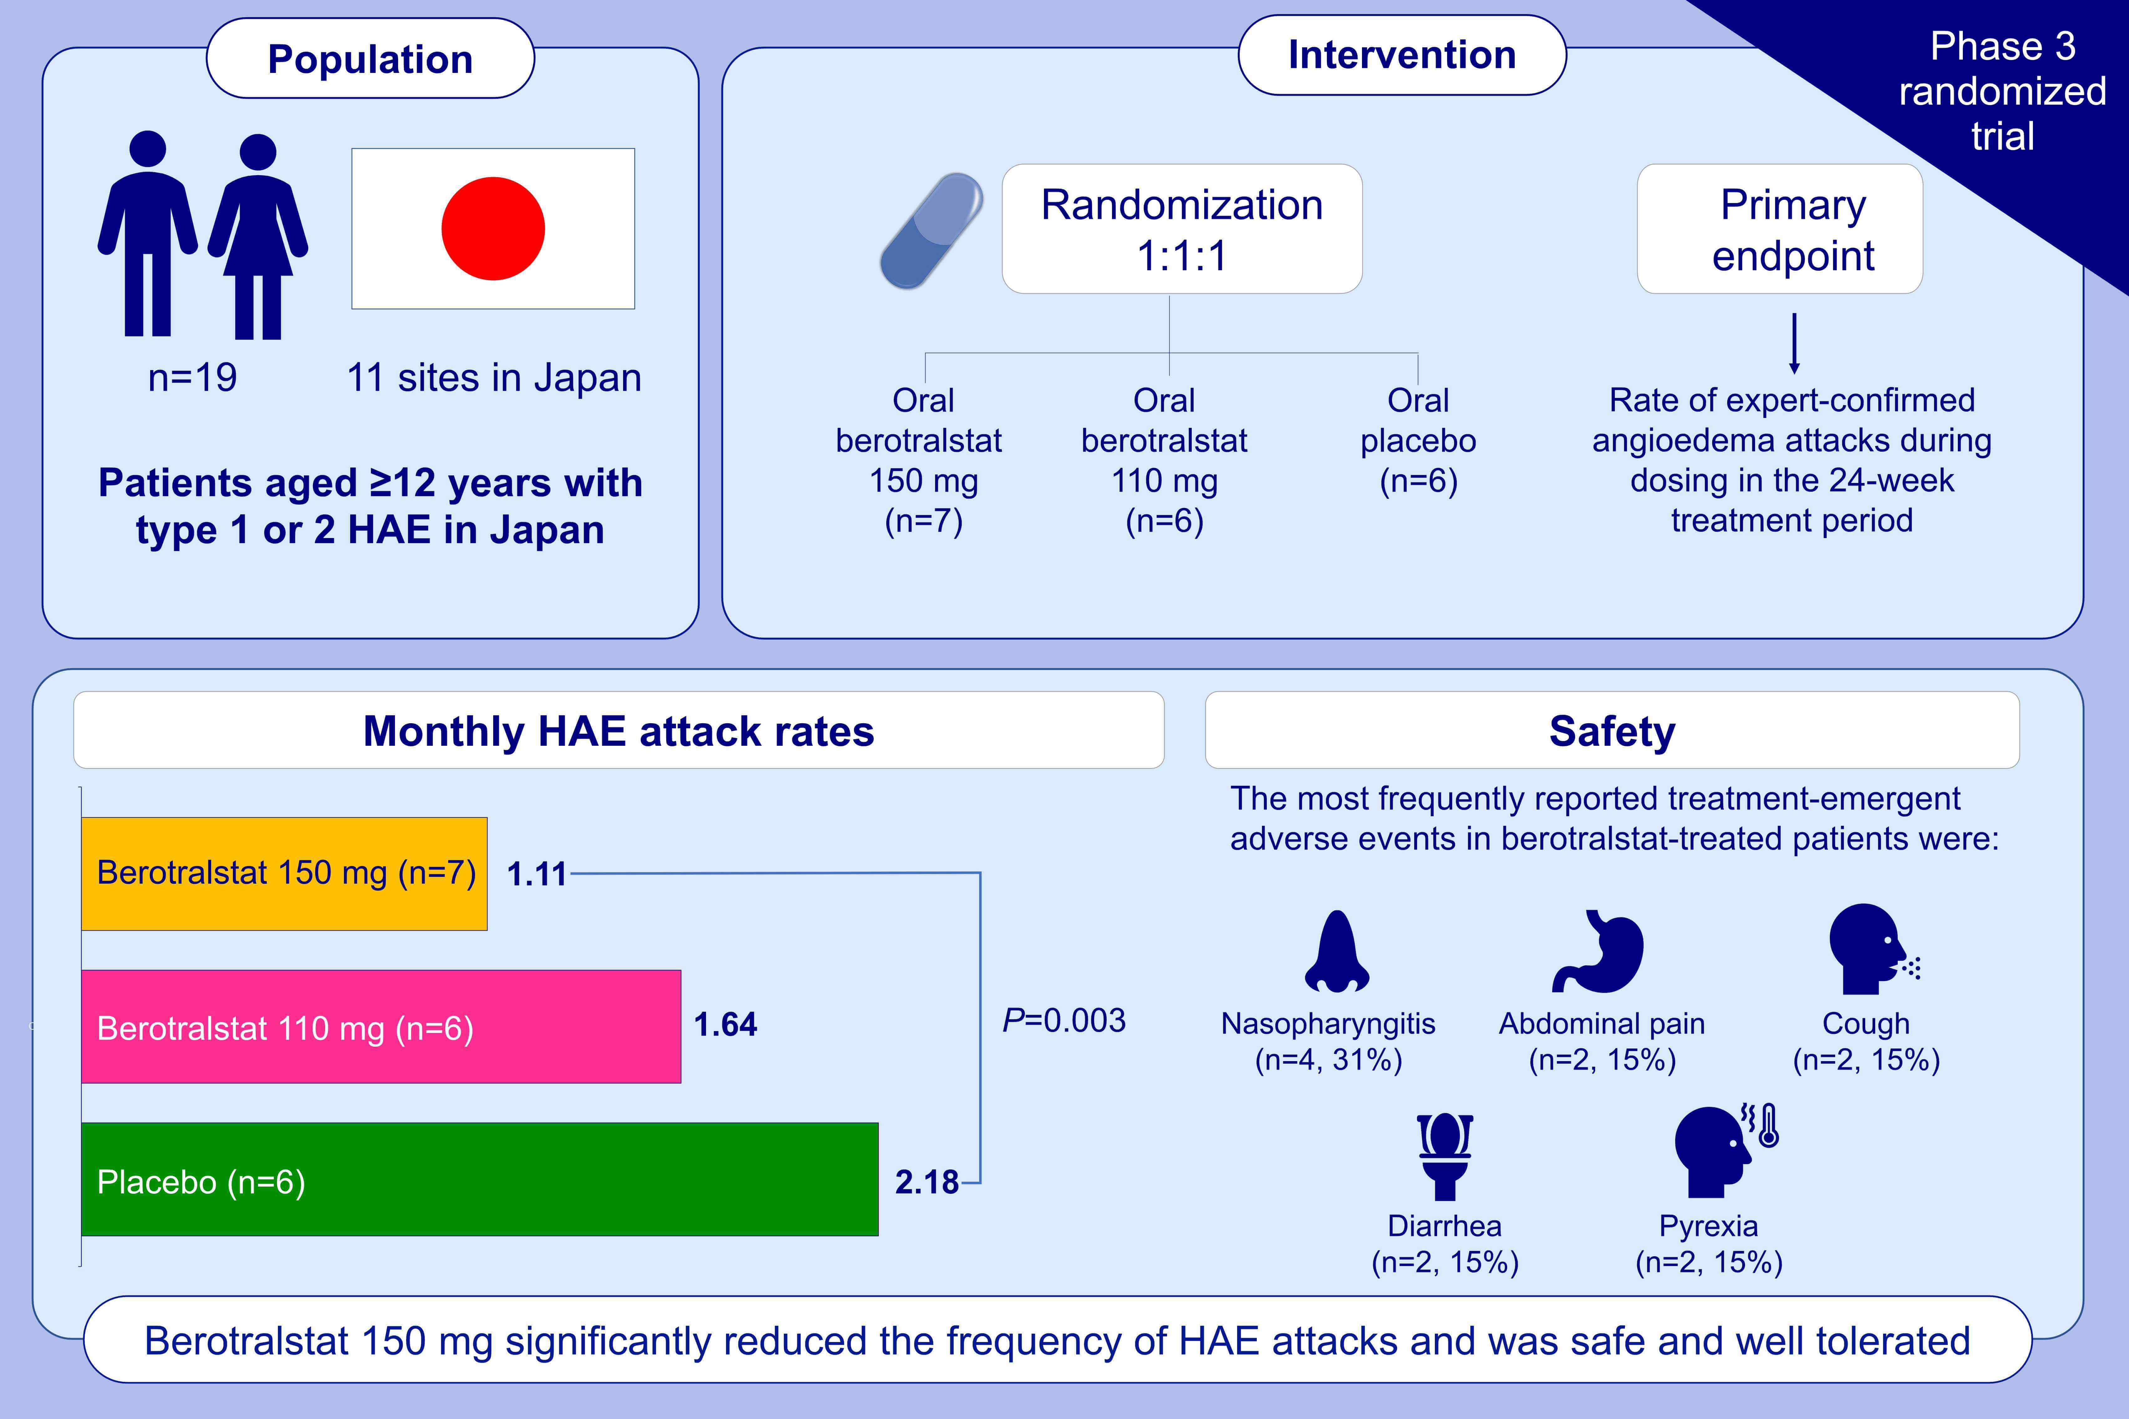
Oral berotralstat for the prophylaxis of hereditary angioedema attacks in patients in Japan: A phase 3 randomized trial
Isao Ohsawa,, Daisuke Honda,, Yusuke Suzuki,, Tomoo Fukuda,, Keisuke Kohga,, et al.
Allergy. 2021; 1789-1799 https://doi.org/10.1111/all.14670
© 2019 EAACI and John Wiley and Sons A/S. Published by John Wiley and Sons Ltd.
Notes:
HIGHLIGHTS
APeX-J is a phase 3, placebo-controlled trial conducted in Japan to assess the efficacy and safety of oral berotralstat in patients with HAE.
Patients were randomized 1:1:1 to receive once-daily berotralstat 110 mg, berotralstat 150 mg, or placebo.
Berotralstat 150 mg significantly reduced the frequency of HAE attacks compared with placebo, supporting its use as a prophylactic therapy.
Abbreviation: HAE, hereditary angioedema

