Slide 1
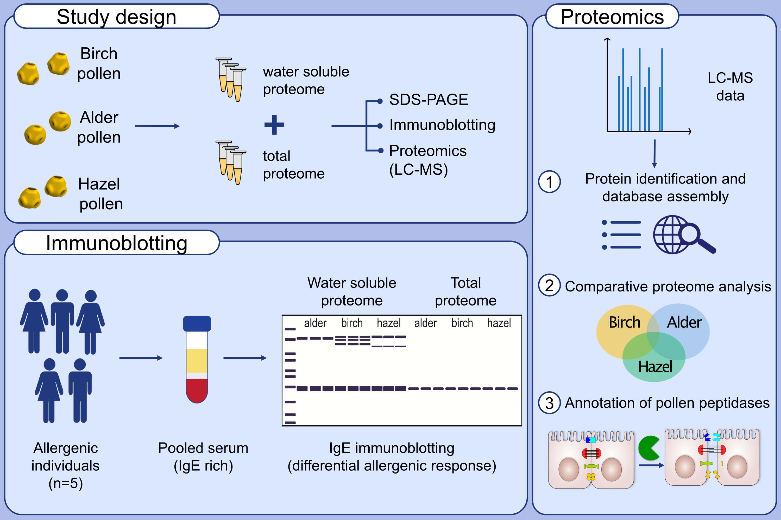
Comparative proteomics of common allergenic tree pollens of birch, alder, and hazel
Barbara Darnhofer,, Tamara Tomin,, Laura Liesinger,, Matthias Schittmayer,, Peter Valentin Tomazic,, et al.
Allergy. 2021; 1743-1753 https://doi.org/10.1111/all.14694
© 2019 EAACI and John Wiley and Sons A/S. Published by John Wiley and Sons Ltd.
Notes:
HIGHLIGHTS
This study aims to identify and annotate novel potentially allergenic proteins
in the three highly related pollen species: birch, hazel and alder.
Immunoblotting of pollen protein extracts with serum from allergenic patients corroborates differential allergenic potential despite of the high similarity of the three species.
Comprehensive proteomics analysis provides the first available protein database of pollens of alder and hazel, enables thorough annotation of proteases and allergens as well as comparative functional analysis of expressed proteins across the three pollens.
Abbreviations: LC-MS, liquid chromatography–mass spectrometry; SDS-PAGE, sodium dodecyl sulfate polyacrylamide gel electrophoresis

