Slide 1
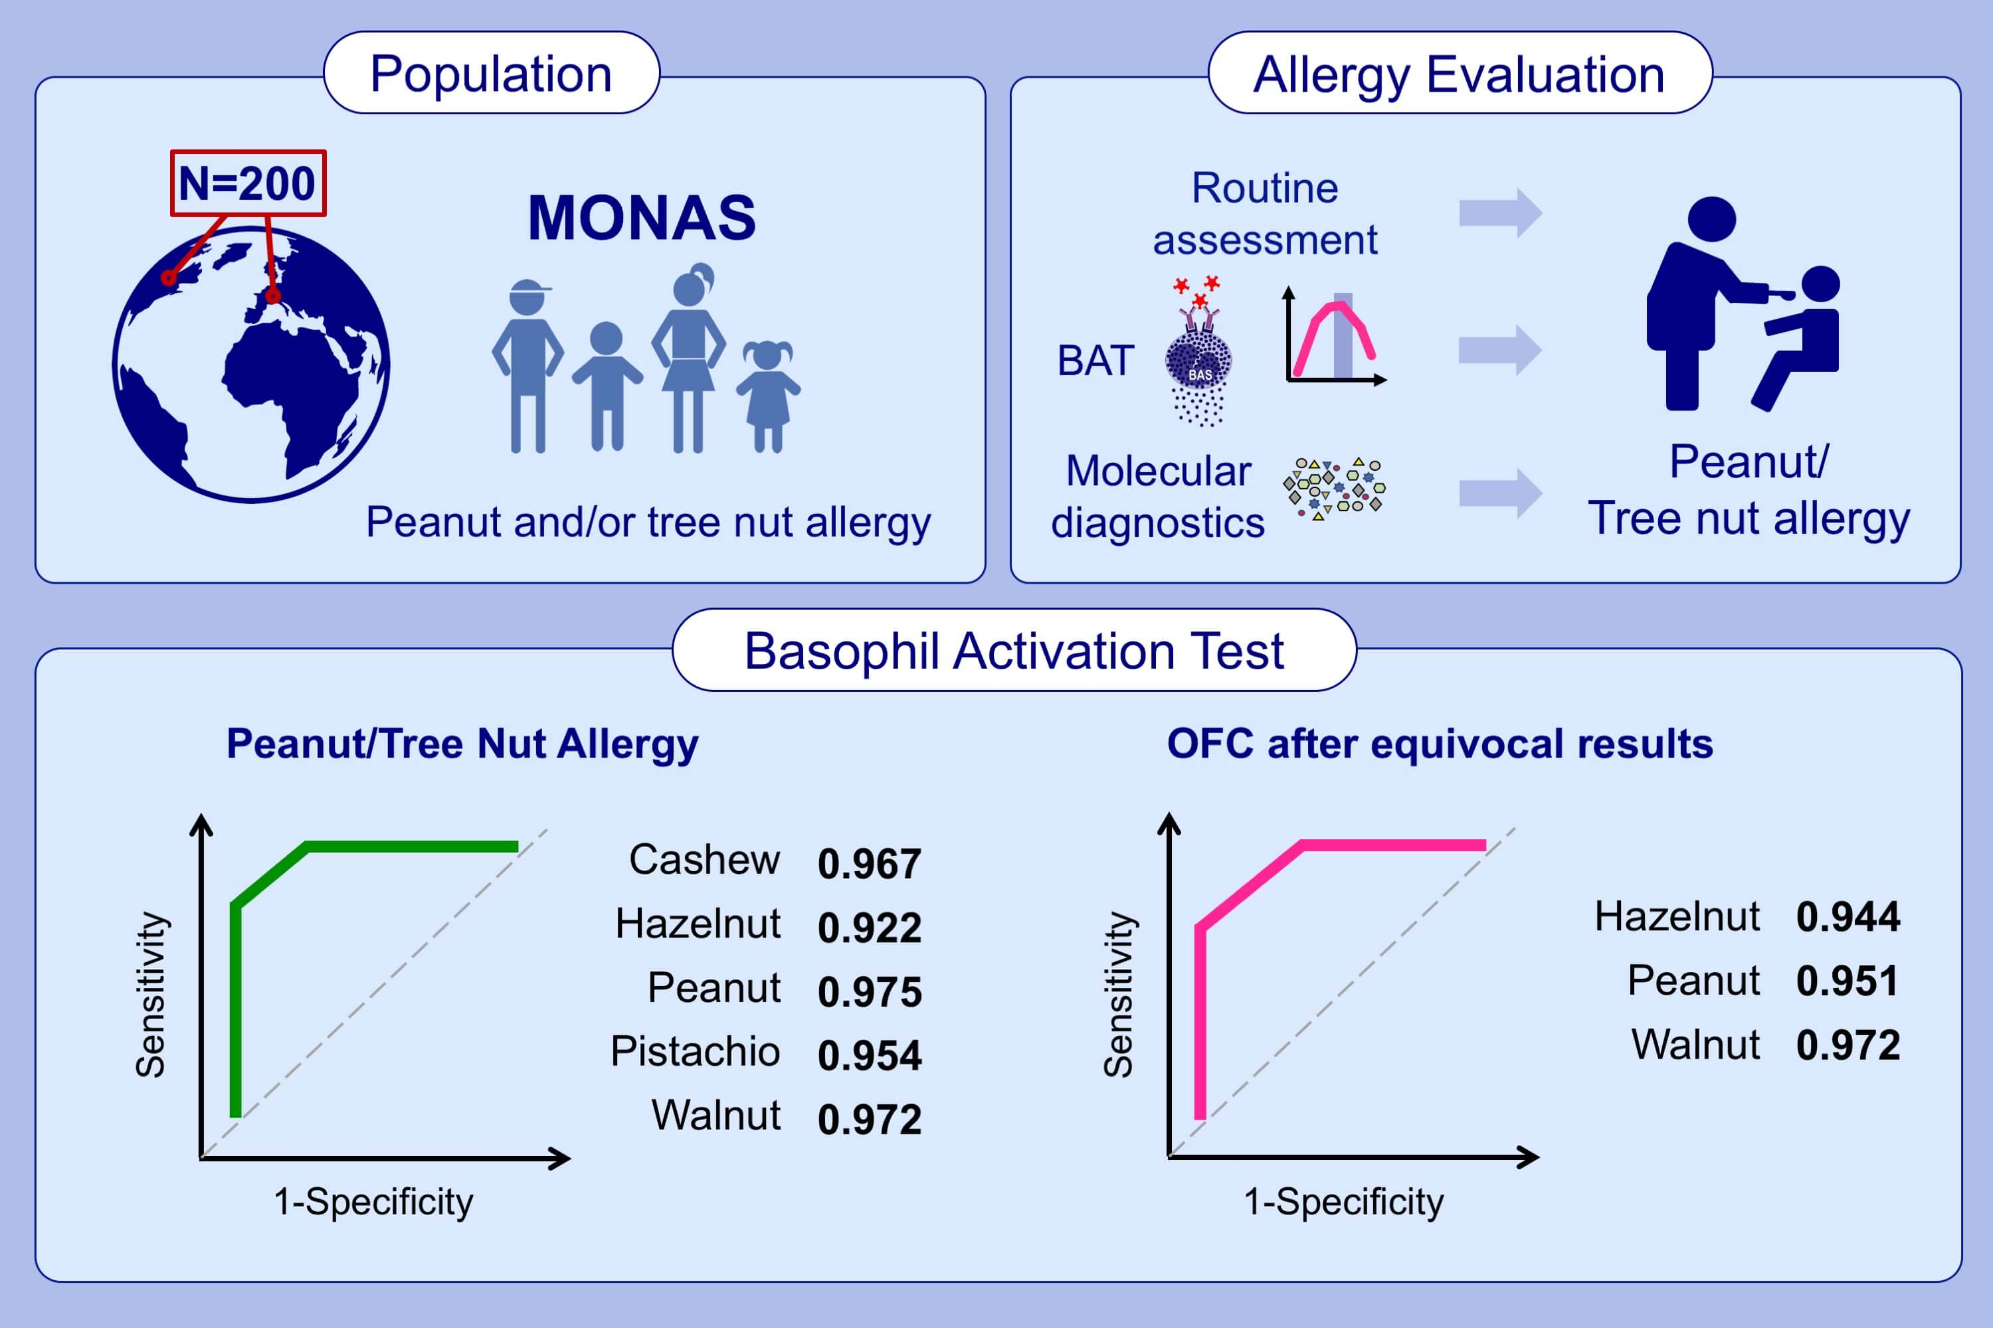
Basophil activation test shows high accuracy in the diagnosis of peanut and tree nut allergy: The Markers of Nut Allergy Study
Lucy Duan,, Alper Celik,, Jennifer A. Hoang,, Klara Schmidthaler,, Delvin So,, et al.
Allergy. 2021; 1800-1812 https://doi.org/10.1111/all.14695
© 2019 EAACI and John Wiley and Sons A/S. Published by John Wiley and Sons Ltd.
Notes:
HIGHLIGHTS
BAT can predict allergic clinical status to peanut and individual tree nuts in multi-nut sensitized children from Austria and Canada.
Mixed effect model integrating 10 and 100 ng/mL of peanut and individual tree nut stimulation is effective in diagnosing allergy.
BAT separates allergic from non-allergic status in patients who underwent clinically indicated OFCs to peanut and individual tree nuts.
Abbreviations: BAT, basophil activation test; OFC, oral food challenge; sIgE, specific IgE

