Slide 1
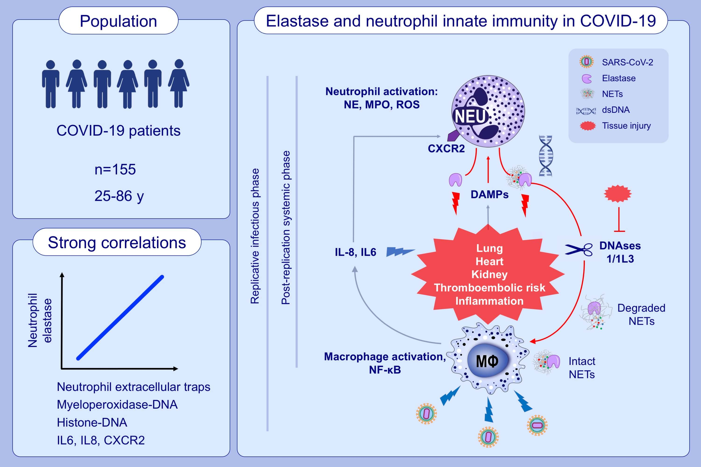
Elastase and exacerbation of neutrophil innate immunity are involved in multi-visceral manifestations of COVID-19
Jean-Louis Guéant,, Rosa-Maria Guéant-Rodriguez,, Julien Fromonot,, Abderrahim Oussalah,, Huguette Louis,, et al.
Allergy. 2021; 1846-1858 https://doi.org/10.1111/all.14746
© 2019 EAACI and John Wiley and Sons A/S. Published by John Wiley and Sons Ltd.
Notes:
HIGHLIGHTS
Blood levels of neutrophil elastase and histone-DNA are associated with severe and systemic and multi-organ manifestations of COVID-19.
Increased blood concentrations of neutrophil elastase and neutrophil extracellular traps are related to exacerbation of neutrophil stimulation through activated IL8/CXCR2 pathway.
Neutrophil elastase and DNase could be potential biomarkers and therapeutic targets of severe systemic manifestations of COVID-19.
Abbreviations: COVID-19, coronavirus disease 2019; CXCR2, C-X-C motif chemokine receptor 2; ds, double-stranded; NETs, neutrophil extracellular traps; NF, nuclear factor; SARS-CoV-2, severe acute respiratory syndrome coronavirus 2
.

