Slide 1
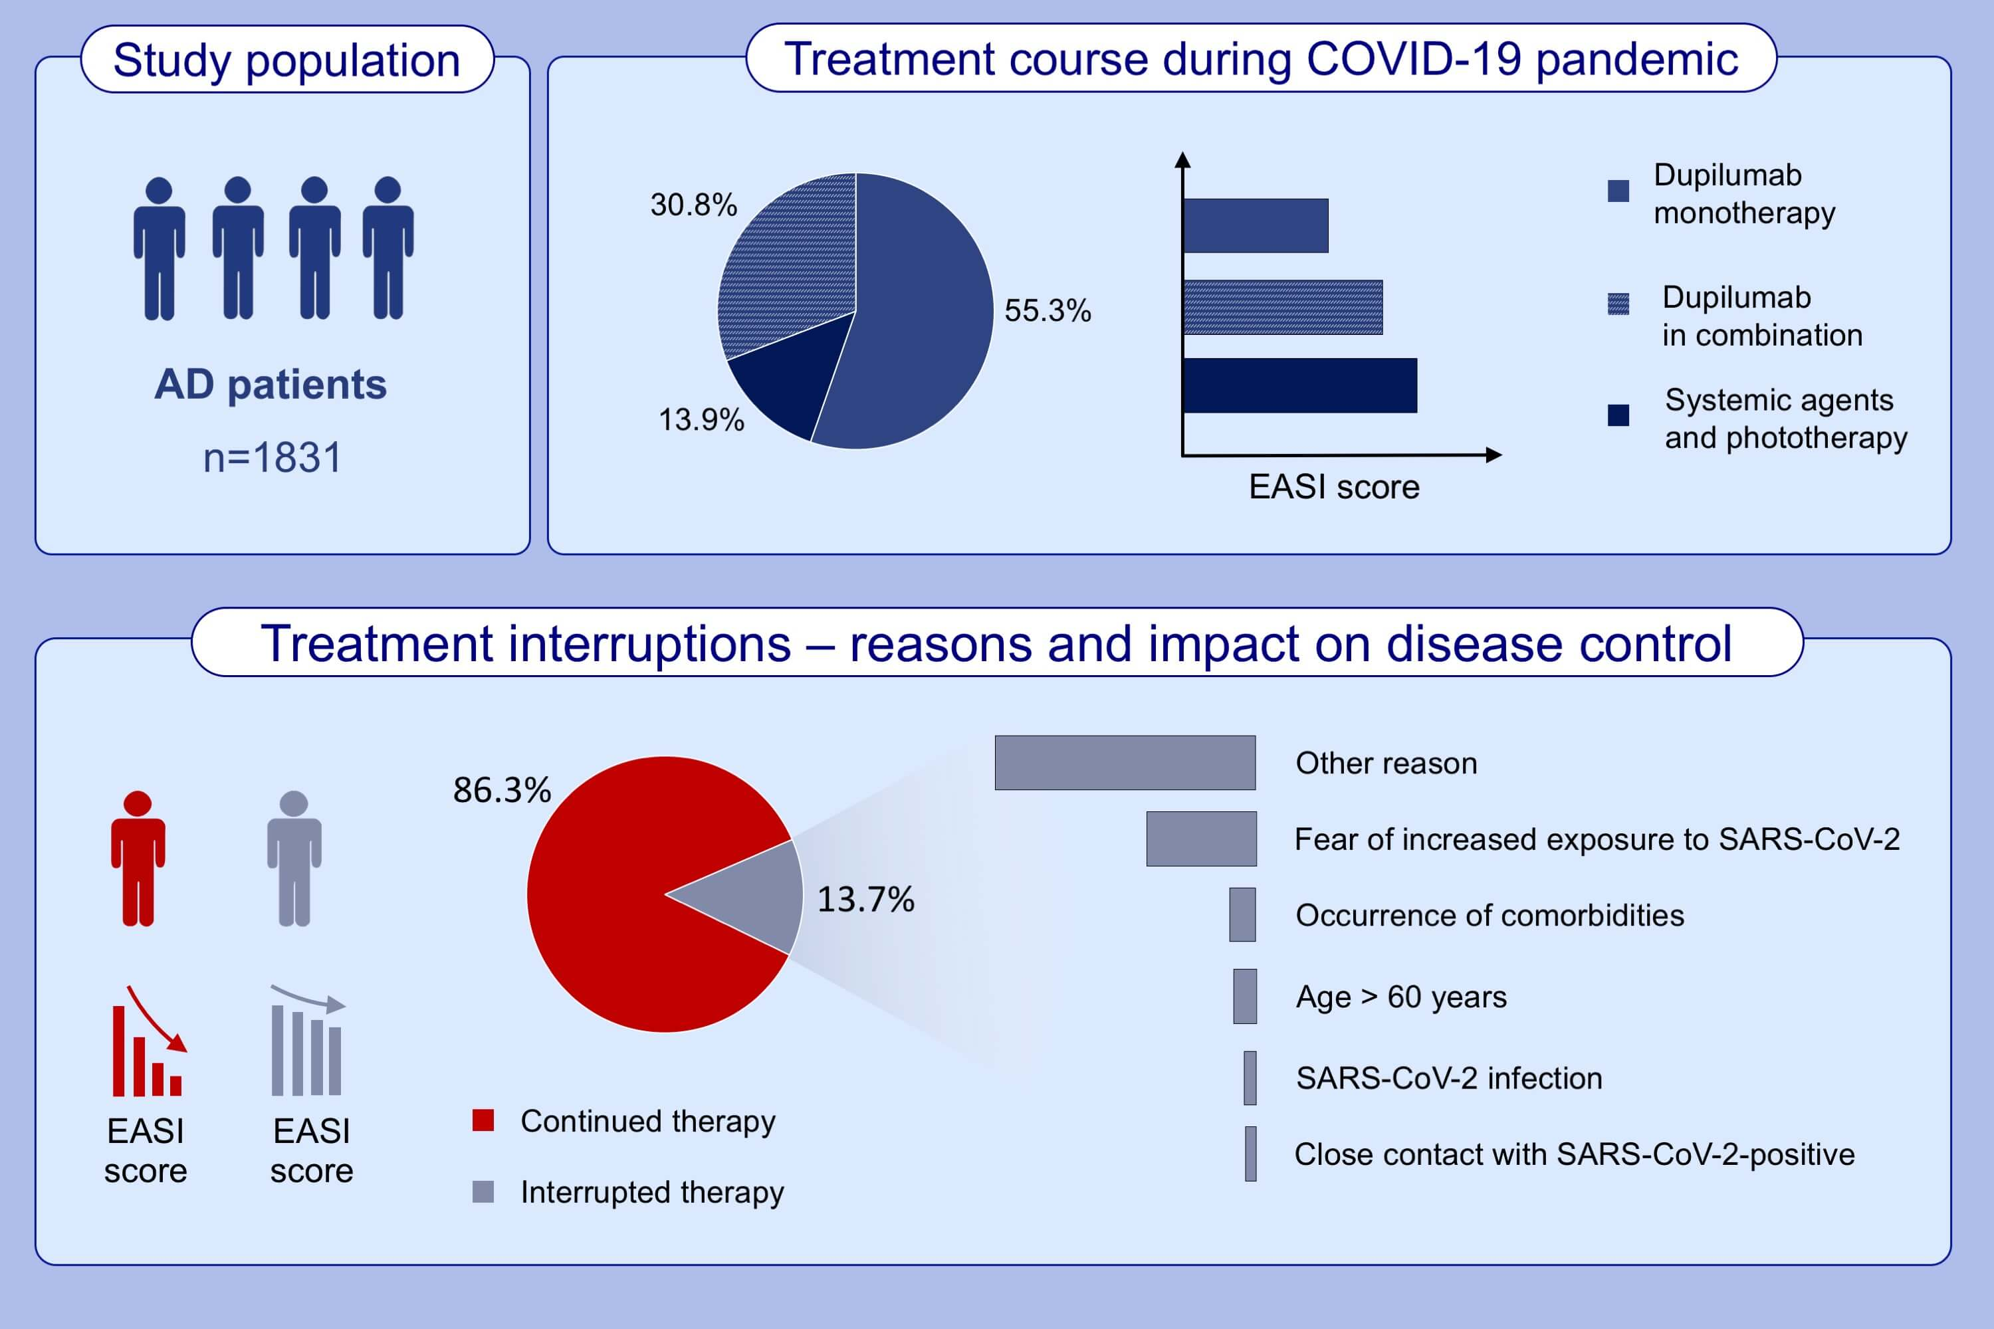
Management of patients with atopic dermatitis undergoing systemic therapy during COVID-19 pandemic in Italy: Data from the DA-COVID-19 registry
Andrea Chiricozzi,, Marina Talamonti,, Clara De Simone,, Marco Galluzzo,, Niccolò Gori,, et al.
Allergy. 2021; 1813-1824 https://doi.org/10.1111/all.14767
© 2019 EAACI and John Wiley and Sons A/S. Published by John Wiley and Sons Ltd.
Notes:
HIGHLIGHTS
Among 1831 studied AD patients, 86.1% were treated with dupilumab.
Patients continuing therapy experienced a marked reduction of disease severity during pandemic.
The causes of treatment interruption included: fear of increased susceptibility to SARS-CoV-2 infection (24.8%), occurrence of comorbidities (5.9%), age above 60 years (5.2%), SARS-CoV-2 infection (2.8%), close contact with SARS-CoV-2-positive subject (2.4%), other reasons, eg. inability to maintain drug supply, non-medical/unspecified causes (58.7%).
Abbreviations: AD, atopic dermatitis; COVID-19: coronavirus disease 2019; EASI, eczema area severity index; SARS-CoV-2, severe acute respiratory syndrome coronavirus type 2

