Slide 1
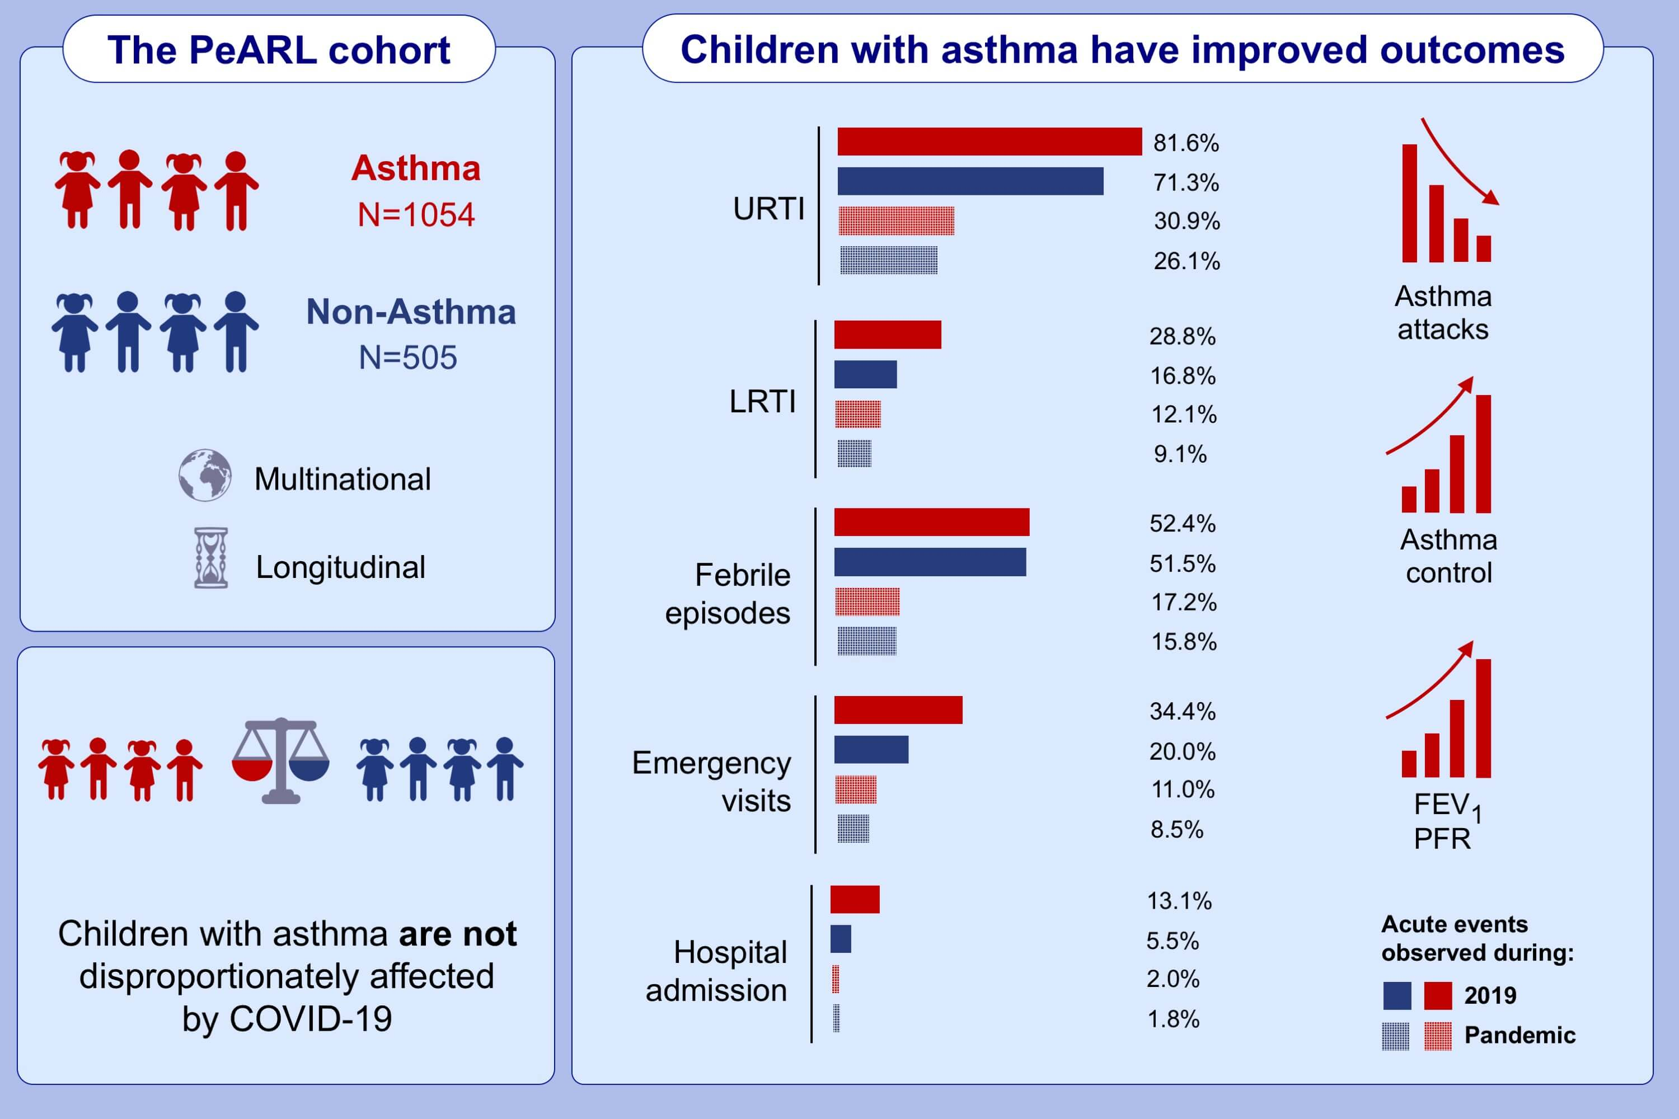
Childhood asthma outcomes during the COVID-19 pandemic: Findings from the PeARL multi-national cohort
Nikolaos G. Papadopoulos,, Alexander G. Mathioudakis,, Adnan Custovic,, Antoine Deschildre,, Wanda Phipatanakul,, et al.
Allergy. 2021; 1765-1775 https://doi.org/10.1111/all.14787
© 2019 EAACI and John Wiley and Sons A/S. Published by John Wiley and Sons Ltd.
Notes:
HIGHLIGHTS
This study evaluates the frequency of acute respiratory and febrile presentations furing the first wave of COVID-19 pandemic in childhood asthma.
Data from the multinational PeARL cohort reveal improved health and asthma activity during the first wave of the COVID-19 pandemic, probably attributed to decreased exposure to asthma triggers and increased treatment adherence.
During that period, children with asthma experienced fewer URTIs, episodes of pyrexia, emergency visits, hospital admissions, asthma attacks and hospitalizations due to asthma, in comparison to the preceding year.
Abbreviations: COVID-19, coronavirus disease 2019; LRTI, lower respiratory tract infections;
FEV₁, forced expiratory value in 1 second; PeARL, Pediatric Asthma in Real Life; PFR, peak respiratory flow rate; URTI, upper respiratory tract infections

