Slide 1
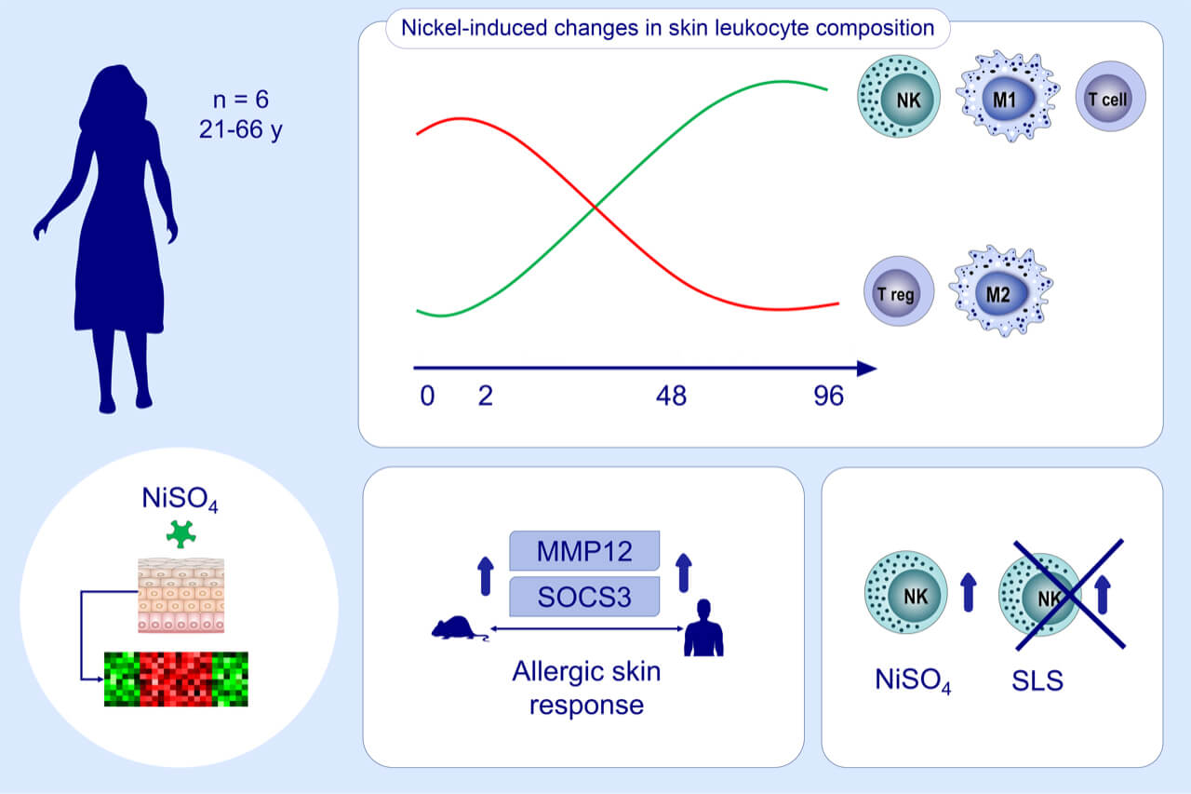
Integrative transcriptome analysis deciphers mechanisms of nickel contact dermatitis
Lukas Wisgrill, Paulina Werner, Erja Jalonen, Angelika Berger, Antti Lauerma, et al.
Allergy. 2021; 804-815 https://doi.org/10.1111/all.14519
© 2019 EAACI and John Wiley and Sons A/S. Published by John Wiley and Sons Ltd.
Notes:
HIGHLIGHTS
Late-phase nickel challenge induces major changes in leukocyte composition including influx and activation of NK cells, macrophage polarization, and T cell immunity.
MMP12 and SOCS3 are highly upregulated, linking our human findings to previous findings in mice.
NK cell infiltration and cytotoxic pathways were found to be uniquely upregulated in nickel-induced allergic skin responses compared to SLS-induced irritant skin responses.
Abbreviations: MMP12, matrix metallopeptidase 12; NiSO₄, nickel sulfate; SLS, sodium lauryl sulphate; SOCS3, suppressor of cytokine signaling 3.

