Slide 1
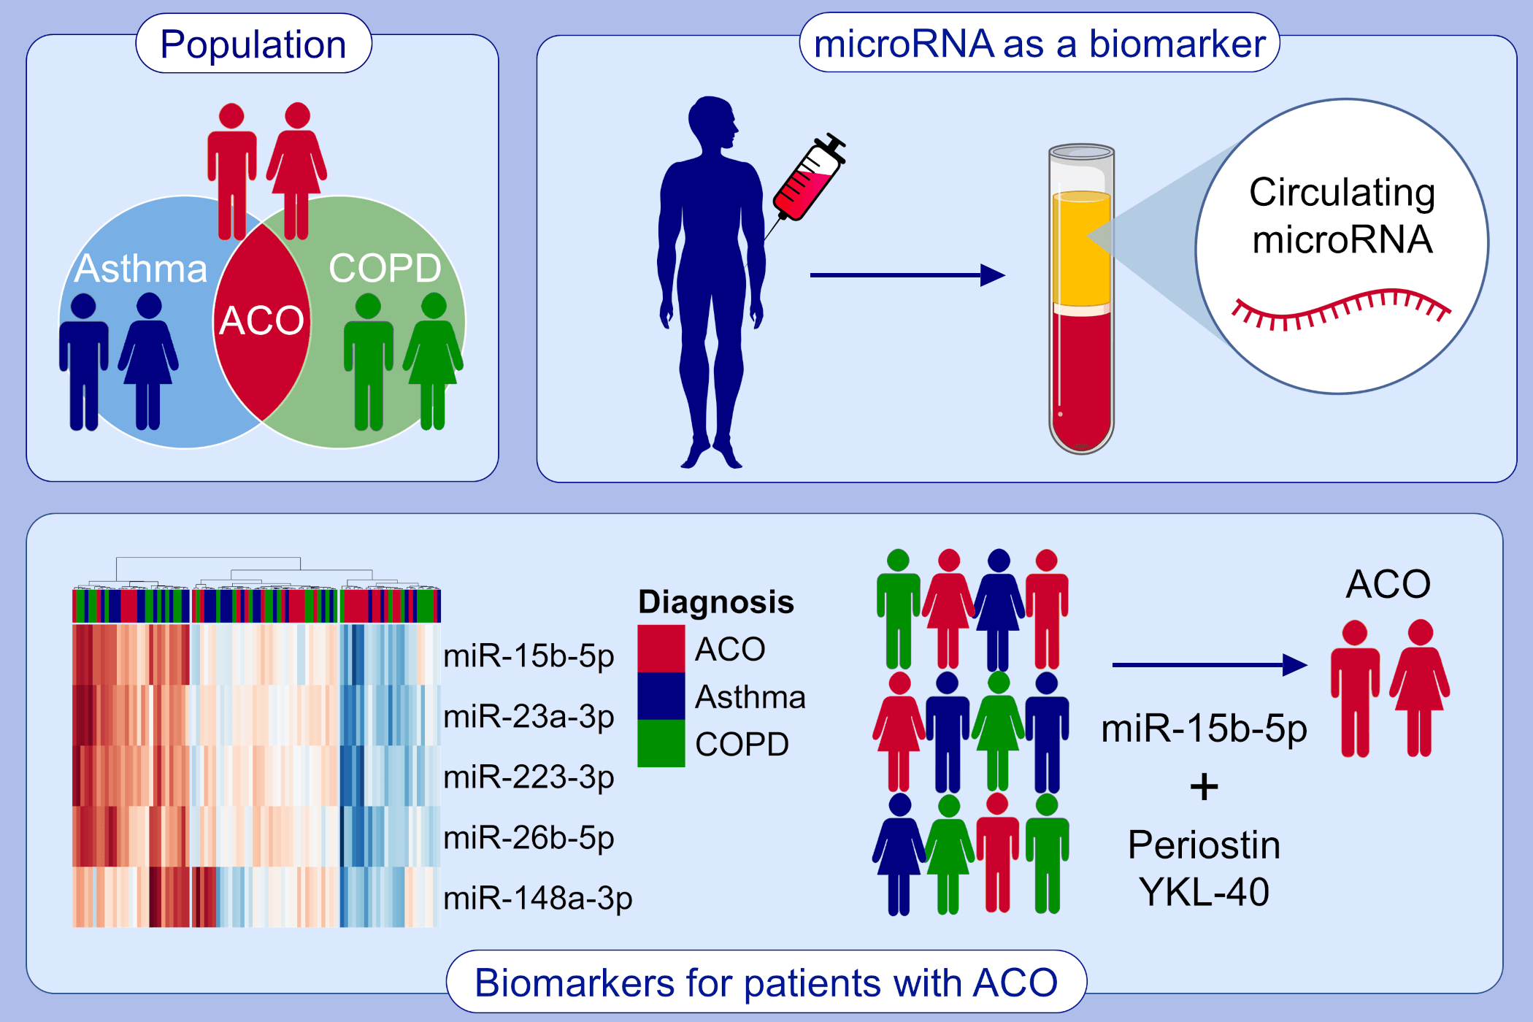
Circulating microRNA‐15b‐5p as a biomarker for asthma‐COPD overlap
Keita Hirai, Toshihiro Shirai, Takayuki Shimoshikiryo, Megumi Ueda, Yasuhiro Gon, et al.
Allergy. 2021; 766-774 https://doi.org/10.1111/all.14520
© 2019 EAACI and John Wiley and Sons A/S. Published by John Wiley and Sons Ltd.
Notes:
HIGHLIGHTS
Patients with ACO could be identified from patients with asthma and COPD by the expression profiles of five microRNAs in plasma, especially miR-15b-5p.
The combined assessment of miR-15b-5p, periostin, and YKL-40 is valuable for characterizing ACO.
MiR-15b-5p can serve as a potential biomarker for identifying patients with asthma-COPD overlap, while also furthering our understanding of the pathophysiology of ACO.
Abbreviations: ACO, asthma-COPD overlap; COPD, chronic obstructive pulmonary disease; YKL-40, chitinase-3-like protein 1

