Slide 1
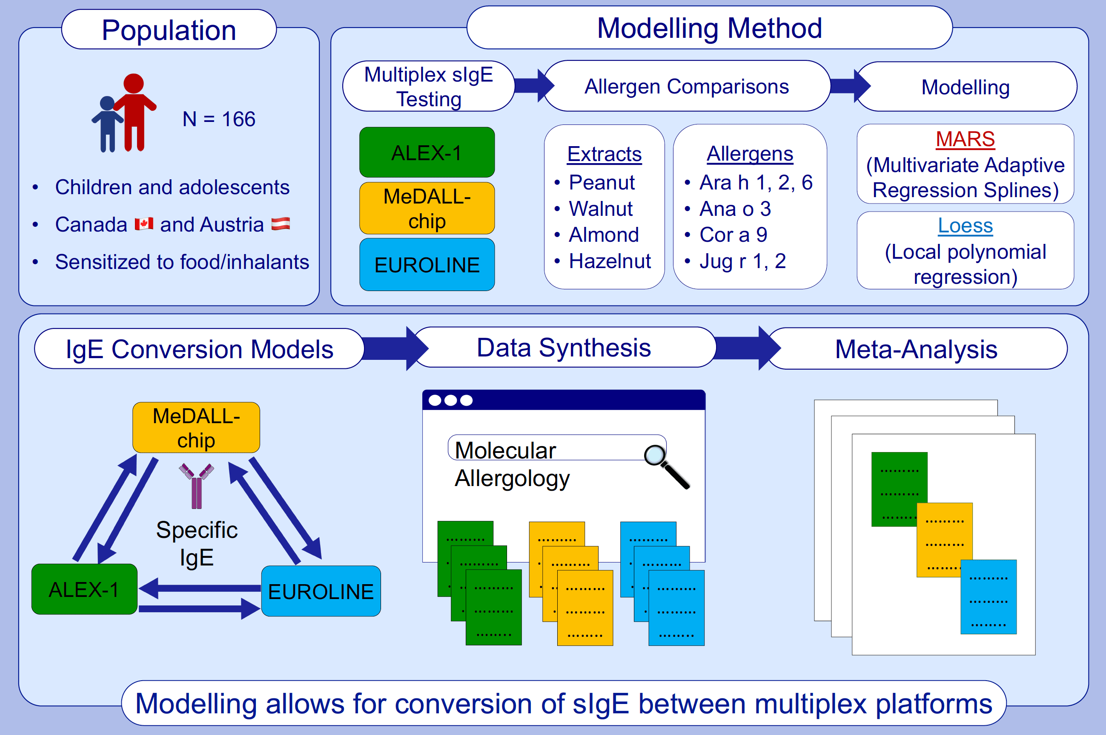
Modeling the conversion between specific IgE test platforms for nut allergens in children and adolescents
Jennifer A. Hoang, Alper Celik, Christian Lupinek, Rudolf Valenta, Lucy Duan, et al.
Allergy. 2021; 831-841 https://doi.org/10.1111/all.14529
© 2019 EAACI and John Wiley and Sons A/S. Published by John Wiley and Sons Ltd.
Notes:
HIGHLIGHTS
This is the first study to present conversion models for specific IgE measurements between 3 multiplex platforms: ALEX-1, MeDALL-chip, and EUROLINE.
Peanut and tree nut specific IgE data from the different platforms were modelled with high measures of fit (63-94%) for major nut allergens.
These conversion models are intended to facilitate harmonization of sIgE data for meta-analyses upon further validation.
Abbreviations: ALEX-1, Allergy Explorer version 1; MeDALL-chip, mechanisms of Development of Allergy-chip

