Slide 1
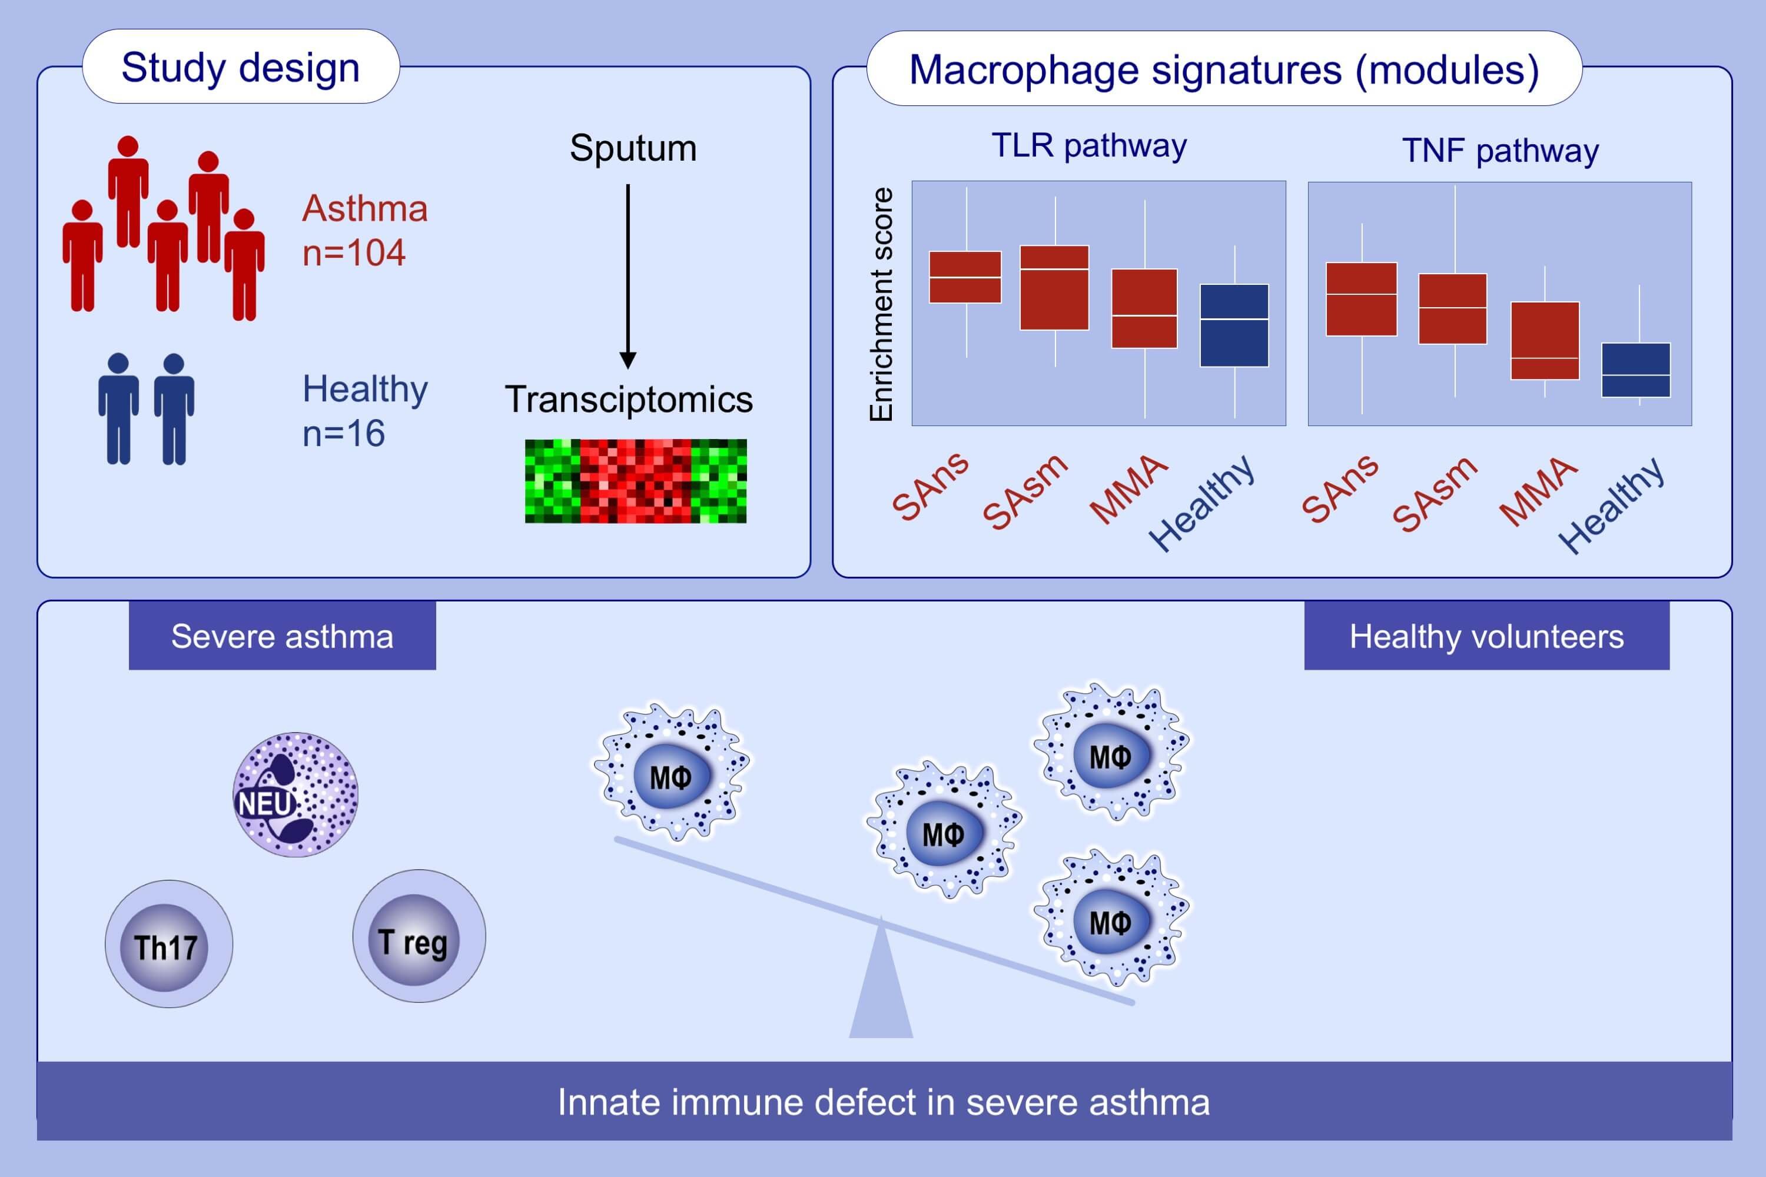
Sputum macrophage diversity and activation in asthma: Role of severity and inflammatory phenotype
Angelica Tiotiu, Nazanin Zounemat Kermani, Yusef Badi, Stelios Pavlidis, Philip M. Hansbro, et al.
Allergy. 2021; 775-788 https://doi.org/10.1111/all.14535
© 2019 EAACI and John Wiley and Sons A/S. Published by John Wiley and Sons Ltd.
Notes:
HIGHLIGHTS
This study investigates gene signature of macrophage phenotypes in sputum of asthmatic and healthy controls.
Several specific macrophage subsets identified by gene signatures are highly activated in severe granulocytic asthma and involved distinct inflammatory pathways (e.g. TNF- and TLR-signaling pathways).
Macrophage activation and numbers are reduced in severe granulocytic asthma highlighting defective innate immunity.
Abbreviations: MMA, mild/moderate asthmatics; SAns, severe asthmatics non-smokers; SAsm, severe asthmatics smokers; TLR, Toll-like receptor; TNF, tumor necrosis factor

