Slide 1
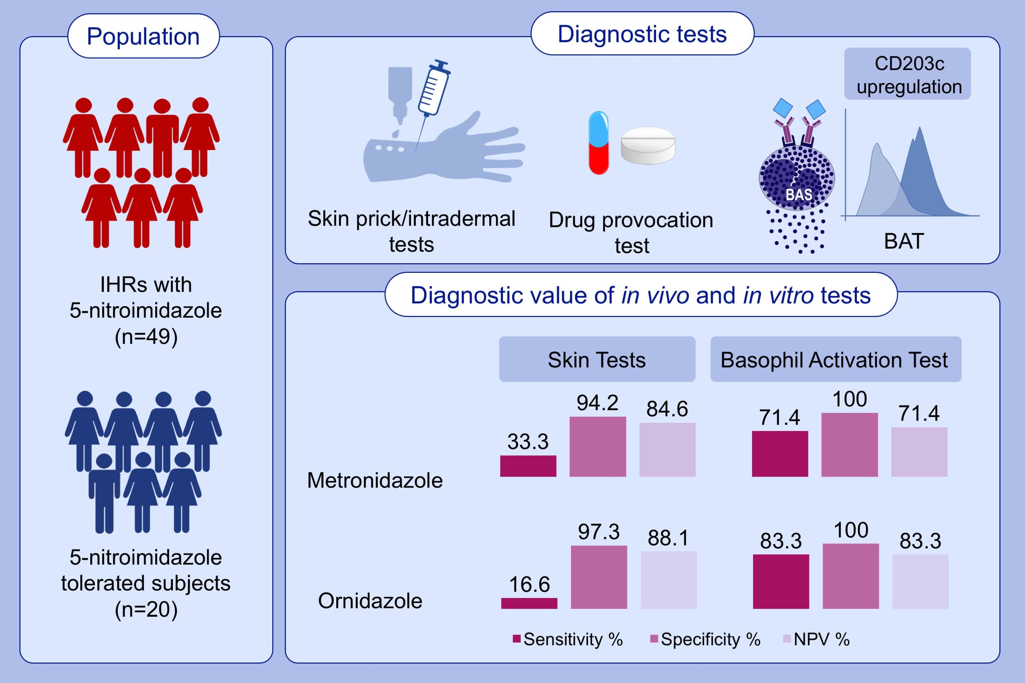
Diagnostic workup including CD203c‐based basophil activation test in immediate hypersensitivity due to metronidazole and ornidazole and evaluation of cross‐reactivity in between
Şengül Beyaz, Nilgün Akdeniz, Abdullah Yılmaz, Semra Demir, Nida Öztop, et al.
Allergy. 2021; 842-852 https://doi.org/10.1111/all.14542
© 2019 EAACI and John Wiley and Sons A/S. Published by John Wiley and Sons Ltd.
Notes:
HIGHLIGHTS
49 patients with IHRs due to 5-nitroimidazole antibiotics (metronidazole and ornidazole) and 20 control subjects are evaluated.
Overall 14.5% and 80% reveal positive ST results and BAT results, respectively.
Sensitivity, specificity and NPV of STs for metronidazole/ornidazole are 33.3%/16.6%, 94.2%/97.3%, and 84.6%/88.1%, respectively. Sensitivity, specificity and NPV of BAT for metronidazole/ornidazole are 71.4%/83.3%, 100%/100% and 71.4%/83.3%, respectively.
Abbreviations: BAT, basophil activation test; IHR, immediate hypersensitivity reaction; NPV, negative predictive value; ST, skin test

