Slide 1
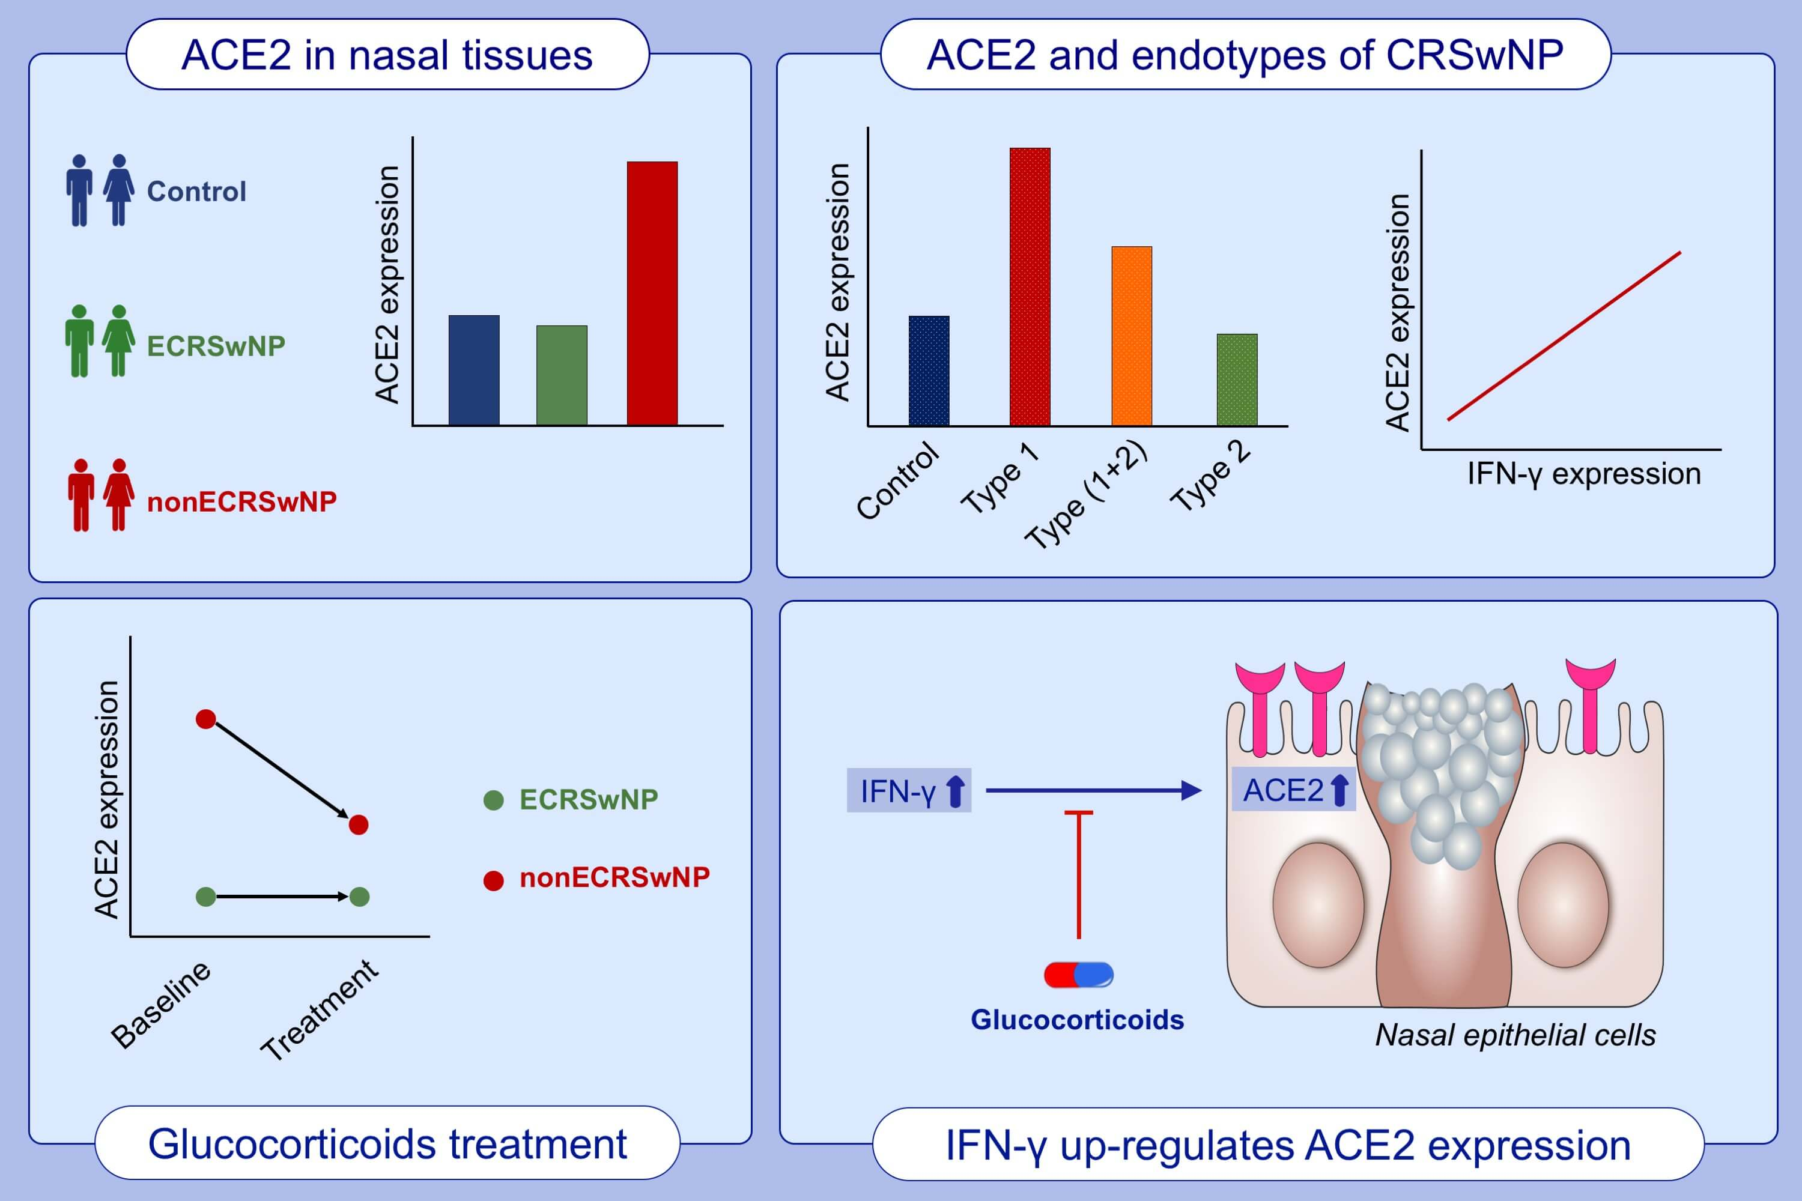
Distinct expression of SARS‐CoV‐2 receptor ACE2 correlates with endotypes of chronic rhinosinusitis with nasal polyps
Ming Wang, Xiangting Bu, Gaoli Fang, Ge Luan, Yanran Huang, et al.
Allergy. 2021; 789-803 https://doi.org/10.1111/all.14665
© 2019 EAACI and John Wiley and Sons A/S. Published by John Wiley and Sons Ltd.
Notes:
HIGHLIGHTS
The expression of SARS-CoV-2 receptor ACE2 is significantly increased in nasal tissues
of nonECRSwNP patients compared to ECRSwNP patients and control subjects.
ACE2 expression is increased in nasal tissues of type 1 endotype of CRSwNP and positively correlated with the expression of IFN-γ.
IFN-γ up-regulates ACE2 expression while glucocorticoids attenuate this increase in cultured nasal epithelial cells.
Abbreviations: ACE2, angiotensin-converting enzyme 2; ECRSwNP, eosinophilic chronic rhinosinusitis with nasal polyps; nonECRSwNP, noneosinophilic chronic rhinosinusitis with nasal polyps; SARS-CoV-2, severe acute respiratory syndrome coronavirus 2

