Slide 1
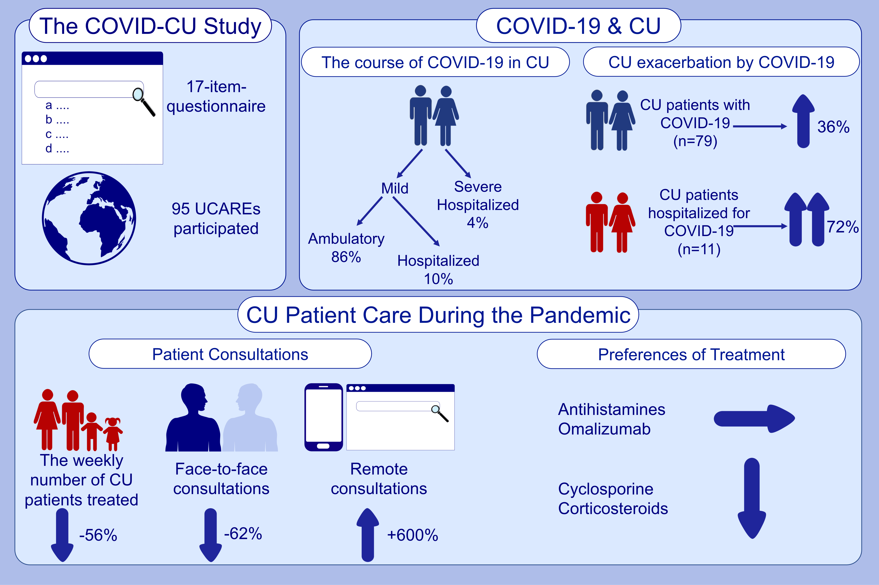
The global impact of the COVID‐19 pandemic on the management and course of chronic urticaria
Emek Kocatürk, Andaç Salman, Ivan Cherrez‐Ojeda, Paulo Ricardo Criado, Jonny Peter, et al.
Allergy. 2021; 816-830 https://doi.org/10.1111/all.14687
© 2019 EAACI and John Wiley and Sons A/S. Published by John Wiley and Sons Ltd.
Notes:
HIGHLIGHTS
The COVID-19 pandemic severely impairs CU patient care, weekly number of patients decreased by more than 50% and the rate of face-to-face consultations decreased by 62%.
CU does not affect the course of COVID-19 with only 4% of CU patients having a severe course of COVID-19, but COVID-19 results in CU exacerbation in one of three patients, with higher rates in patients with severe COVID-19.
Cyclosporine and systemic corticosteroids, but not antihistamines or omalizumab, are used less during the pandemic.
Abbreviations: CU, chronic urticaria; COVID-19, coronavirus disease 2019; UCARE: urticaria centers of reference and excellence
.

